Slide 1
^{#BGSOrientation #PENNBGS4U}
Today’s program:
Cores & Computing – Yale Cohen & Li-San Wong, ~30min
Responsible Conduct of Research — Steve, ~30 min
Community for Rigor — Carolina and Zac, ~5-10 min
Ready, Set, Experiment – Kurt Engleka, ~30min
With case study discussions to follow…

Slide 2
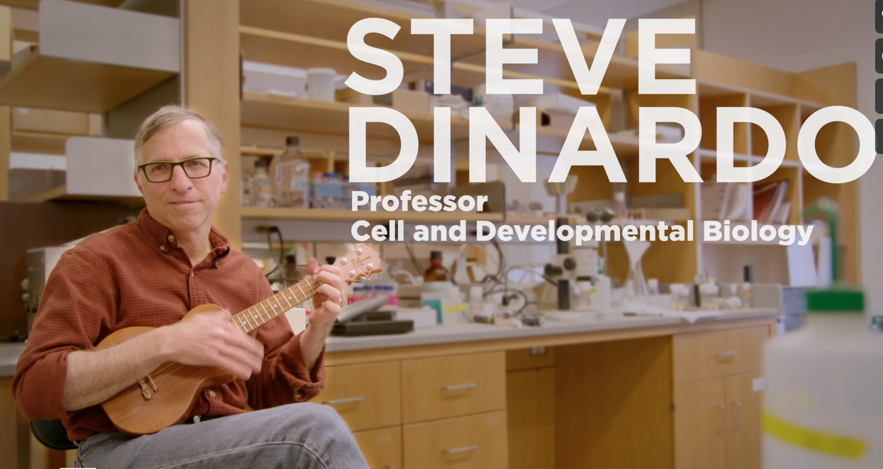
responsible conduct of research (RCR)
Biomedical Graduate Studies
Steve DiNardo
Director, Training Support and Career Development, BGS
Notes:
I will frame today’s topic around YOUR goals.

Slide 3
What are YOUR GOALs this YEAR?
pause
In a nutshell → DO ‘GOOD’ SCIENCE.
Your future self → HELP OTHERS IDENTIFY AND DO ‘GOOD’ SCIENCE
All of that while CREATING YOUR ‘PROFESSIONAL SELF’
Notes:
What are your goals? Give me some words…
Do Good science
Recognize good science
Help Others – Kelly talked about this a lot from the POV of you getting from others –remember that you guide others, too
You are creating your professional self.

Slide 4
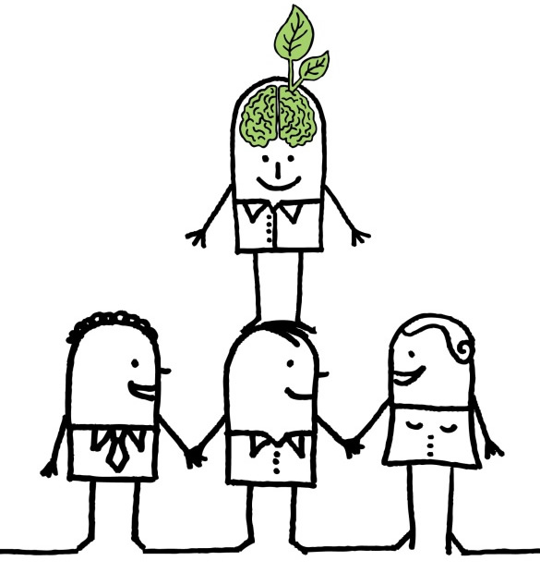
Science is a unique Enterprise
Science research requires that we stand on the shoulders of those who came before.
But, how do you pick the right shoulders?
NEED TO IDENTIFY ‘GOOD’ SCIENCE.
That is science that was carried out:
Responsibly
Reproducibly
& with Rigor.
RCR training provides you with tools to recognize those qualities.
https://blog.yorksj.ac.uk/moodle/files/2014/05/LAWW.jpg
Notes:
Requires that the science that came before is done Responsibly
Reproducibly
& with Rigor.

Slide 5
The beauty: it’s a cycle!
By executing ‘GOOD’ science …
And creating your ‘professional’ self …
You become the shoulders to stand on!
You are here
You need to carry out research done:
Responsibly
Reproducibly
& with Rigor!
Notes:
Requires that the science that came before is done Responsibly
Reproducibly
& with Rigor.

Slide 6
Hold it: Let’s Define
‘Professional self’
You are here
Each of you are individuals:
Celebrate that identity
Bring your perspective & life’s experiences
Do not aspire to arbitrary criteria set by anyone
Many scientists will know you ONLY from the quality of your published work – that is the ‘professional self’ I’m talking about.
Notes:
Requires that the science that came before is done Responsibly
Reproducibly
& with Rigor.

Slide 7
Some Essential QUALITIES
(that i strive for):
HONESTY — conveying information truthfully and honoring commitments
ACCURACY— reporting findings precisely and taking care to avoid errors
EFFICIENCY— using resources wisely and avoiding waste, and
OBJECTIVITY— letting the facts speak for themselves and avoiding improper bias.

Slide 8
responsibly conduct research (RCR)
THOSE
QUALITIES are needed to:
Notes:
Those qualities allow you to conduct research responsibly.
Responsible to whom?
Yourself
Peers / Colleagues
Profession
Society

Slide 9

areas that require
‘Responsible Conduct’
Acquisition and Management of Data
Collaborative Science
Conflicts of Interest and Time
Mentoring
Peer Review
Research Misconduct
Responsible Authorship and Publication
Scientists as Responsible Members
of Society
Use of Animals in Research
Use of Humans in Research
ETHICAL QUESTIONS
CAN WILL ARISE
IN THESE
SUBJECT AREAS

Slide 10
Training in RCR
Training in RCR is continual.
Why?
See concepts several times; In different contexts
= they are “sticky”!
  On-line instruction in Years 1–4
  Workshops based on ‘Case Studies’ in Years 2–4
  RCR-focused lab meetings in Years 3–5
Notes:
So, with regard to the nuts and bolts of training, know first that NIH requires training of us and other biomedical institutions in RCR.
We meet the requirements through …
This is another of Kelly’ s examples of, “You will see this several times, in several contexts.
It must be important.
Oh, I see now why (else) its important (because you are ready for it in another context)

Slide 11
Case Studies
You will read ‘Case Studies’
These are a source for discussion
Small groups, to promote comfortable discussion
Each group has a ‘facilitator’
  One who guides, not lectures
  (for some topics) there will be no perfect answer
Notes:
We use case studies *a lot*.

Slide 12

Apply those Essential QUALITIES in considering case studies
HONESTY — conveying information truthfully and honoring commitments
ACCURACY— reporting findings precisely and taking care to avoid errors
EFFICIENCY— using resources wisely and avoiding waste, and
OBJECTIVITY— letting the facts speak for themselves and avoiding improper bias.

Slide 13
Example Case Study
Mike is a 4th-year student. His work is progressing well, however some data aren’t falling into place.
Specifically a few control experiments he knows should work are not working.
He doesn’t want to bother his thesis advisor or thesis committee with what he thinks is a minor detail, so he has not asked for advice or help.
(continued)
Notes:
Let’s start with a case study.
This one deals with Mike, a graduate student. We have others that deal with staff, postdocs, faculty.
A control is a validation that your basic experimental assumptions are correct.
How are we feeling about Mike at this point, with regard to the core elements we outlined?
What should we do if we were to counsel him?
(Kelly): seek the advice of others.

Slide 14
Case Study, Continued
Perhaps because he expects them to work soon, or because he does not want to ruin what’s really a pretty nice story, Mike, when asked about the controls at a lab meeting says, “…no worries, I’ve done them; they were as expected”.
How do you rate Mike?
(Honesty, Accuracy, Efficiency, Objectivity)
(continued)
pause
Notes:
How are we feeling now?? So let’s think about that.

Slide 15
Case Study, Continued
The advisor is happy that everything is in place, and asks that the experiments be included in a poster Mike is preparing for a meeting.
Mike does so, without the – nonexistent – controls.
At the meeting, Mike intentionally steers discussion at the poster away from any consideration of controls.
And, now? Honesty, Accuracy, Efficiency, Objectivity
(continued)
pause

Slide 16
Case Study, Continued
When Mike returns to lab, he finds that the advisor has incorporated his data into a manuscript just submitted to a journal, with the controls mentioned in the text.
We’ve focused on Mike;
What about his PI? What is/was their role?
pause
Notes:
-Mike fesses up at this point, the advisor contacts the editorial staff to retract the article from review.
We’ve focused on the student, BUT .. .
Does the advisor come out of this case study unscathed?
Breakdown. Obviously with serious consequences.

Slide 17
Which area(s) does this case study highlight?
Acquisition and Management of Data
Collaborative Science
Conflicts of Interest and Time
Mentoring
Peer Review
Research Misconduct
Responsible Authorship and Publication
Scientists as Responsible Members
of Society
Use of Animals in Research
Use of Humans in Research
Notes:
research misconduct
In presenting it, but also in skewing conversations that occurred.

Slide 18
Research Misconduct
A definition:
Fabrication, falsification, plagiarism, or other serious deviation from accepted practices in…”
  Proposing
  Performing
  Reviewing
  Reporting
  …research or research results.
Notes:
It’s all about misrepresentation in any setting

Slide 19
The goal of your RCR training:
Acquisition and Management of Data
Collaborative Science
Conflicts of Interest and Time
Mentoring
Peer Review
Research Misconduct
Responsible Authorship and Publication
Scientists as Responsible Members
of Society
Use of Animals in Research
Use of Humans in Research
Provide you with
tools to
anticipate matters
arising in these areas
Notes:
Research misconduct aside, there’s not a week that goes by that I don’t think about each of these in some fashion or another.

Slide 20
RCR will be continual during your time here
  On-line instruction in Years 1–4
  Workshops based on Case studies in Years 2–4
    Year 2: Research misconduct, Data management; Promoting Safe Workplace Culture
    Year 3: Collaborative Science, Mentorship, Animal and Human Subjects
    Year 4: Conflict of interest, Responsible authorship/
    publication, Peer review
  RCR-focused lab meetings in Years 3–5
BGS provides a Resource for you
Notes:
Manning’s wonderful stuff!

Slide 21
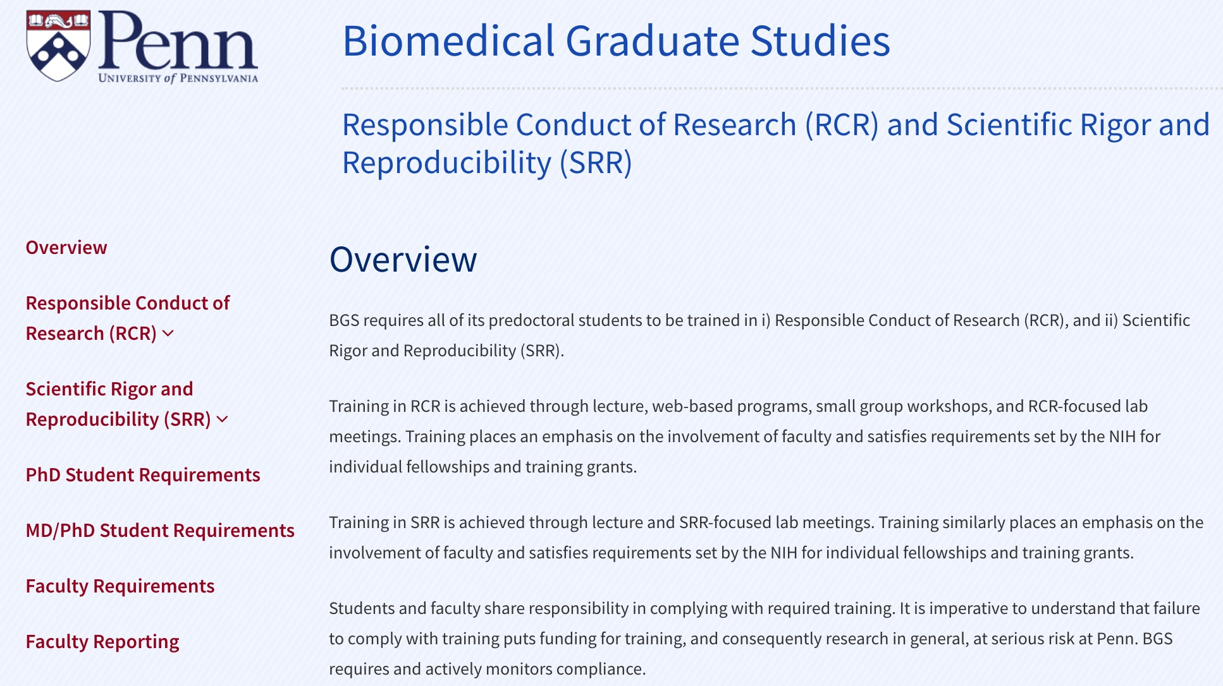
BGS RCR/SRR Website

Slide 22
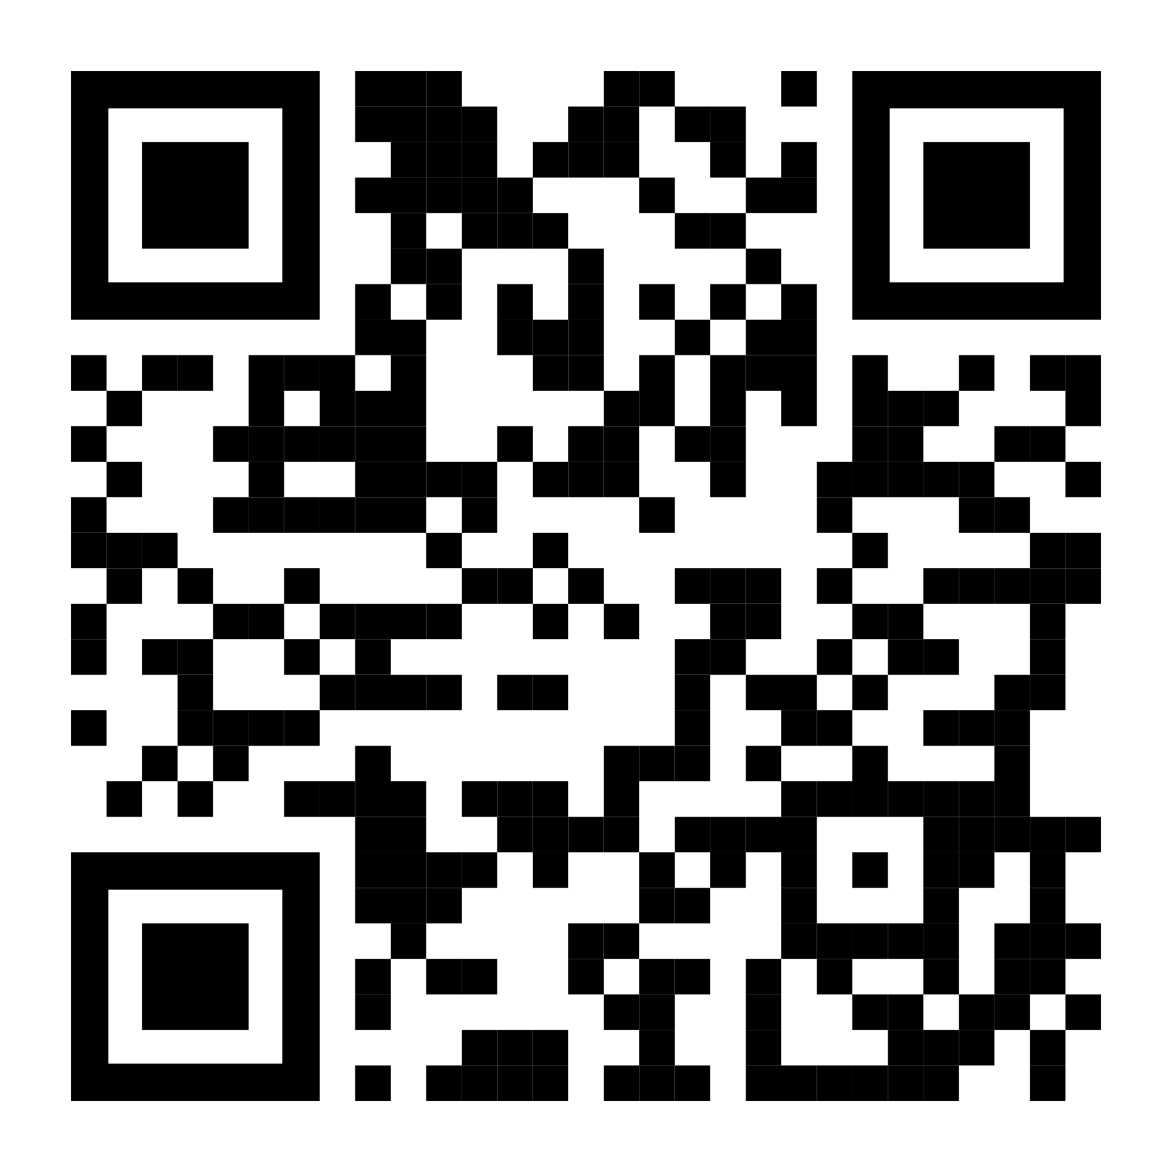
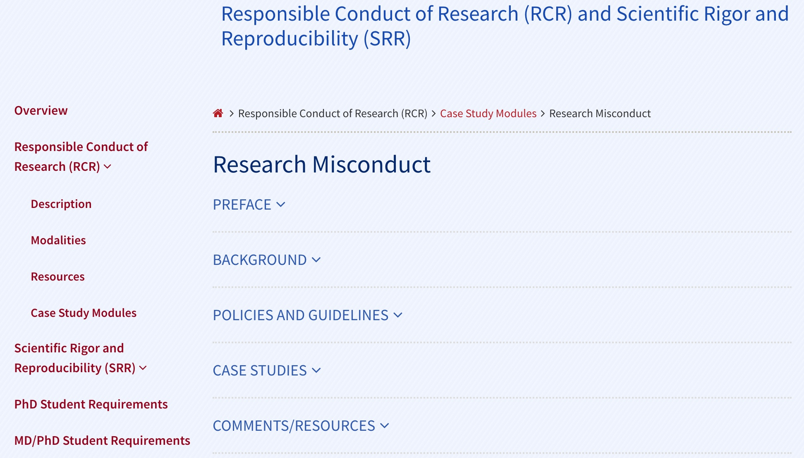
BGS RCR/SRR Website http://bit.ly/BGS_RCR_UPENN
Sydney Cason;
Alice Sukhina; Mary Putt &
Ben Voight:
Updated narratives reflecting real-lab-life

Slide 23
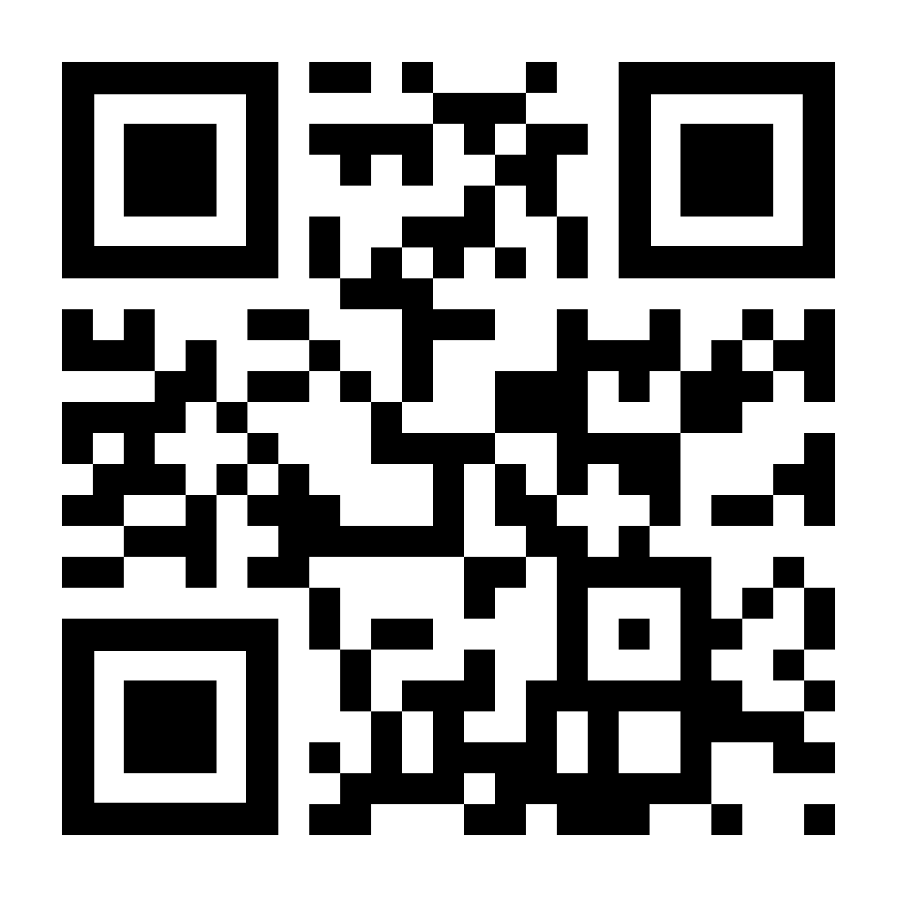
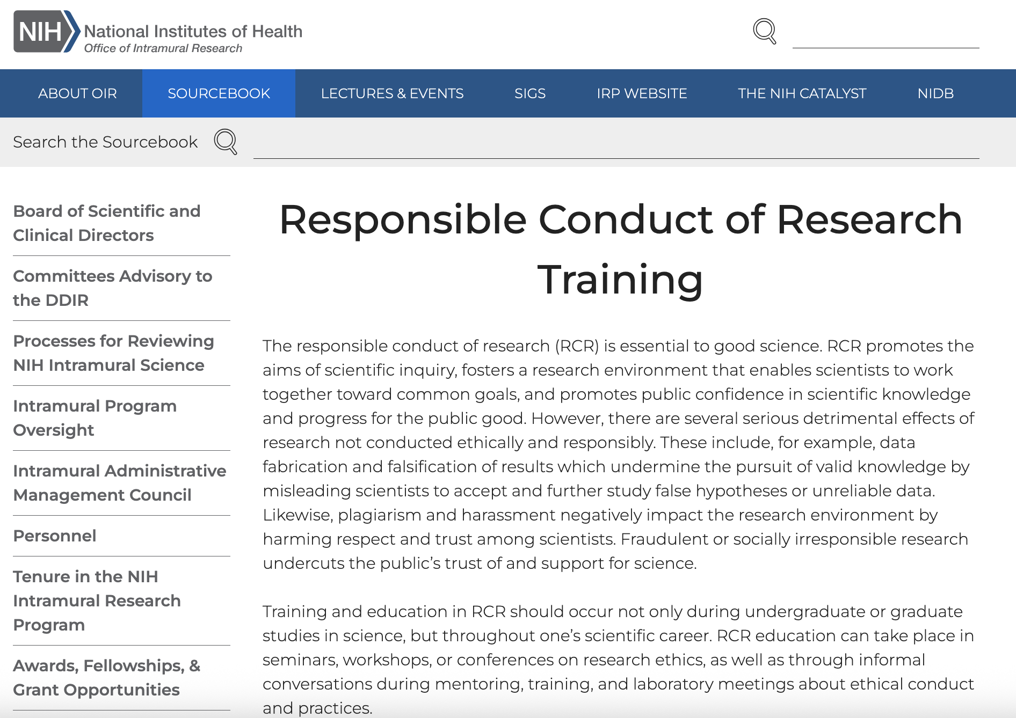
NIH RCR Resources http://bit.ly/NIH_RCR

Slide 24
To Sum up: these ARE your QUALITIES
HONESTY — conveying information truthfully and honoring commitments,
ACCURACY— reporting findings precisely and taking care to avoid errors,
EFFICIENCY— using resources wisely and avoiding waste, and
OBJECTIVITY— letting the facts speak for themselves and avoiding improper bias.
Notes:
You are in control of your work. Apply the above to your work. Must consider all areas of your ‘reach’. Must actively think about these.

Slide 25
YOUR GOALs:
CREATING YOUR ‘PROFESSIONAL SELF’:
Be the right shoulders to stand on!
Be here
By carrying out your science:
Responsibly
Reproducibly
& with Rigor!
Notes:
Requires that the science that came before is done Responsibly
Reproducibly
& with Rigor.

Slide 26
^{#BGSOrientation #PENNBGS4U}
Today’s program:
Responsible Research — Steve, ~25min
  Theme: Starting your Professional Life off with Rigor
Community for Rigor — A brief introduction
  Theme: Be Attentive to our Biases
Experimental Design — Kurt Engleka
  Theme: Good Design Saves Time
Notes:
What are your goals? Give me some words…
Do Good science
Recognize good science
Help Others – Kelly talked about this a lot from the POV of you getting from others –remember that you guide others, too
You are creating your professional self.

