Slide 1

Fostering Generations of Scientists by Making Science Accessible to our Community!
BGS Orientation
August 12th, 2025

Slide 2
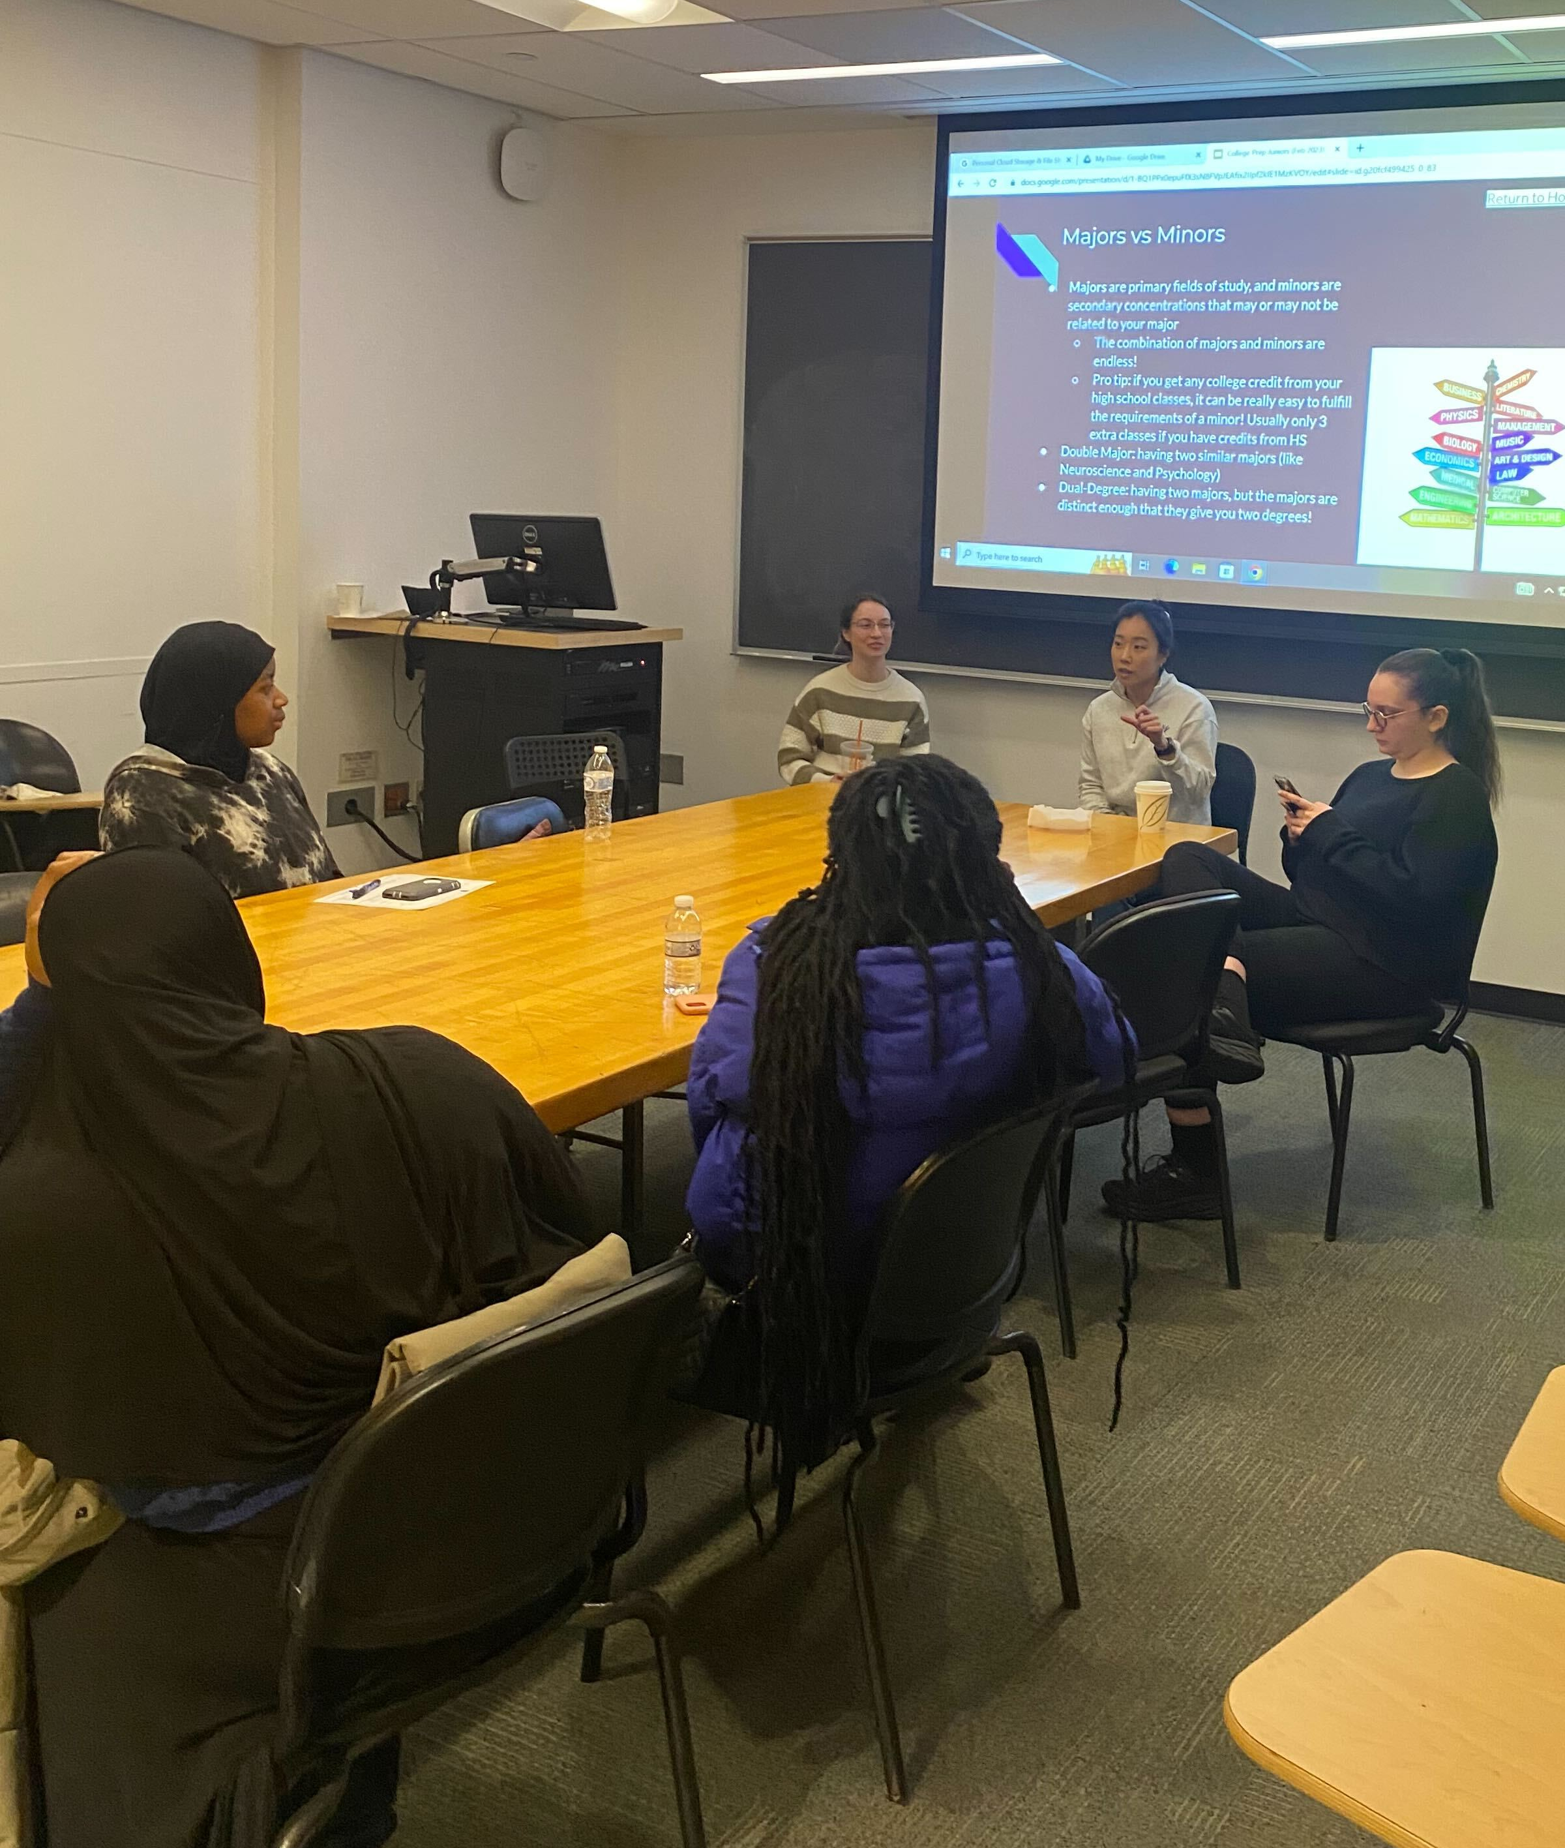
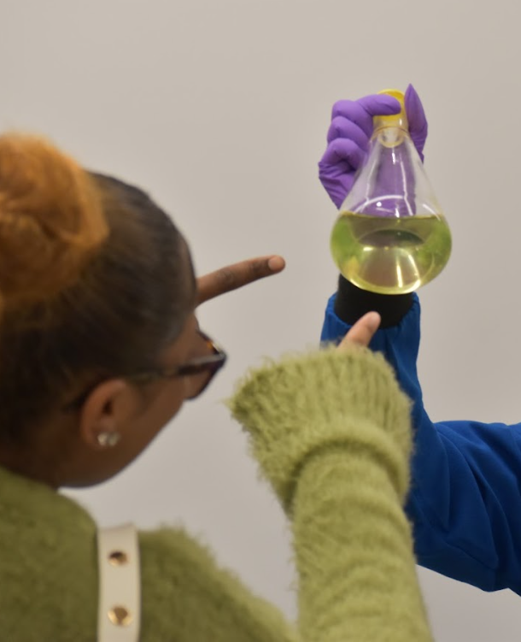
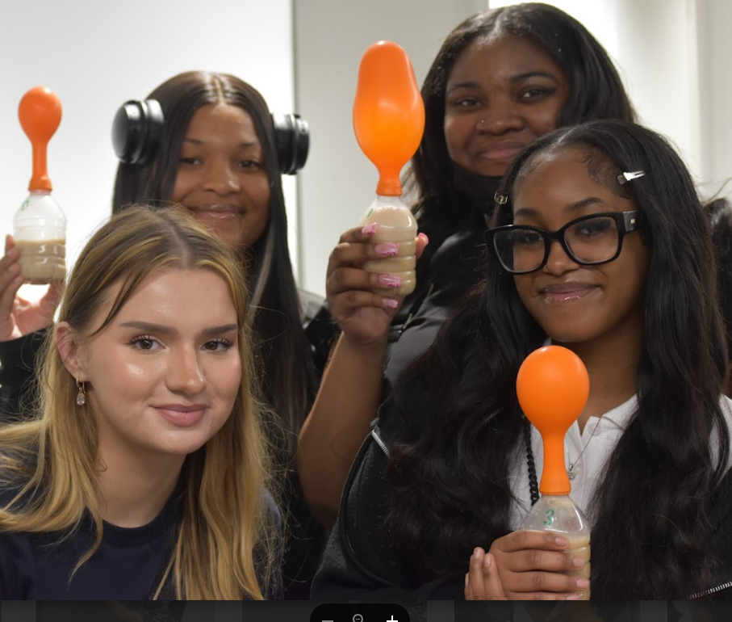
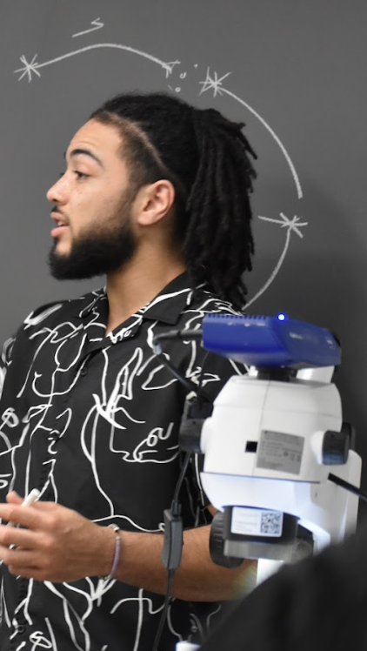
Who are we? Our Mission & vision
Pharm4Good is a graduate student-led organization that upholds values of scientific outreach, scholarship, and leadership. Our goal is to foster generations of scientists from underrepresented communities by encouraging science education and communication.
Mission
Pharm4Good’s vision is to create long-lasting relationships with local students and educators by encouraging Penn graduate students to be active members of the Philadelphia community.
vision

Slide 3

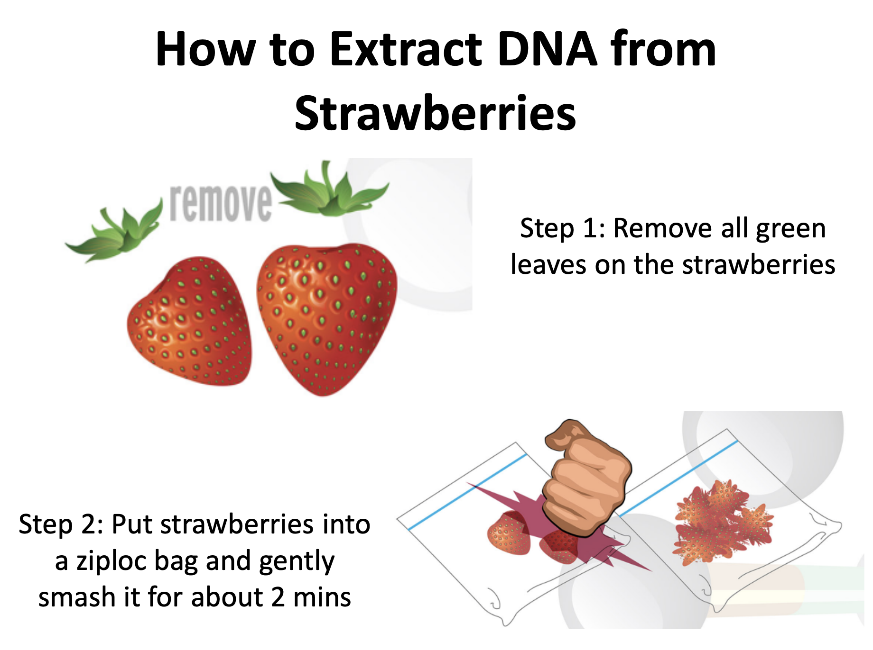
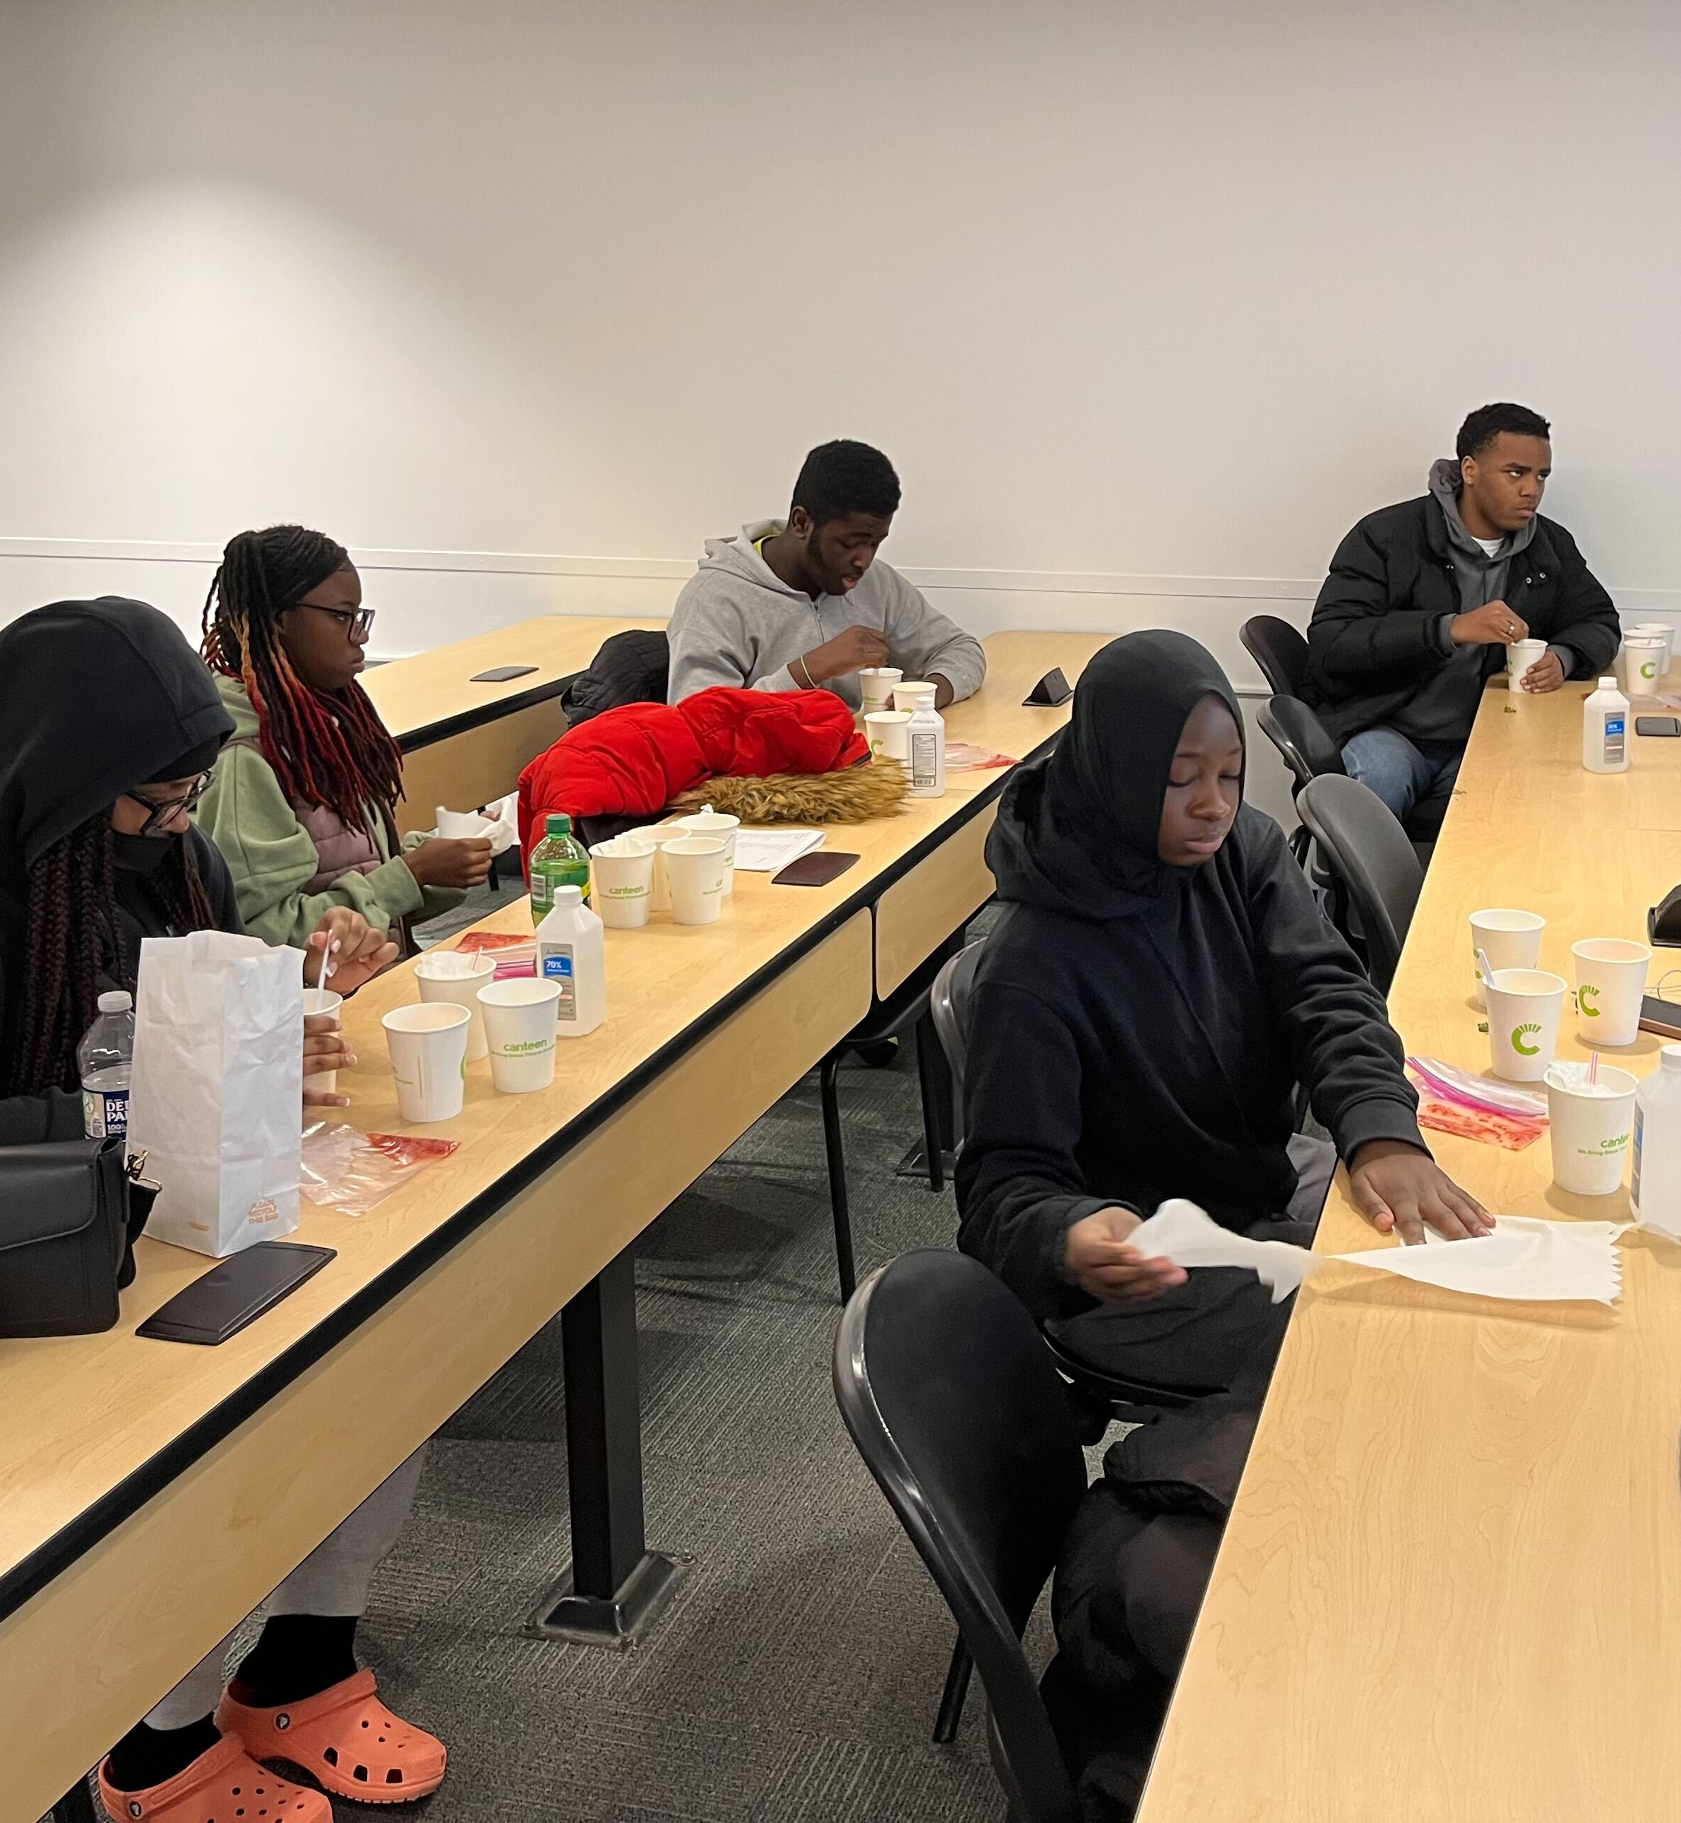
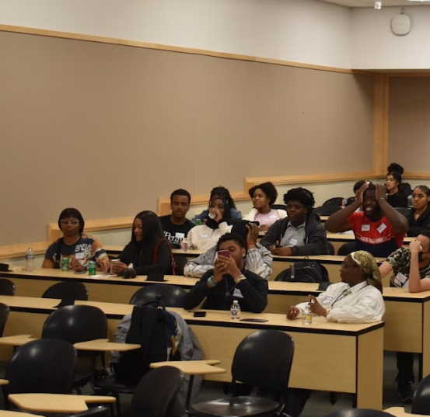
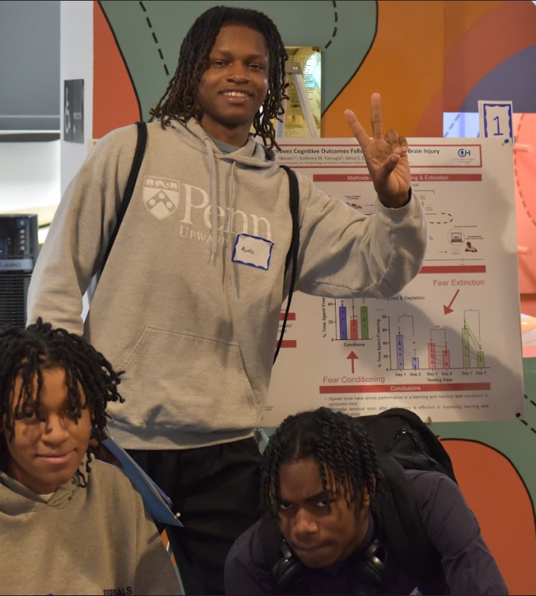
community outreach and partnerships
PHARM4GOOD SERVES HIGHLY MOTIVATED HIGH SCHOOL STUDENTS FROM FIRST-GENERATION AND LOW-INCOME FAMILIES
School-Year Partnership with Upward Bound
“Reverse” Science Fair!
College preparation
Pharm4GOOD volunteers with Upward Bound students
Hands-on activities that teach different science themes
  Strawberry DNA extraction; Air pollution and environmental health; Veterinary medicine
Giving high school students an opportunity to learn about the research conducted at Penn in a fun, digestible way.
Students become the judges!
Summer Partnership with Upward Bound
Teach a 4-week elective to high school students!
Introduction to disease models and drug development
Shark Tank: Pitch a novel anti-cancer drug to a panel of “Pharmacology Sharks”

Slide 4
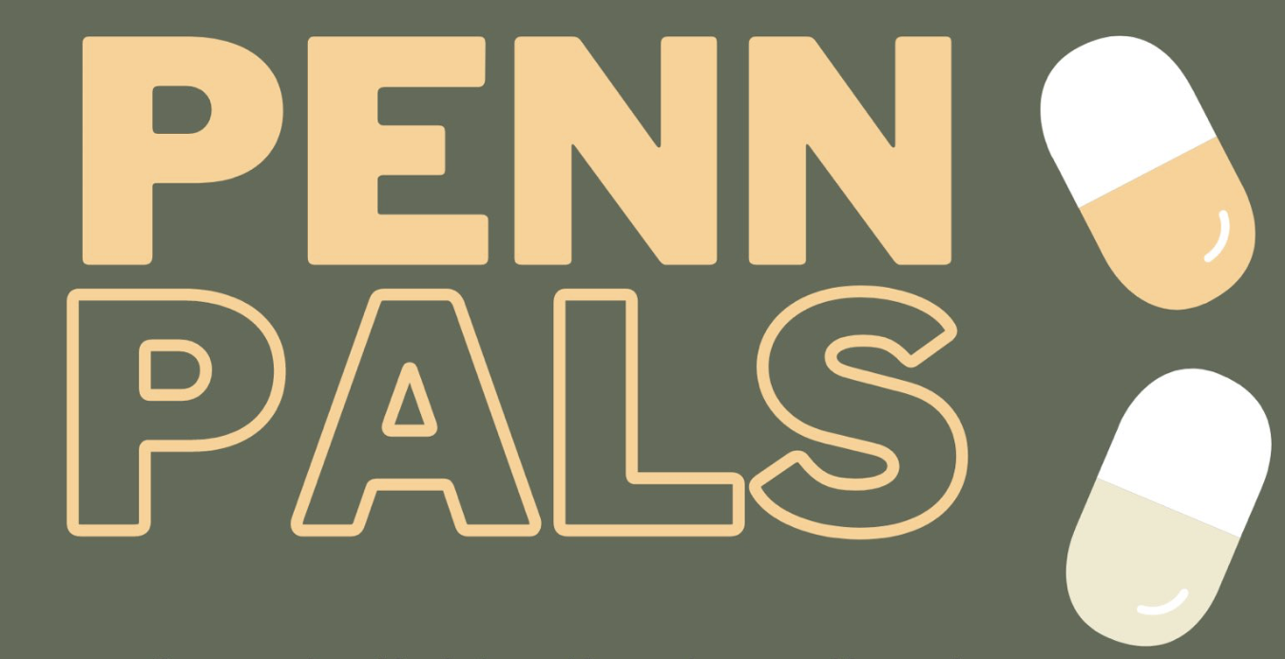

One-on-one Mentorship opportunities
PHARM4GOOD SERVES HIGHLY MOTIVATED HIGH SCHOOL and Undergraduate STUDENTS FROM FIRST-GENERATION AND LOW-INCOME FAMILIES
Undergraduate Level: PennPals BGS Application Support
BGS application assistance for applications from first-generation and low-income backgrounds
One-on-One pairing between Pharm4GOOD volunteers with prospective applicants
Runs October - December
High School Level: School-Year Partnership with Upward Bound
One-on-One mentorship initiative pairing Pharm4GOOD volunteers and 10th Grade Upward Bound students
Meet in small groups with students to discuss college majors/decisions, work/life balance, careers in STEM, essay workshopping, and whatever other needs Upward Bound or the students indicate
Meet 5-6 Saturdays throughout the academic year
Notes:
We are excited to announce a new Pharm4GOOD volunteer opportunity!
IDEAL Research at Penn has been running a 5-week virtual seminar series for prospective biomedical sciences PhD program applicants for the past 3 years. This series is geared towards preparation of PhD application materials including crafting personal statements and CVs/resumes. Prospective applicants receive 1 on 1 feedback from the Penn community. Through this series, IDEAL Research targets all applicants to SUIP (Summer Undergraduate Internship Program) and PennPREP (Post-Baccalaureate Research Education Program) as well as any undergraduates and researchers that they meet during their fall recruitment events.
This year, they have 70 Paths to PhD participants that they will be providing feedback to during the week of November 11th to November 15th. If you are interested in mentoring in the PhD application process, please fill out this GoogleForm by Monday.

Slide 5
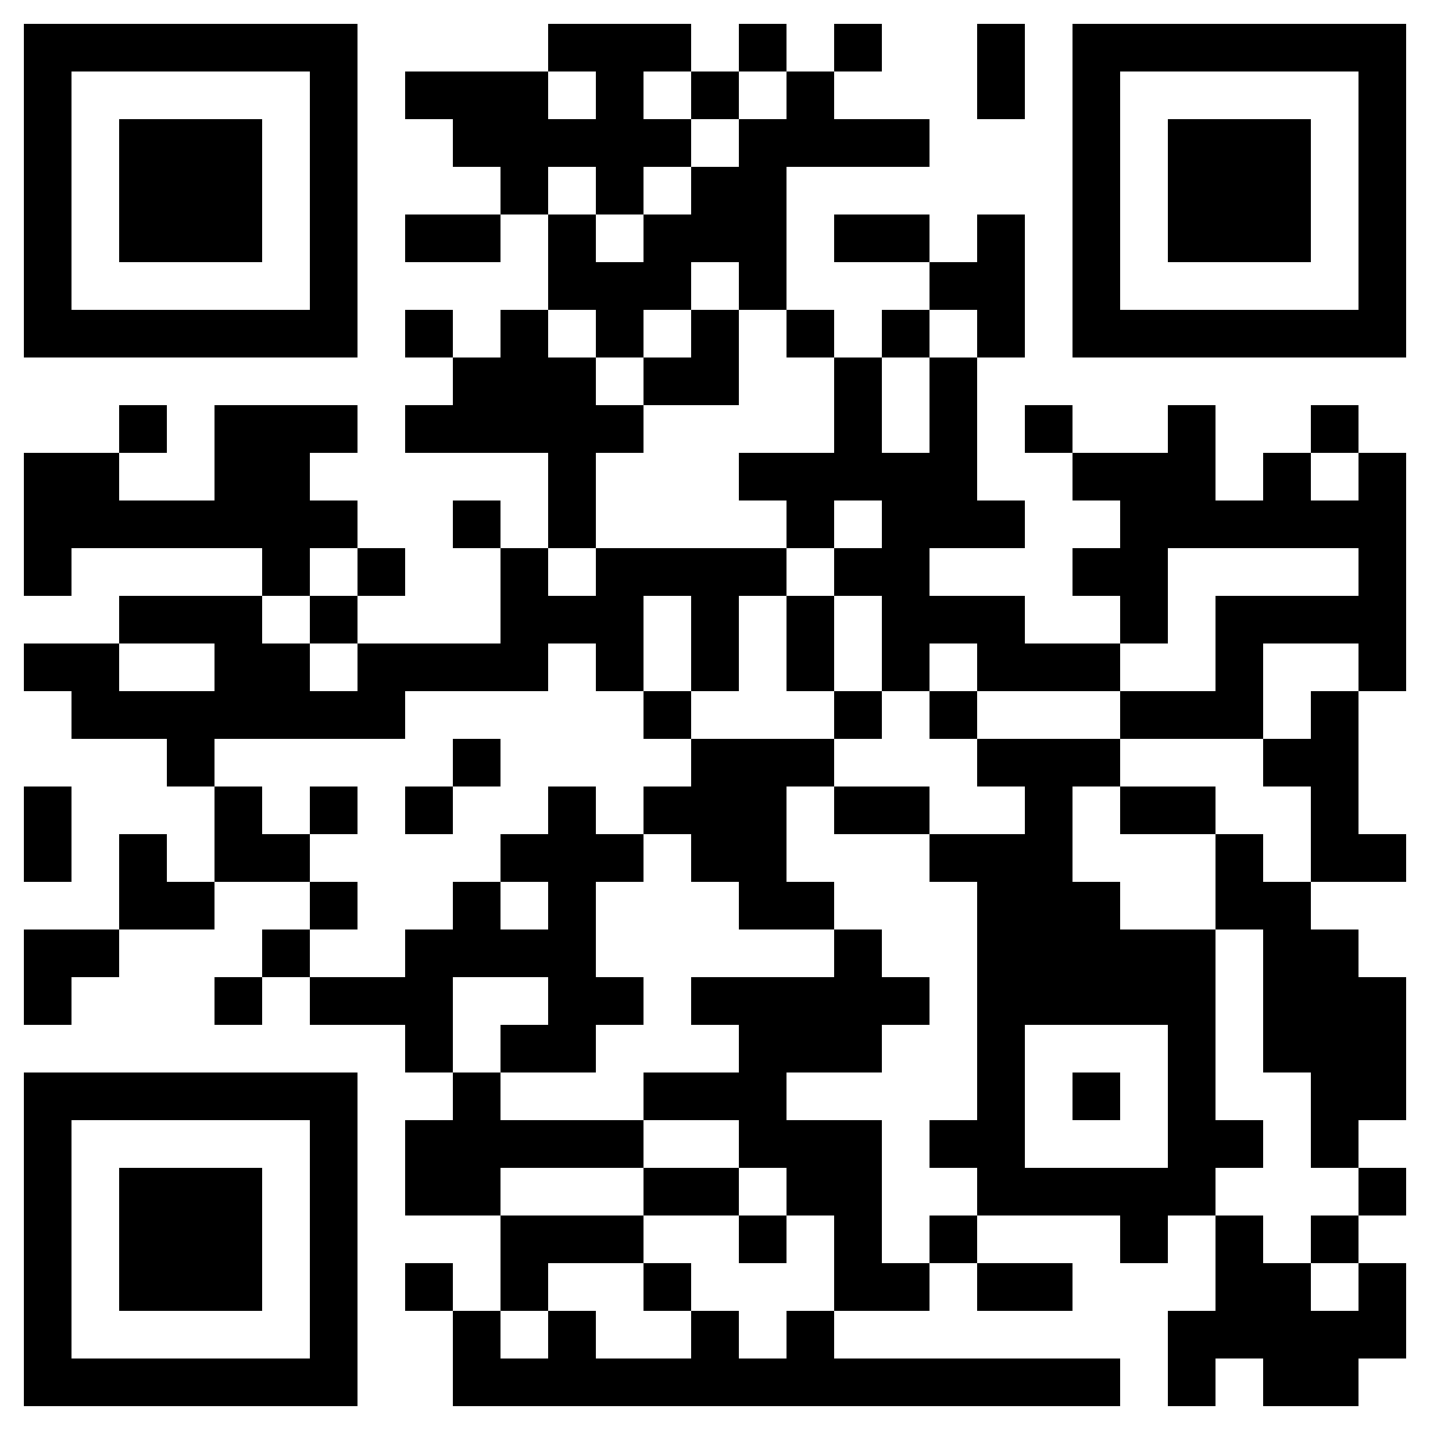

JOIN US!
General interest meeting
GoogleForm QR code
General Interest Meeting
Date to be announced! In the meantime, scan the QR code to join the slack for updates on new opportunities and meetings!
Questions?
Michelle Wang: michelle.wang1@pennmedicine.upenn.edu
Yolanda Simpson: yolanda.simpson@pennmedicine.upenn.edu
Cece Petruconis: cece.petruconis@pennmedicine.upenn.edu

