Slide 1
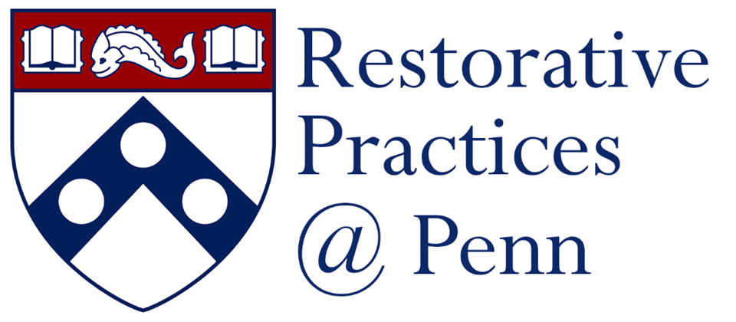
Restorative Conflict & Communication Skills
Presented by:
Imani Hester, Associate Director, Training and Community Building
Notes:
Introductions
Today we will spend some time talking about some communication tools and techniques that can help us navigate through moments of conflict, particularly responding and addressing incidents of Bias – including racism, sexism, ableism,
We are focused here on interpersonal level as well group conversation context and many of these skills are ones used by restorative justice facilitators in both their personal lives and in RJ processes

Slide 2
Restorative Practices @ Penn
PRIVATE & CONFIDENTIAL RESOURCE
Training
Faculty
Staff
Facilitation
WHO WE SERVE
WHAT WE DO
Students
Consultation &
Conflict Coaching
Post-Docs
RP@P – Healing, Accountability and Community Building

Slide 3
Goals
Familiarize/Re-familiarize core concepts and vocabulary of RJ/RP
Understand Logistics and Practices of RJ implementation
Explore how to live Restoratively day to day

Slide 4
Restorative Frameworks
“Restorative justice is a process to involve, to the extent possible, those who have a stake in the specific offense and to collectively identify and address harms, needs, and obligations, in order to heal and put things as right as possible.” ​
​
~ Howard Zehr, The Little Book of Restorative Justice, 2002​
Restorative Practices
Restorative Practices applies the values, principles and modalities of Restorative Justice in a wider range of contexts, to build community, make decisions, and prevent harm before it happens.
Restorative Justice

Slide 5
Inclusive Community
BELONGING
AGENCY
ACCOUNTABILITY
Beliefs
Views
Power
Restorative
Values
Norms
Needs
Growth Mindset
Notes:
How do we identify our needs when we experience harm so we can make strategic decisions to get our needs met?
How to intervene when we see racism or bias happening?
How do we receive feedback in a way that cultivates our growth and learning as opposed to defensiveness?
With a community invested in belonging, agency, and accountability innovation thrives and views, beliefs, and values are not only respected, but also integrated.

Slide 6
Let’s Circle Up Restorative Justice Values
We are all connected to one another.
We are all different from one another.
We are called to care for and respect one another.
The past, present, and future influence and shape our lives.
We are called to live in ways that are life-giving to others and ourselves.
We are called to be humble and aware of our limitations.
We all have needs that require attention.
We are called to 'do no harm' to others and ourselves.
We all want to feel included in working through our own problems.
We are responsible for our actions that harm others.
(adapted from "A Shared Just Peace Ethic: Uncovering Restorative Values," Mediation and Facilitation Training Manual, 5th Edition (Akron, PA: MCC US Office on Justice and Peacemaking), p85-87. Retrieved from https://www.letscircleup.org/restorative-justice)
Notes:
11:10-11:20

Slide 7
Meaningful Accountability
How do we receive feedback and make amends?
When someone causes harm, they incur obligations. The process of Meaningful Accountability is how we come to understand and fulfill our obligations.

Slide 8
Meaningful Accountability
What accountability does not look like:
Identity Violation
“I’m not like that!”
“I work in West Philly – how could you say that about me?”
Denial
“That’s not what I meant”
“You misunderstood”
Minimizing
“I wouldn’t worry about that – I think it was just a joke?”
“He talks to everyone like that”
ALL THE ABOVE
“My best friend is X, so I am definitely not biased”
Notes:
11:10-11:14

Slide 9
Fear
Anxiety
Shame
Guilt
Identity & Cognitive Dissonance
Meaningful Accountability
Why is it so difficult?
Notes:
11:14-11:17

Slide 10
Meaningful Accountability
Necessary Steps for Accountability
Acknowledge that you caused harm
01
Acknowledge you had agency in your actions
02
Understand the impact that you had
03
Work to repair the harm
04
Notice patterns in your own life that led to you making the harmful decision
05
See the Creative interventions: Tools for everyday people to end violence, (http://www.creative-interventions.org),
Mia Mingus’ “How to Give a Genuine Apology,” and Until We Reckon, by Danielle Sered for more information about meaningful accountability​

Slide 11
Guiding Questions from Restorative Justice
Who has been harmed?
What are their needs?
Whose obligation is it to address these needs?

Slide 12
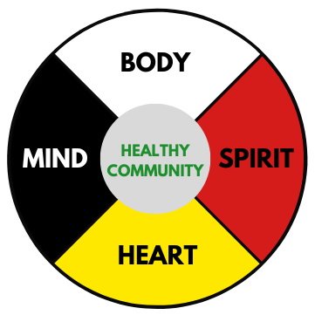
Medicine Circle
Adapted from Kay Pranis “Circle Keepers Handbook,” Unpublished
Notes:
2:15-2:25
Offer reflection on stage setting, values, and eventually group norms

Slide 13
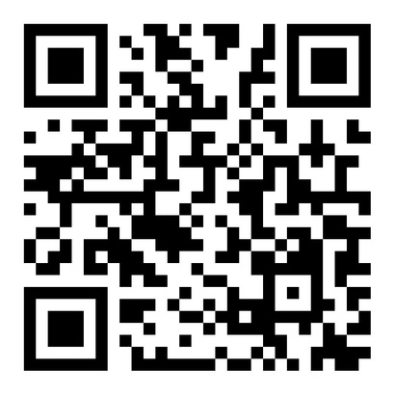
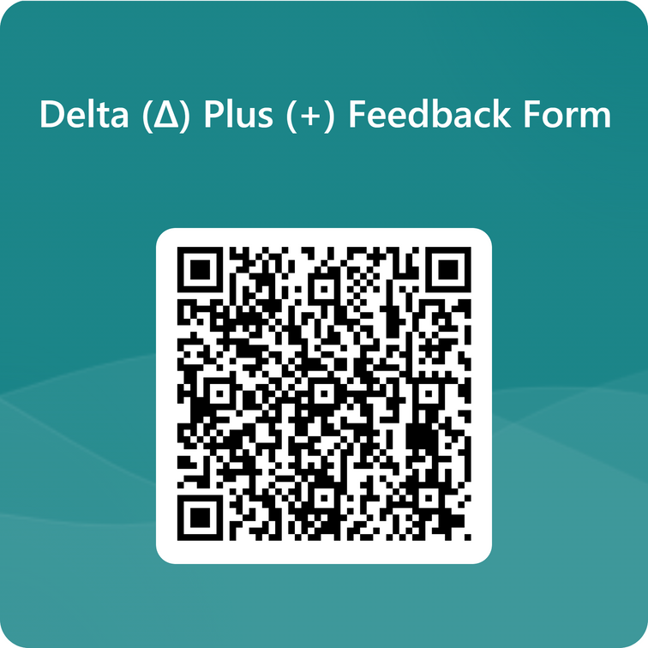



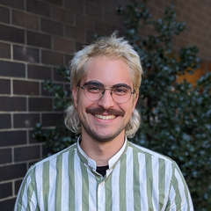
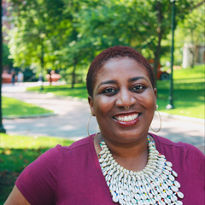
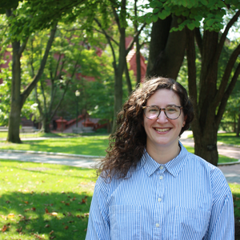
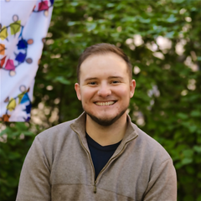
CONNECT WITH US!
RP@P Website
Feedback?
215-746-9332
Restorative
practicesatpenn
Pablo Cerdera
Imani Hester
Jenn Mirel
Jake Muscato
Deputy Director
Restorative Practices @ Penn
pcerdera@upenn.edu
Associate Director
Training & Community Building
ihester@upenn.edu
Associate Director
Dialogue & Accountability
jmirel@upenn.edu
Facilitation Specialist
Restorative Practices @ Penn
jakemusc@upenn.edu

