Slide 1

Grad School Logistics
Presented By:
Judy Jackson, Administrative Director Kyle Brown, Registrar
Carol Reich, Associate Director, Finance

Slide 2
What We Will Cover Today
BGS Basics (Judy)
Academic Office Functions
Staff Activities of Interest to Students
Affiliated Offices
Academic Logistics and Resources (Kyle)
Path@Penn (Academic Records)
Workday Learning
Loan deferments
Computing resources
Emergency aid
Financial Information (Carol)
Your Fellowship
Payroll & Workday
Taxes
Where to turn with questions

Slide 3
BGS Academic Office
The central BGS office is right next door! Room 160 BRB
Judy Jackson, Administrative Director
Kyle Brown, Registrar
Colleen Dunn, Curriculum Coordinator
Candace Cain, Career Development Coordinator
Catlin Herb, Admissions Coordinator
Gabby Ostapovich, Training Grants Assoc Dir

Slide 4
Some of the stuff we do in the BGS Academic Office…
Work closely with the 7 graduate groups on policies, procedures, curriculum development, and student support
Meet regularly with leaders of the student organizations on ways to enhance students’ training and quality of life
Partner with University Offices, e.g., Vice Provost for Graduate Education, Univ Registrar, Wellness, Career Services, Libraries, Graduate Student Center, Student Intervention Services
Administer various trainings and opportunities: Core Courses, Certificate Programs, Responsible Conduct of Research, Individual Development Plans, Career- and Professional Development Activities, Optional TA-ships and Internships
Support various fellowship application processes (HHMI-Gilliam, Regeneron, Schmidt) and coordinate a shared training grants nomination process
NOTE: Support for NSF and NIH-NRSA fellowships provided by graduate groups and Marianne Altland in the BGS Finance Office

Slide 5
Candace Cain
Career development activities and resources
Certificate programs:
Graduate Training in Medical Sciences
Public Health
Community-Engaged STEM
Weekly bulletin and other email communications
BGS website and social media
Software sign-ups (Adobe, Prism)
Support for student organization leaders with scheduling and other logistics

Slide 6
Colleen Dunn
BGS core courses staffing, including these courses:
BIOM 6000 – Cell Biology - Fall 1st Year
BIOM 5550 – Regulation of the Genome - Spring 2nd Year
BIOM 6100 – Foundations in Statistics - Fall 2nd Year
Course information management and scheduling
Course evaluations and new course approvals
RCR training: small group workshops in Years 2, 3, and 4
Orientation and Graduation event scheduling & logistics

Slide 7
BGS Finance Office
Located on 4th floor Anat-Chem (417 & 414)
Jill Baxter, Director
Carol Reich, Payroll
Sherita Blair, Student Accounts
Regina Medlock, Student Organizations Support
Marianne Altland, Grants & Fellowships
Jennifer Lu, Graduate Group Support
The office handles:
Coordination of student funding mechanisms
Payment of student stipends, tuition, and fees
Student conference travel awards
Individual students’ NIH NRSA (F) Awards
Budgets: graduate student organizations, academic office, graduate group offices

Slide 8
Other Affiliated Offices
All the Graduate Groups!
BBCB – Hannah Johnson- 206 Anat-Chem
CAMB – Meagan Schofer, Kathy O’Connor-Cooley,
Anna Kline, Ryan Bieber - 404 Anat-Chem
GCB – Anne-Cara Apple - B303 Richards
GGEB – Eli Elliott - 627 Blockley
IGG – Claudia Schatz- 206 Anat-Chem
NGG – Mariel Featherstone, Judy Qian– 140 Anat-Chem
PGG – Sarah Squire - 10-110 Smilow
Research Training Affairs – 6th floor Jordan Med Ed Center
MD-PhD Office – 6th floor Jordan Med Ed Center
VMD-PhD Office – Rosenthal Mezzanine
Notes:
Additional Contact information can be found in your orientation folder.

Slide 9
Academic Information

Slide 10
Check Your Email

Slide 11
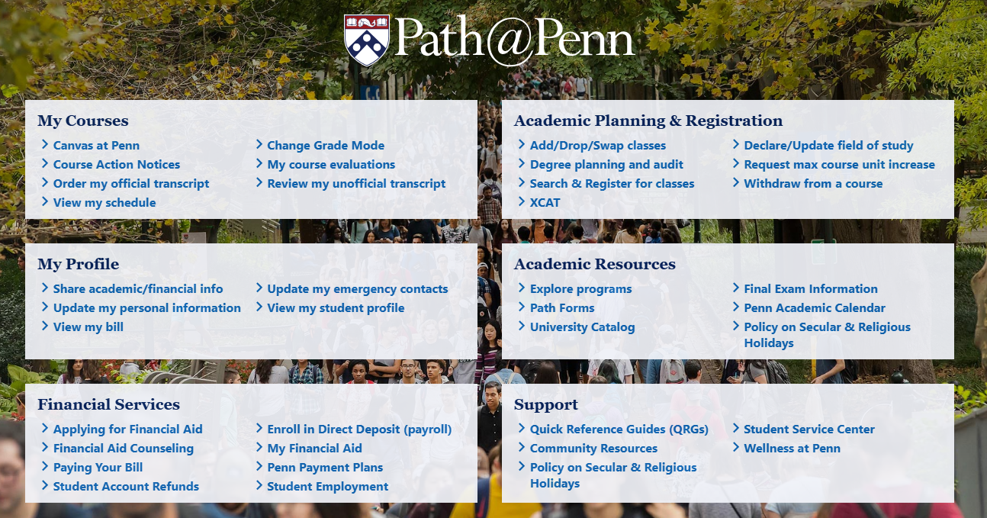
Path@Penn
Student Portal
View schedule and search for classes
Updating personal information
Ordering transcripts and viewing unofficial transcripts
Important links (Canvas, Financial Aid, etc.)

Slide 12
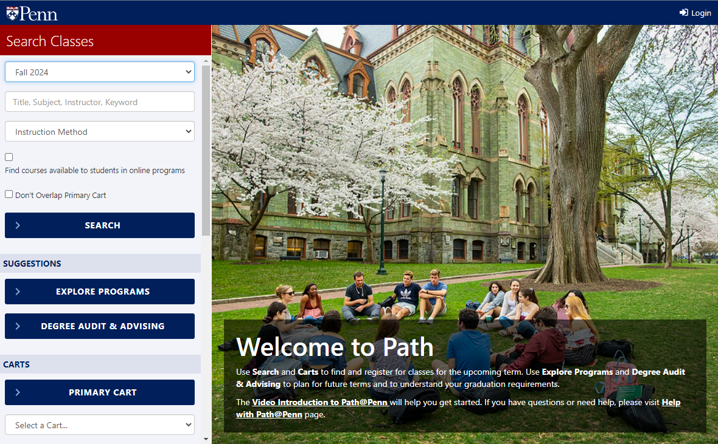
Path@Penn (Registration)
Generally, all course registrations are entered by your graduate group coordinator
Required course registrations will be done; electives and lab rotations will be entered after you have made selections with approval of your graduate group advisors
Knowledge and approval of your graduate group is REQUIRED for all registration and lab rotation changes.
BGS students will still use Path@Penn to:
View class schedule
Search for electives
Request permits for courses
Verify course enrollment

Slide 13
Reminder: Check Your Email

Slide 14
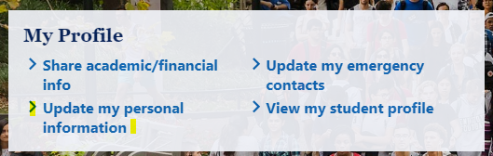
Path@Penn (Contact Information)
Update required information:
*UPennAlert Student Mobile Phone Number
Emergency or Missing Person Contact Information
Learning From Address
Permanent Address
Update optional information:
Preferred name
Personal pronouns
Gender identity

Slide 15
Workday Learning
Basic Lab Safety Training from EHRS
This will be assigned: “Laboratory and Biological Safety at Penn Curriculum-EHRS”
Lab-Specific Training (e.g., animals, radiation) may be assigned by your rotation lab
HIPAA
Responsible Conduct of Research (RCR)
Intro module will be assigned “CITI Responsible Conduct of Research Training – UNIV”
Elective Training
Lots of training tutorials are available, which you can “self-assign” – software, coding, etc.
Workday-->Menu-->Learning-->Discover

Slide 16
Don’t forget: Check Your Email

Slide 17
Loan Deferments
If you have student loans that are eligible for in-school deferment, Penn reports enrollment automatically each semester.
Reporting occurs for each term
First semester enrollment is not reported until after the term has started
If additional enrollment verification is needed, contact Kyle Brown, BGS Registrar

Slide 18
Computing resources
Laptops (new PhDs, rising 3rd year combined degrees)
Software
University Software
Microsoft O365
Matlab
Qualtrics
BGS-Provided Software
Adobe Creative Cloud
Prism
Stata (Epidemiology)
Computing Storage
PennBox
Dryad

Slide 19
Check Your Email

Slide 20
Other Services
Request for additional courses
Career-related coursework
BGS generally does not cover summer tuition
Leave of Absences
Individual Development Plans (IDP)
Required of all PhD students EVERY YEAR
Internship approvals
Graduation Information
Name change information

Slide 21
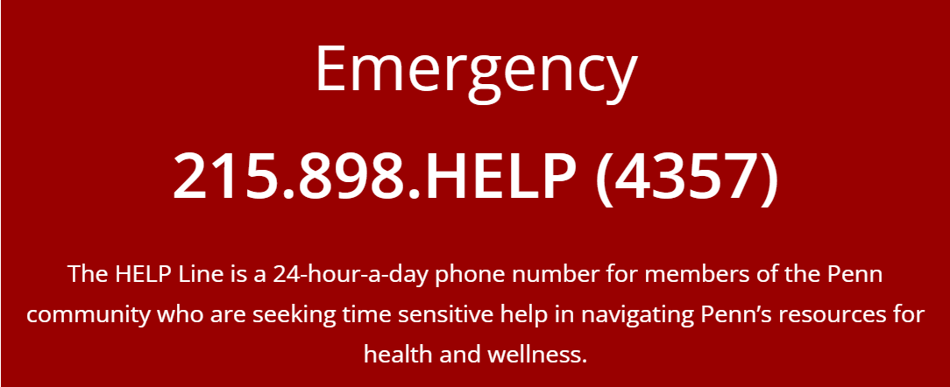
Emergency Aid
If you are experiencing an immediate financial emergency impacting your housing or health, contact Student Intervention Services right away: 215-898-6081.
The Graduate Emergency Fund, administered by the Graduate Student Center, provides grants to assist currently enrolled graduate and professional students with urgent financial needs and acute financial hardship due to unanticipated one-time expenses.

Slide 22
Also, Check Your Email!

Slide 23
Financial Information

Slide 24
Fellowship Essentials
Stipend: $42,745 effective in September pay
Tuition and fees (general, clinical, tech)
Penn Student Health Insurance (PSIP)
- Single coverage only through Aetna
Optional dental insurance through Penn Dental (PHD Students)
Reimbursed via your student account
University covers 50% of the cost, BGS covers other 50%
Note: Optional Aetna dental insurance is not covered
Optional vision insurance (PHD Students)
Reimbursed via your student account
Refer to the email from Kyle for details on optional dental & vision insurance

Slide 25
Payroll Dates
Graduate Students are paid monthly on the last business day of each month: Friday, 8/29/2025; Tuesday, 9/30/2025; Friday, 10/31/2025, etc.
The first pay will be on Friday, August 29, 2025, for most students.
For eligible students onboarded in time, the first pay will include the relocation award, which is taxed. ☹
Foreign national students not in the U.S. on 8/1/2025 will receive their first pay on Tuesday, September 30, 2025.

Slide 26
Onboarding for Payroll – Time Sensitive!
In-person I-9 Part 2 at Onboard@Penn with original documents
Direct deposit bank information entered in Workday
If you have not already completed this process, please visit https://www.onboard.upenn.edu/ for requirements and to schedule your appointment.
Onboard@Penn is located at 3601 Walnut Street-2nd floor of the Penn Bookstore.
Essential: Complete by Thursday, 8/14/2025, at the latest for the August payroll.

Slide 27
Workday – What now?
**Important!** Viewing the details of your pay -- Workday Tip Sheet “Self Service: Understanding Your Payslip.” (Before reaching out with any questions regarding your stipend, please check your payslip.)
Updating your contact & personal information -- Workday Tip Sheet “Self Service: Modify Your Personal Information”
Setting up/changing your bank account(s) for direct deposit -- Workday Tip Sheet “Self Service: Manage Pay Elections”
Workday@Penn → easiest way to get to Workday is to Google “Workday at Penn”
Questions? The “Solution Center” is the Workday HelpDesk: Solution Center at Penn Service Portal (freshdesk.com)

Slide 28
Taxes
University of Pennsylvania employees (e.g., BGS Finance Team) are not authorized to provide personal tax advice. Please consult with a qualified tax specialist or the IRS www.irs.gov.
Other tax resources:
Penn’s “Guide to Graduate Student Appointments” -- During their time in BGS, students will have different jobs depending upon their program year, mentor support, training grant appointments, T.A. activities, etc. The Guide outlines the tax implications of the different jobs. During their first two years, most students are “Educational Fellowship Recipients.”
Penn’s Division of Finance – Payroll & tax information: https://www.finance.upenn.edu/payroll-taxes/individual-tax-rates-and-forms/tax-rates/
Foreign national students are subject to different tax rules based on their country of citizenship.
Questions? Contact the HCM Solution Center: (HCMsolutioncenter@upenn.edu)

Slide 29
Preview: Future Financial Fun!
BGS provides $1,000 max per fiscal year (July 1 – June 30) for scientific conferences for those who will be presenting (papers or posters).
For pre-approved travel, students who incur allowable/approved out of pocket expenses, will submit an expense report in Concur for reimbursement.
Many rules apply!
Details & resources:
https://www.med.upenn.edu/bgs/student-funding.html
https://benhelps.upenn.edu/support/solutions/articles/15000043222-create-an-expense-report-students
https://www.finance.upenn.edu/policy/2364-travel-and-entertainment-non-reimbursable-items/

Slide 30
For Workday Issues, Tax Questions, or General Questions:
Contact the HCM Solution Center
EMAIL: hcmsolutioncenter@upenn.edu
PHONE: 215-898-7372
Please note that you are NOT an employee of the University, even though you receive your stipend payments through the University’s Workday system. Your status is that of a fully funded Graduate Student, which can be verified by viewing your Job details screen in Workday.

Slide 31
Questions, Issues or Help Regarding Your Stipend or Your Student Account
Stipend: Carol Reich
reichc@pennmedicine.upenn.edu
Student Account: Sherita Blair
blairsch@pennmedicine.upenn.edu
Note: If your tuition or fees are not paid by 9/15, contact Sherita. Be sure to monitor your bill for personal charges.

