Slide 1
SRR at PENN
New Student Welcome and Orientation
2025
Kurt A. Engleka (Ingelkay, hard “g”) (he/him)
Adjunct Assistant Professor, Cell & Dev Biol
Director of Curriculum, BGS
kengleka@pennmedicine.upenn.edu
orcid.org/0000-0001-5539-4076
Notes:
More acronyms! Is this the hardest part of graduate school?
I will briefly talk to you today about the importance of the theory and practice guiding the design of experiments. This session represents our first steps in providing intellectual and physical resources that will help you plan and perform the best experiments you can, pursuing science at the highest level, that yield results that you and others can reliably build upon to discover something new. At least within the limits of time, money, energy, encouragement and thought at your disposal.
It is a little overwhelming to singularly stand here in front of all the talent in these seats. I sense your eagerness to be unleashed into the labs to conduct experiments. Think of how many different types of experiments and accompanying bytes of data you are about to bring into existence! Consider, though, that effective experiments, even seemingly simple ones, require a well-conceived plan PRIOR to the actual conducting of the experiment. How EXACTLY is the experiment performed? What EXACTLY is measured? What EXACTLY will you learn? A good experimentalist answers such questions BEFORE the actual conducting of the experiment. This is why we are introducing experimental design during orientation, so it is at the forefront before you begin experiments in the labs.
“Are you ready to perform experiments at Penn!” You are fortunate to be in an institution where you can do almost any experiment you want.
“What kind of data are you going to produce? Is the data from an experiment that was the best experiment you could perform under the circumstances? Is the data reproducible by you and others? Is it predictive so that you and others can build upon the results?”

Slide 2
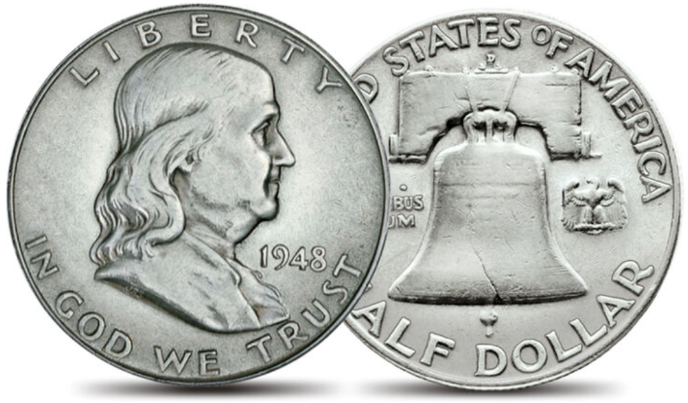
Two Sides of Same Coin
- either side you win -
Responsible Conduct of Research
(RCR)
Scientific Rigor and Reproducibility
(SRR)
Mandate that research be ethically sound and of rigorous methodological quality.
2
Notes:
Think about what I am going to tell you about today as two sides of the same (precious) coin: research integrity and reproducibility. Coin of the realm!
Goal of RCR/SRR efforts: demanding that research be ethically sound and of rigorous methodological quality
UPenn supports a continuing debate on attitudes and behaviors to improve scientific integrity, rigor, and reproducibility.
Encourage scientists to confront their own attitudes and behaviors while practicing science.

Slide 3

Goals for today
Develop an awareness of reproducibility and transparency initiatives and how they integrate with your training, research, and career
Provide you with a basic set of resources and tools to promote best practices for producing robust, unbiased results from your experiments
Notes:
This is an early discussion in the process of engaging all BGS students in SRR initiatives. Today’s discussion serves as one step to be followed by many as part of life-long training in achieving excellence in science.
A goal is “improving the ability to judge and ‘do’ science well.”
The concerns raised and open debate about SRR reinforces the strength of our system.
Strive:
for the most efficient, effective use of precious research efforts
to conduct the best experiments you can.
Promote a career-long positive attitude toward research ethics, the responsible conduct of research, scientific rigor and reproducibility and the system of science in general.

Slide 4
Reproducibility is foundational but difficult to achieve
4
Notes:
How many of you have experienced failure to confirm results, validate reagents, chemicals, specialty reagents?
How many times have you found a paper that does exactly the thing you are struggling to do but you go to the methods and you get vague sentences/no code?
There is a growing movement to encourage reproducibility and transparency practices in the scientific community.
Scientists often experience failure to reproduce results.
A recent survey (2016) revealed that about 70% of biology and medical scientists were unable to reproduce experiments from other scientists as well as the inability of around 60% to reproduce their own work.
Conduct the best experiments you can.
Science is hard! Replication failure is the norm.
A recent replication study (Errington):
The effect sizes the replicators observed were on average 85% smaller than originally reported
Animal experiments fared worse than in vitro experiments (animals are not little people in furry costumes)
None of the papers selected contained enough detail for the researchers to repeat the experiments.
Authors could often not provide details (information not recorded/ personnel no longer in lab) or were uncooperative.
Inability of original authors to reproduce their own experiments
Difficult-to-match factors
Nature. 2021 Dec;600(7889):359-360. doi: 10.1038/d41586-021-03736-4. PMID: 34912092
Errington TM, Mathur M, Soderberg CK, Denis A, Perfito N, Iorns E, Nosek BA. Investigating the replicability of preclinical cancer biology. Elife. 2021 Dec 7;10:e71601. doi: 10.7554/eLife.71601. PMID: 34874005; PMCID: PMC8651293.
Errington TM, Denis A, Perfito N, Iorns E, Nosek BA. Challenges for assessing replicability in preclinical cancer biology. Elife. 2021 Dec 7;10:e67995. doi: 10.7554/eLife.67995. PMID: 34874008; PMCID: PMC8651289.
Begley CG, Ioannidis JP. Reproducibility in science: improving the standard for basic and preclinical research. Circ Res. 2015 Jan 2;116(1):116-26. doi: 10.1161/CIRCRESAHA.114.303819. PMID: 25552691.

Slide 5
Factors that Affect Reproducibility
Technical
Experimental Design
Unvalidated reagents
  antibodies, cell lines
  RNAi
Contaminated cell lines
  Batch effects
  Sophisticated techniques
  Natural variability
Study design flaws
  small sample size
  non-validated system
Inappropriate statistics
  HARKing
  P-hacking/multiple testing
  Confirmation bias
Human
Culture
  Inadequate method reporting
  Poor archiving
    Reagents, data, code
  Mistakes/fraud (minor)
Publication bias
Novelty over replication
Lack of incentives
Hyper competitiveness
Notes:
Science Self-Corrects In the Long Term but Not Short Term
What short-circuits self-correction?
Poor Training in Experimental Design/Statistics
Lack of Openness/Transparency
Publication Practices – Blind to negative data
Culture – “Survival” reward system
Technical
Do experiments measure what we think they are measuring
Batch effects - refers to an individual group of samples that are processed differently relative to other samples in the experiment
Sophisticated techniques: unequal amplification during PCR, cell lysis, reverse transcriptase enzyme efficiency, and stochastic molecular sampling during sequencing.
Differences in physiology: preclinical to clinical
Separating meaningful experimental changes from background variability is a challenge in epigenomic studies
Experimental Design - Poor research practices and experimental design
Flexible study designs and statistical analyses can present anything as significant (listening to the Beatles makes you younger); running small studies with low statistical power (because of low sample size or small effects or both)
Failing to consider all biological variables (sex, gender, race, microbiome, environment, weight, confounding health issues, social economic status, background, etc.)
Use of misidentified, cross-contaminated, or over-passaged cell lines and microorganisms.
Unauthenticated antibodies
Inability to manage complex datasets
HARKing - hypothesizing after results are known
“the idea is to cut down on the statistical shenanigans and memory-holing of negative results that got the field into this mess. No more collecting a giant blob of data and then combing through it for a publishable outcome”
P-hacking - collect or select data or statistical analyses until nonsignificant results become significant.
p (for probability) -value: the probability that a perceived result is actually the result of random variation.
easy to find an effect if explore the data after collecting results
Confirmation bias – “reasoning with an agenda”; hypothesis myopia
Human
Fraud and misconduct (minor part of the problem)
Cognitive bias
Culture
Pressure, competition, ambition
Publication bias - ‘negative’ studies are left unpublished
distorted view of drug efficacy if multiple redundant studies of a drug but only one shows a benefit, but that is the one that is published
everyone at some point will get a null result; it’s important to disseminate these studies such as in a registry
Scientists are amplifying their story lines and weakening their self checks, while constantly searching for more funding
Publishing in “top-tier” journals and gaining media attention is good for careers but is it good for science
Others: economics
Science is hard! Most of the common diseases that we study and questions trying to answer are exceedingly complex.
Are we training students/post-docs how to be good paper publishers and not discoverers of new knowledge?

Slide 6
Which reward system is for you?
Survival
Good Research Practices
Publish lots of papers
Get lots of citations
Acquire funding
Get promoted
Rigor/reproducibility
Scientific collaboration
Unrestricted access
Freely sharing data
Value constancy of results with the goal of building reliable knowledge about the world.
6
Notes:
The pressure to increasingly publish in high-impact journals, receiving numerous citations, obtain funding for research, or be appointed to a certain positions are major drivers of misconduct and questionable research practices. Responsible scientific behavior and success are increasingly at odds.
Current system: fierce competition for scarce resources leads to choices that do not really align with the goal of building reliable knowledge about the world.
Don’t think it is better to be first rather than right.
Many questionable research practices stem from methodological flaws.
Role of supervisors, PI’s, and mentors: which reward system do they promote?
Competitiveness often drives science onto sidetracks, away from addressing the most important questions and pursuing transformative ideas as people are forced or incentivized to go for low-hanging fruits and trends. (Sara Wickström)
Are we training students/post-docs how to be good paper publishers and not discoverers of new knowledge?

Slide 7

Shared values in Scientific research
Honesty
convey information truthfully and honoring commitments
Accuracy
Core competency:
Proficiency in experimental design
report findings precisely and take care to avoid errors
Efficiency
use resources wisely and avoid waste
Objectivity
let the facts speak for themselves and avoid improper bias
Notes:
https://grants.nih.gov/policy/research_integrity/what-is.htm
Honesty
reporting the research process accurately
taking alternative opinions and counterarguments seriously
being open about margins of uncertainty
refraining from making unfounded claims
refraining from fabricating or falsifying data or sources and refraining from presenting results more favorably or unfavorably than they actually are
Scrupulousness
Using methods that are scientific or scholarly
Exercising the best possible care in designing, undertaking, reporting and disseminating research
Transparency
ensuring that it is clear to others what data the research was based on, how the data were obtained, what and how results were achieved and what role was played by external stakeholders
line of reasoning must be clear and that the steps in the research process must be verifiable
Objectivity
not guided by non-scientific or non-scholarly considerations (e.g., those of a commercial or political nature)
Impartiality/avoiding bias
letting the data speak for itself and
Responsibility
Consider the legitimate interests of human and animal test subjects, as well as those of commissioning parties, funding bodies and the environment
Conducting research that is scientifically and/or societally relevant.
code of conduct
(https://www.universiteitenvannederland.nl/files/documents
/Netherlands%20Code%20of%20Conduct%20for%20Research%20Integrity%202018.pdf)

Slide 8
YOU as A SCIENTIst
Self-
Learning
Institutional
Other
Scientists
You as a
Scientist
Recognize good science!
Funding
Applications
Publications
Research
8
Notes:
Before you can do great research, you have to truly internalize what great research in your field is.
NIH/NSF/Penn/CHoP/Wistar
Institutions have responsibilities they follow in terms of training and supervision, ethical standards and procedures, and the promotion of open science, particularly with regard to data management, publication, and disseminating study results.
Self-Learning
Learn by observation and imitation
Evaluation of yours and others’ experiments/results
Reading
Doing Experiments
Pay attention to speakers: what kinds of information are they telling the audience? How do they weave theory and experiments together? How do they present their findings? What kinds of questions do people in the audience ask? This will provide implicit learning opportunities. Reading papers is another way to do so, but in-person observation experiences can be irreplaceable.

Slide 9

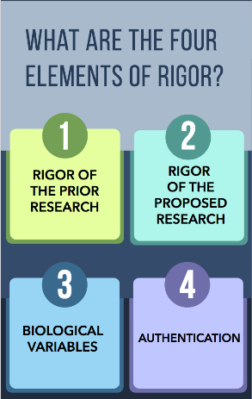
Evaluate
Strengths
Weaknesses
Plan to
Address
Weaknesses
Experimental
Design
Robust,
Unbiased
Results
Variables
Factored
In
Black Box
Reagents
Validated
SRR and You
https://grants.nih.gov/policy/reproducibility/guidance.htm
Notes:
Scientific rigor is the strict application of the scientific method to ensure unbiased and well-controlled experimental design, methodology, analysis, interpretation and reporting of results.
Research
Research/Career Development
Individual Fellowships
Training
Institutional Training & Career Development
Fellowships
Career Development
Rigor of The Prior Research
strengths weaknesses of prior research (including yours) that serves as key support
identify weakness or gaps in a line of research
Rigor of The Proposed Research
Plan to address weaknesses of prior research (including yours) that serves as key support
Experimental design/Methods: describe how will achieve robust and unbiased results
Appropriate sample sizes
Randomization and blinding
Adequate positive and negative controls
Appropriate statistical tests
Consideration of relevant biological variables
Authentication of key resources
Etc.
Consideration of Relevant Biological Variables
e.g., sex, age, weight, underlying health conditions
Describe how these are factored into research design and analysis
Authentication of Key Biological and/or Chemical Resources
e.g., cell lines, specialty chemicals (serum), antibodies – “black box” reagents
Describe methods to ensure the identity and validity of reagents that vary
Infographic courtesy of Ms. Nichole Swan, Dr. Shana Spindler, and Dr. Yvette Pittman of the Eunice Kennedy Shriver National Institute of Child Health and Human Development (NICHD).
Emphasis on scientific premise (measure of the strength of the body of evidence supporting the proposed work, rigorous experimental design, consideration of biological variables (such as sex), authentication of reagents
For innovative and exploratory research where preliminary data may be lacking, the scientific premise should provide idea of risks to be addressed and support the rationale of the proposed work.

Slide 10

NIH initiatives
Evaluate
Strengths
Weaknesses
Plan to
Address
Weaknesses
“reviewers are asked to evaluate the scientific merit of the application include components that address reproducibility, rigor, and transparency.”
Experimental
Design
Robust,
Unbiased
Results
Variables
Factored
In
Black Box
Reagents
Validated
SRR and You
https://grants.nih.gov/policy/reproducibility/guidance.htm

Slide 11

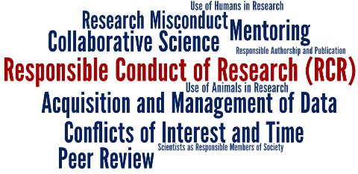
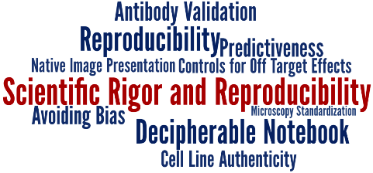
https://www.med.upenn.edu/bgs-rcr-exdes/
11
Notes:
So, with regard to the nuts and bolts of training, know first that NIH requires training of us and other biomedical institutions in RCR and SRR.

Slide 12

experimental design within BGS
Self-
Learning
RCR and SRR
Training
Thesis Research
Classes
You as experimentalist
Other
Scientists
Lab
Rotations
Thesis
Defense
Preliminary
Exams
12
Notes:
For the remaining minutes, I would like to explain the myriad ways you will be trained and exposed to aspects of experimental design as part of your formal graduate education at Penn.
Critical Scientist
Lab Rotations/Modeling: Labs perform science differently. Scientists can be passionately critical of different approaches to a given problem.
Preliminary Exams: is a detailed plan of your thesis research
Training
Connectivity with Responsible Conduct of Research and Scientific Rigor and Reproducibility
Classes
Basis of knowledge
Exam Questions
Class Participation
Thesis Research
Repeating experiments. (yours and others)
Extending
Throughout all your training, you will have to filter and execute.
At the end of your grad school career: Have I done the experiment as well as I possibly could?

Slide 13
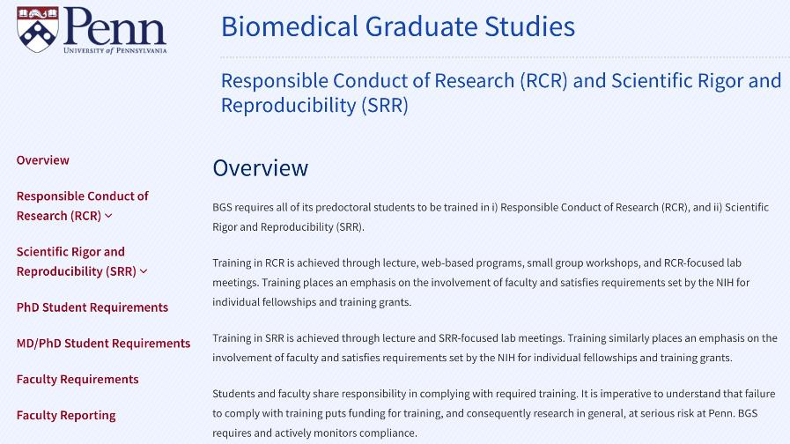
BGS RCR/SRR Website
13
Notes:
https://www.med.upenn.edu/bgs-rcr-exdes/

Slide 14

Training in RCR/SRR
Career-long learning
On-line instruction (Workday)
Workshop-based using case studies
RCR- and SRR-focused lab meetings
14
Notes:
So, with regard to the nuts and bolts of training, know first that NIH requires training of us and other biomedical institutions in RCR and SRR.

Slide 15
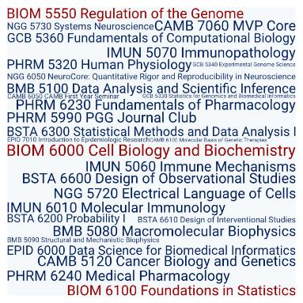
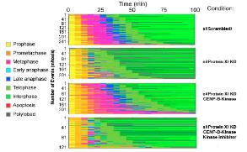
Courses
You will be asked about the experimental basis of knowledge!
Example Exam Question
Given an observation
  describe/interpret data
  formulate a hypothesis
  describe experiments to test the hypothesis
  describe controls
  make predictions
  summarize the results and analysis
  make own conclusions
15
Notes:
In order to design an experiment that effectively adds to current knowledge, it is necessary to understand the current state of knowledge, as well as to have an idea of what the outcome of the experiment will add.

Slide 16
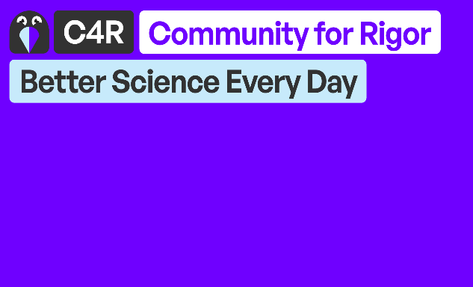

C4R Curriculum
https://c4r.io/
16
Notes:
https://c4r.io/
Community for Rigor is an open-access educational resource network that helps researchers of all kinds learn, practice, and promote scientific rigor.
Find answers to topic-specific questions
Learn how to question “best” practices
Collaborate for positive change
Practice your skills with interactive learning modules
Connect directly with peers for actionable support
Share your knowledge through open-source curriculum

Slide 17
Candidacy Exams
Two years from now you will face your preliminary exam where you will submit and defend a detailed plan about research.
What will you do?
Why will you do it?
Where will you do it?
Who will help you?
How will you do it?
How well do you have to do it?
When will you do it?
How many times will you do it?
How will you interpret the data?
What will happen if you see only a slight difference?
17
Notes:
Once the hypothesis, question, or model is set, you will need to define in depth the path to test the hypothesis, answer the question, or probe the model.
think through the whole process from end-to-end
identify the novel parts, the easy and hard parts
define the key milestones and create a road map
Statistics
Statisticians need this information up front
How to collect
What to control for
Number of data points
What things you will quantify?
Vet experimental details with your PI or some other qualified researcher.

Slide 18
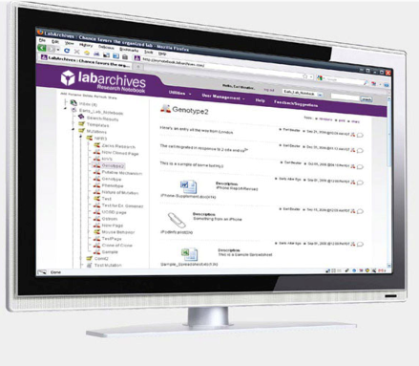

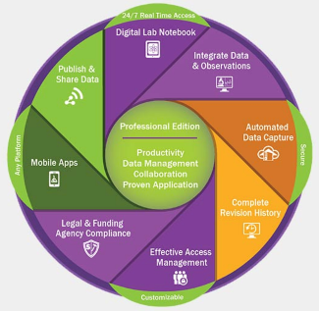
UPENN: LabArchives
- electronic Notebooks -
Also
Benchling
OneNote
No cost!
https://research.upenn.edu/resource/labarchives/
https://research.upenn.edu/support-topic/data-management/
18
Notes:
Institutions have responsibilities they should follow in terms of training and supervision, ethical standards and procedures, and the promotion of open science, particularly with regard to data management, publication, and disseminating study results.
Careful documentation of the experimental set-up is crucial to improving the replicability of experiments.
Is it misconduct if published experiments are not reproducible? No
Reproducibility does not have to do with ensuring the ‘correctnessʼ of results, but rather with ensuring the transparency of exactly how the research was performed.

Slide 19
Laboratory Notebooks
Table of Contents
Indexes
ID #’s for each experiment; link to data files
Storage of reagents
Document each experiment
Daily entries, dated, indelible, readable
Document extensively: omitting data is dishonest
Context: purpose and expectations
Procedure
Include details: lot numbers, expiration dates
“Can another lab person understand the protocol, locate my reagents, and replicate my results without my input?”
Results
Follow best practices for recording and archiving
Discussion/future directions
Let the data speak for itself and avoid improper bias
Authentication
Independent review
Resources/Tools
19
Notes:
Problems:
illegible handwriting; not understandable/poor readability
lack of context
Insufficient detail
Unclear research direction
Can you and others repeat your work or even provide a satisfactory summary after looking at your notebook?
Exercise: ask lab mate/PI to look at notebook and summarize experiment
Authentication by your PI: Review, sign, date
ELNs are searchable, cannot be damaged or misplaced, and are easy to back-up and share with collaborators.
Write while your ideas are fresh. Memories are faulty.
Make raw data openly available so is accessible for reuse and data mining
The lab notebook does not belong to you or even the lab – it is the property of UPenn. It should not be taken off campus without permission. At any time, such as a fraud investigation, legal may confiscate notebooks to evaluate scientific practices.
__________________________________________________________
mcmanuslab.ucsf.edu

Slide 20
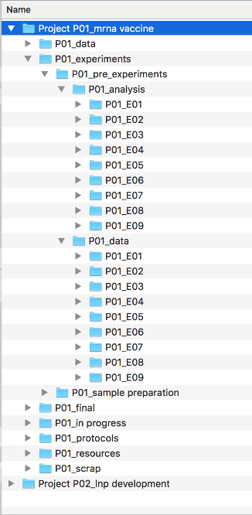
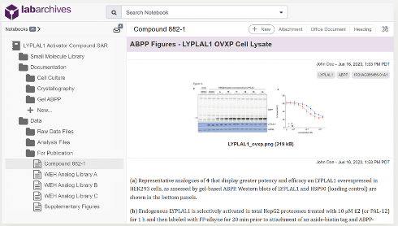
Separate project folders
Numerated folders for each experiment
you should be able to find your research data in seconds
Notes:
An organized notebook validates your findings, defends your claims, avoids fraud, and allows reproducibility.
https://www.calliechappell.com/blog/2020/3/19/lab-notebook
labfolder.com/electronic-lab-notebook-eln-research-guide/
https://www.labarchives.com/

Slide 21
NIH: Data Management and sharing policy (DMSP)
“ALL grant or renewals that generate Scientific Data to include a robust and detailed plan to manage and share data during the funding period”
Plan & Budget for the Management and Sharing of Data
Submit a DMSP for Review when applying for Funding
datasets, imaging files, etc. (not lab notebooks)
Comply with the Approved DMSP
“… reasonable efforts will be made to digitize all scientific data.”
Data Management and Sharing Plan Format
https://www.med.upenn.edu/evdresearch/nih-data-management/
Resources/Tools
21
https://guides.library.upenn.edu/dmp/dmp_penn
Notes:
NIH:
https://sharing.nih.gov/data-management-and-sharing-policy/planning-and-budgeting-for-data-management-and-sharing/writing-a-data-management-and-sharing-plan#elements-to-include-in-a-data-management-and-sharing-plan
Scientific data does not include: laboratory notebooks, preliminary analyses, completed case report forms, drafts of scientific papers, plans for future research, peer reviews, communications with colleagues, or physical objects, such as laboratory specimens.
Examples of DMSPs: https://www.med.upenn.edu/evdresearch/sample-templates.html
https://guides.library.upenn.edu/dmp/dmp_penn
Laboratory Management
Day-to-day reproducibility workflow
Equipment/reagent/protocol standardization with controls
Routinely seek to reproduce a scientific claim/reagent before commencing a research project/experiment
Archive management plan
Organization: Electronic notebooks/documentation
File naming (latest version, location)
Computer codes (versions, settings)
Data analysis workflows
Accessibility/dissemination and sharing by all lab members

Slide 22









DATA MANAGEMENT is NOT SKIPPable
- FAIR Principles -
Large data sets, including all metadata, should be deposited in public repositories so that data is
Bioinformatic analytic pipelines and scripts can be shared via data repositories or computational containers such as Singularity
Findable
Accessible
Interoperable
Reusable
Resources/Tools
22
Notes:
How many times have you found a paper that does exactly the thing you are struggling to do but you go to the methods and you get vague sentences/no code?
Wilkinson MD, Dumontier M, Aalbersberg IJ, Appleton G, Axton M, Baak A, Blomberg N, Boiten JW, da Silva Santos LB, Bourne PE, Bouwman J, Brookes AJ, Clark T, Crosas M, Dillo I, Dumon O, Edmunds S, Evelo CT, Finkers R, Gonzalez-Beltran A, Gray AJ, Groth P, Goble C, Grethe JS, Heringa J, 't Hoen PA, Hooft R, Kuhn T, Kok R, Kok J, Lusher SJ, Martone ME, Mons A, Packer AL, Persson B, Rocca-Serra P, Roos M, van Schaik R, Sansone SA, Schultes E, Sengstag T, Slater T, Strawn G, Swertz MA, Thompson M, van der Lei J, van Mulligen E, Velterop J, Waagmeester A, Wittenburg P, Wolstencroft K, Zhao J, Mons B. The FAIR Guiding Principles for scientific data management and stewardship. Sci Data. 2016 Mar 15;3:160018. doi: 10.1038/sdata.2016.18. Erratum in: Sci Data. 2019 Mar 19;6(1):6. PMID: 26978244; PMCID: PMC4792175.
Making raw data openly available is not only important for reuse and data mining.
Authors should list and cite all programs used, including version numbers, DOI’s, and parameters.
Make data FAIR (that is, findable, accessible, interoperable and reusable).
https://fairsharing.org
https://www.go-fair.org/fair-principles/
Providing a program as a pre-compiled binary or R/Python package
“Using tools that are designed to support reproducible research, such as R Markdown, package management systems including Conda, or executable notebooks such as Jupyter, when conducting
computational studies can substantially ease the amount of further work required to make code shareable.”
Code deposition is unskippable. Nat Genet 55, 723 (2023). https://doi.org/10.1038/s41588-023-01411-0
https://marimo.io/

Slide 23
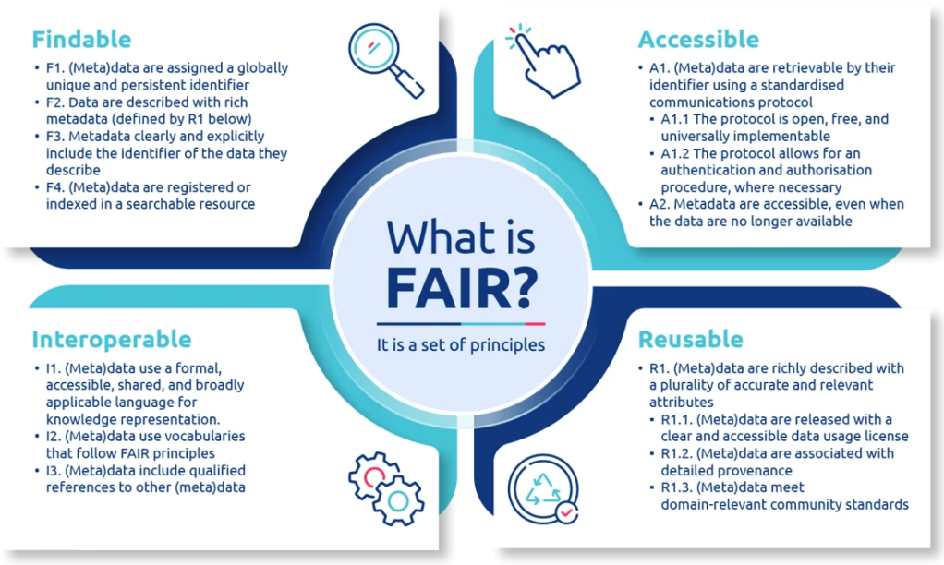
23
Notes:
Make data FAIR (that is, findable, accessible, interoperable and reusable).
https://fairsharing.org
https://www.go-fair.org/fair-principles/
https://datavid.com/blog/data-centricity-and-fair

Slide 24
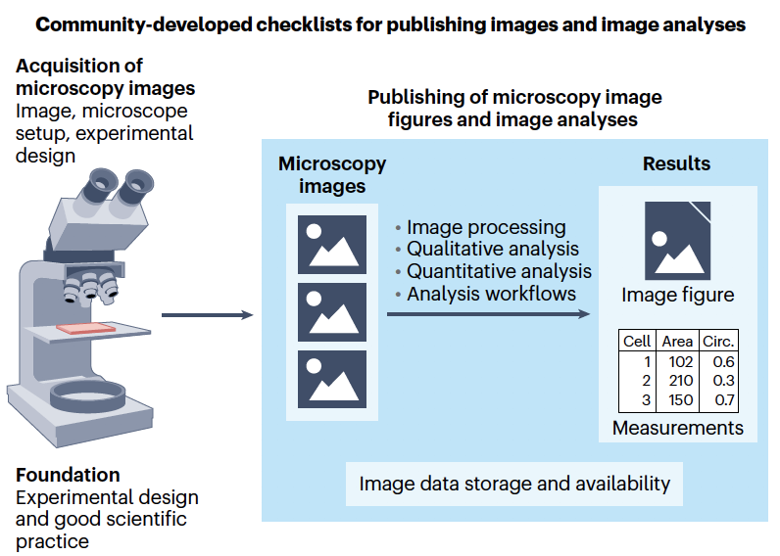
Publishing Images and Image analyses
24
Notes:
Schmied, C., Nelson, M.S., Avilov, S. et al. Community-developed checklists for publishing images and image analyses. Nat Methods 21, 170–181 (2024). https://doi.org/10.1038/s41592-023-01987-9
Jambor HK. A checklist for designing and improving the visualization of scientific data. Nat Cell Biol. 2025 Jun;27(6):879-883. doi: 10.1038/s41556-025-01684-z. PMID: 40514429.

Slide 25
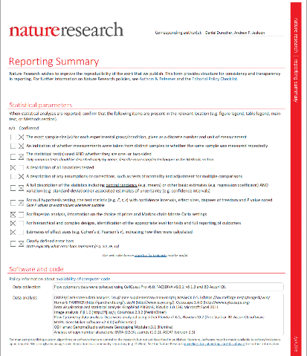
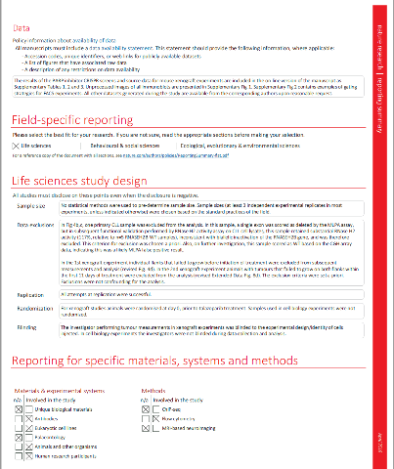
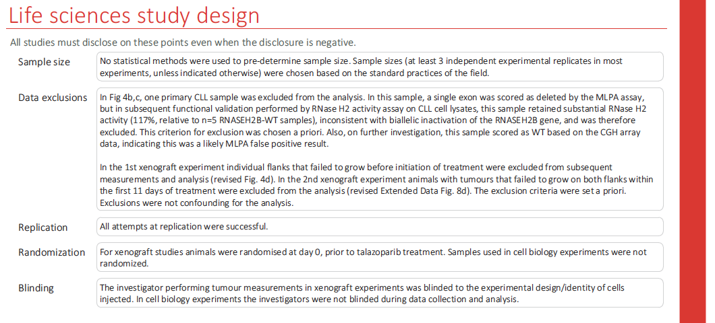
Publication: Reporting
- Summary Forms -
Resources/Tools
25
Notes:
Zimmermann M, Murina O, Reijns MAM, Agathanggelou A, Challis R, Tarnauskaitė Ž, Muir M, Fluteau A, Aregger M, McEwan A, Yuan W, Clarke M, Lambros MB, Paneesha S, Moss P, Chandrashekhar M, Angers S, Moffat J, Brunton VG, Hart T, de Bono J, Stankovic T, Jackson AP, Durocher D. CRISPR screens identify genomic ribonucleotides as a source of PARP-trapping lesions. Nature. 2018 Jul;559(7713):285-289. doi: 10.1038/s41586-018-0291-z. Epub 2018 Jul 4. PMID: 29973717; PMCID: PMC6071917.
It is likely necessary to check the checklist in the experimental design phase - before the experiment is conducted – so that criteria necessary for publication in that journal are met.

Slide 26
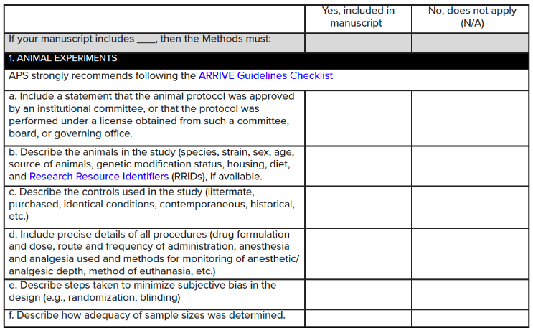
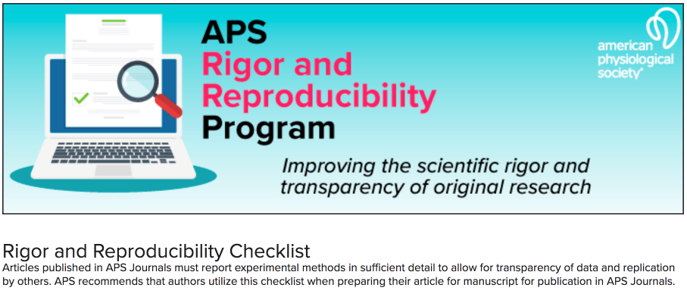
Journal Checklists
Resources/Tools
26
Notes:
https://journals.physiology.org/pb-assets/PDFs/APS_Rigor-Reproducibility-Guidelines-1620307615793.pdf

Slide 27
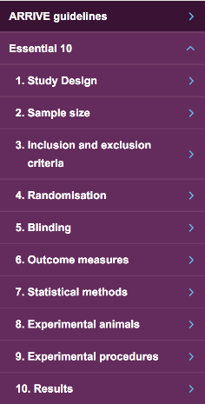

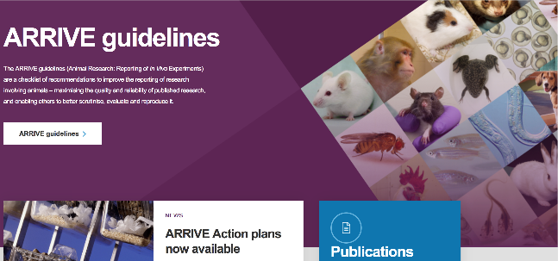
ARRIVE GUIDELINES FOR
ANIMAL RESEACH
Resources/Tools
https://arriveguidelines.org/
27
Notes:
Kilkenny C, Browne WJ, Cuthill IC, Emerson M, Altman DG. Improving bioscience research reporting: The ARRIVE guidelines for reporting animal research. J Pharmacol Pharmacother. 2010 Jul;1(2):94-9. doi: 10.4103/0976-500X.72351. PMID: 21350617; PMCID: PMC3043335.
Percie du Sert N, Hurst V, Ahluwalia A, Alam S, Avey MT, Baker M, Browne WJ, Clark A, Cuthill IC, Dirnagl U, Emerson M, Garner P, Holgate ST, Howells DW, Karp NA, Lazic SE, Lidster K, MacCallum CJ, Macleod M, Pearl EJ, Petersen OH, Rawle F, Reynolds P, Rooney K, Sena ES, Silberberg SD, Steckler T, Würbel H. The ARRIVE guidelines 2.0: Updated guidelines for reporting animal research. PLoS Biol. 2020 Jul 14;18(7):e3000410. doi: 10.1371/journal.pbio.3000410. PMID: 32663219; PMCID: PMC7360023.
Also PREPARE (Planning Research and Experimental Procedures on Animals) checklist
Smith AJ, Clutton RE, Lilley E, Hansen KEA, Brattelid T. PREPARE: guidelines for planning animal research and testing. Lab Anim. 2018 Apr;52(2):135-141. doi: 10.1177/0023677217724823. Epub 2017 Aug 3. PMID: 28771074; PMCID: PMC5862319.
https://norecopa.no/prepare

Slide 28
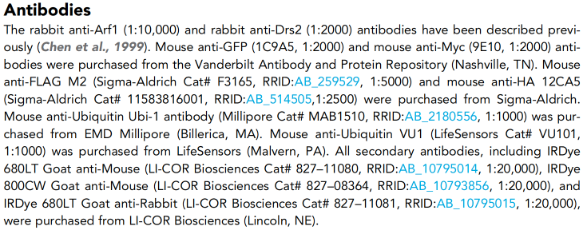
Research Resource Identifiers (RRIDs)
Metadata for cell lines, plasmids, and antibodies to avoid misidentification:
eLife typesets the RRIDs with live links
System Validation
https://www.rrids.org/
28
Notes:
Similar to your ORCiD, a digital ID for researchers that distinguishes you from every other researcher.
From:
Xu P, Hankins HM, MacDonald C, et al. COPI mediates recycling of an exocytic SNARE by recognition of a ubiquitin sorting signal. elife. 2017;6:1–22. eLife 2017;6:e28342
Examples:
“Tissue sections were washed (3x) and placed in PBS containing the following: 1% (vol/vol) normal goat serum, 1% (vol/vol) BSA, 0.25% (vol/vol) Triton X-100, and mouse monoclonal anti-5.8S rRNA, clone Y10b at 1:500 (Abcam, ab37144, RRID: AB_777714) overnight at 4 ºC.”
“The constructions were prepared using the vector pSpCas9(BB)-2A-Puro (PX459) V2.0, which was a gift from Feng Zhang (Addgene plasmid #62988; RRID: Addgene_62988).”

Slide 29

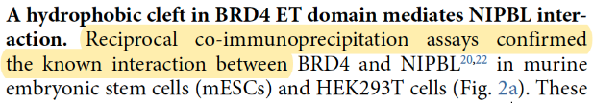
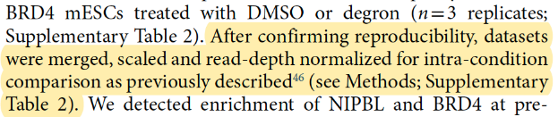

Write “SRR-Y” to support data quality
SRR and You
Linares-Saldana R, et al Nat Genet. 2021 Oct;53(10):1480-1492
29
Notes:
Don’t be shy about emphasizing your efforts to reproduce other work.
“We confirmed efficient, tissue-specific deletion… “
”Reciprocal co-immunoprecipitation assays confirmed the known interaction … “
“After confirming reproducibility, datasets were merged and normalized … “
“After confirming data quality and reproducibility … “
Linares-Saldana R, Kim W, Bolar NA, Zhang H, Koch-Bojalad BA, Yoon S, Shah PP, Karnay A, Park DS, Luppino JM, Nguyen SC, Padmanabhan A, Smith CL, Poleshko A, Wang Q, Li L, Srivastava D, Vahedi G, Eom GH, Blobel GA, Joyce EF, Jain R. BRD4 orchestrates genome folding to promote neural crest differentiation. Nat Genet. 2021 Oct;53(10):1480-1492. doi: 10.1038/s41588-021-00934-8. Epub 2021 Oct 5. Erratum in: Nat Genet. 2021 Nov 1;: PMID: 34611363; PMCID: PMC8500624.
Examples:
“Animals were assigned to experimental groups using simple randomization.”
“Responses were then scored by an experimenter blinded to injection condition and experimental cohort.”
“Sample size was based on estimations by power analysis with a level of significance of 0.05 and a power of 0.9.”
“Six healthy C57BL/6 mice (20-30 g, three males and three females, 4–8 months old) were treated.”
“Cells were authenticated by short tandem repeat (STR) profiling and flow cytometry.”
“All cell lines were obtained from ATCC and tested negative for mycoplasma contamination.”
“Slices were then washed (3x) and placed in PBS containing the following: 1% (vol/vol) normal goat serum, 1% (vol/vol) BSA, 0.25% (vol/vol) Triton X-100, and mouse monoclonal anti-5.8S rRNA, clone Y10b at 1:500 (Abcam, ab37144, RRID: AB_777714) overnight at 4 ºC.”
“The constructions were prepared using the vector pSpCas9(BB)-2A-Puro (PX459) V2.0, which was a gift from Feng Zhang (Addgene plasmid #62988; RRID: Addgene_62988).”
Menke J, Roelandse M, Ozyurt B, Martone M, Bandrowski A. The Rigor and Transparency Index Quality Metric for Assessing Biological and Medical Science Methods. iScience. 2020 Oct 20;23(11):101698. doi: 10.1016/j.isci.2020.101698. PMID: 33196023; PMCID: PMC7644557.

Slide 30
Write “SRR-Y” to support data quality
“Cells were authenticated by short tandem repeat (STR) profiling and flow cytometry.”
“All cell lines were obtained from ATCC and tested negative for mycoplasma contamination before and after the experiment.”
“Cells in tissue culture dishes were treated and processed by the experimenter who was blinded to sample identity until data collection and analysis was complete.”
“Sample size was based on estimations by power analysis with a level of significance of 0.05 and a power of 0.9.”
“Mice were randomly assigned into one of three groups using a table of random numbers.”
“Six healthy C57BL/6 mice (20-30 g, three males and three females, 4–8 months old) were treated.”
SRR and You
30
Notes:
Don’t be shy about emphasizing your efforts to validate your experimental system.
International Cell Line Authentication Committee (ICLAC)
http://www.dsmz.de/fileadmin/Bereiche/HumanandAnimalCellLines/Cross_Contaminations_v7_1.pdf
http://iclac.org/databases/cross-contaminations/
Cellosaurus database
https://web.expasy.org/cellosaurus/
Capes-Davis, A., Theodosopoulos, G., Atkin, H., Kohara, A., MacLeod, R., Masters, J., Nakamura, Y., Reid, Y., Reddel, R., and Freshney, R. (2010). Check your cultures! A list of cross-contaminated or misidentified cell lines. Int. J. Cancer 127, 1–8.
Authentication of cell lines is usually accomplished by sequencing methods or short tandem repeat (STR) profiling. This procedure is recommended at the outset of the experiment, at the conclusion of the experiment, and at a random time during the experiment.
Antibodypedia: A database documenting antibodies that have been validated.
https://www.antibodypedia.com/
Resources for Rigor & Reproducibility: A comprehensive list of antibody validation (and cell line authentication) resources from the Brown University Library.
https://libguides.brown.edu/reproducibility/validation
Weller M. Ten basic rules of antibody validation. Anal. Chem Insights. 13 (2018).
Statistical Power
Statistical power is the probability that a study yields a statistically significant effect, if there is a true effect to be found (Lakens D. On the challenges of drawing conclusions from p-values just below 0.05. PeerJ. 2015 Jul 30;3:e1142. doi: 10.7717/peerj.1142. PMID: 26246976; PMCID: PMC4525697.)
Performed prior to a study using an estimation of the size of the effect being measured (small, medium, or large) and the desired power level, power analyses determine the required sample number in each group.
If there is no a priori power-based determinant of the sample size, conditions are primed for determining sufficient sample size along the way, generally after looking at iterations of results as the sample size increases (i.e., “optional stopping”)
Backward: viewing statistical significance as proof of sufficient power when, in fact, low power increases the likelihood of observing statistical significance
A power of 0.9 means that a true positive effect (correct rejection of the null hypothesis) would be detected 90% of the time if a study were repeated using the same conditions (0.8-0.95 is generally considered desirable)
Power Analysis:
performed using a statistical software package
G*power (https://stats.oarc.ucla.edu/other/gpower/)
s-quest.bihealth.org/power_replication/

Slide 31
Write “SRR-Y” to support data quality
“The results are robust to alternative fitting methods and various binning schemes, and similar to the exponent of the corresponding cumulative distribution function, which avoids binning data into size classes.”
“We build a hierarchical interface (https://....) giving easy access to data, methods, and sources.”
Avoid surprising reviewers:
reveal weaknesses in study
be transparent about types of error
indicate where data is “coarse”
provide upper and lower bounds
SRR and You
31
Notes:
Hatton IA, Galbraith ED, Merleau NSC, Miettinen TP, Smith BM, Shander JA. The human cell count and size distribution. Proc Natl Acad Sci U S A. 2023 Sep 26;120(39):e2303077120. doi: 10.1073/pnas.2303077120. Epub 2023 Sep 18. PMID: 37722043; PMCID: PMC10523466.

Slide 32
A Good experimentalist…
Designs non-biased, effective experiments using a well-conceived plan
Produces results with
-high reproducibility
-high predictive value
… IS aware of and AVOIDs traps
Key concepts:
Parameters defined PRIOR to experimentation
Quality controls
AVOID biases and inappropriate data filters
32

Slide 33
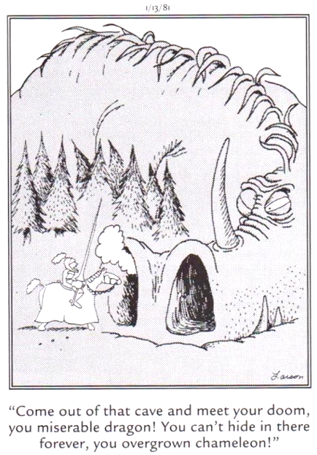
Be aware: Opportunities for deception are plentiful.
Your expectations can influence what you see.
It is easy to be fooled!
Good experimentalists are aware of these traps.
Far Side, Gary Larson
33

Slide 34
What’s in it for you?
Promotes experimental quality
learn something new every experiment
Facilitates reproducibility
others will build on your research
Avoids bias
keeps you following the evidence to learn something new
Saves time, resources, and avoids frustration
mainly yours
34
Notes:
SRR – What’s in it for you
Promotes experimental quality: learn something new every experiment
Facilitates reproducibility
Avoids bias
Saves time, resources, and avoids frustration (mainly yours)

Slide 35
SRR TAKEAWAYS
If your work comes under scrutiny, you want to be the
First to Fix
Be the first to address or take the lead in addressing
35
Notes:
Is it misconduct if published experiments are not reproducible?
No, but …
if it is your work that is not reproducible, you want to be the first to address or take the lead in addressing.
Reproducibility does not have to do with ensuring the ‘correctnessʼ of results, but rather with ensuring the transparency of exactly how the research was performed.

Slide 36
Experimental design…
requires a detailed plan and sticking to it!
How EXACTLY is the experiment performed?
What EXACTLY is measured?
What EXACTLY will you learn?
Details are critical and we want to hear them!
36
Notes:
Statements can be vague and provoke misunderstandings.
Example: is there a difference between “transcription factor X activates the expression of gene Y” and “transcription factor X promotes the expression of gene Y”? Mathematical equations provide clarity over language descriptions.

Slide 37
Scenario
You submit a manuscript for publication to a prestigious journal. The editor replies with a request for you to supply the raw data* supporting your results as a pre-requisite for review.
Would you be able to comply with confidence that re-analysis of the raw data will confirm your original conclusions?
*All quantified numerical data for each sample used for statistical analyses, raw microscopy data, the images for entire membranes of immunoblots with size markers, data bases, code, etc.
37
Notes:
Or will you do what many authors did when confronted with this request: they submitted to another journal.
Careful documentation of the experimental set-up is crucial to improving the replicability of experiments.
Is your data in a format that can be forwarded to another scientist and interpreted?
Is the data record complete enough for another scientist to confirm your conclusions?

Slide 38
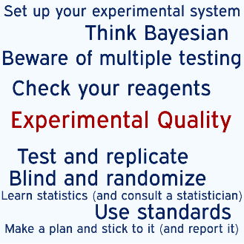
Science Delivers!
Perform Experiments!
Give the data the final word!
38
Notes:
Science is in the business of learning from its mistakes.
Science course-corrects as new insights are gained and as old theories are overturned. And despite the important debates about research integrity, reproducibility, robustness and the factors that can pull against good practice in these times of scarce funding, the system and the culture of science delivers. Knowledge is advanced, new medicines are made, human suffering is reduced.
Self-correcting
United in the spirit of inquiry
Importance of being open about methods, data and mistakes

Slide 39
Ready, Set, Experiment!
New Student Welcome and Orientation
2024
Kurt A. Engleka (Ingelkay, hard “g”) (he/him)
Adjunct Assistant Professor, Cell & Dev Biol
Director of Curriculum, BGS
kengleka@pennmedicine.upenn.edu
orcid.org/0000-0001-5539-4076
Notes:
I will briefly talk to you today about the importance of the theory and practice guiding the design of experiments. This session represents our first steps in providing intellectual and physical resources that will help you plan and perform the best experiments you can, pursuing science at the highest level, that yield results that you and others can reliably build upon to discover something new. At least within the limits of time, money, energy, encouragement and thought at your disposal.
It is a little overwhelming to singularly stand here in front of all the talent in these seats. I sense your eagerness to be unleashed into the labs to conduct experiments. Think of how many different types of experiments and accompanying bytes of data you are about to bring into existence! Consider, though, that effective experiments, even seemingly simple ones, require a well-conceived plan PRIOR to the actual conducting of the experiment. How EXACTLY is the experiment performed? What EXACTLY is measured? What EXACTLY will you learn? A good experimentalist answers such questions BEFORE the actual conducting of the experiment. This is why we are introducing experimental design during orientation, so it is at the forefront before you begin experiments in the labs.
“Are you ready to perform experiments at Penn!” You are fortunate to be in an institution where you can do almost any experiment you want.
“What kind of data are you going to produce? Is the data from an experiment that was the best experiment you could perform under the circumstances? Is the data reproducible by you and others? Is it predictive so that you and others can build upon the results?”

Slide 40
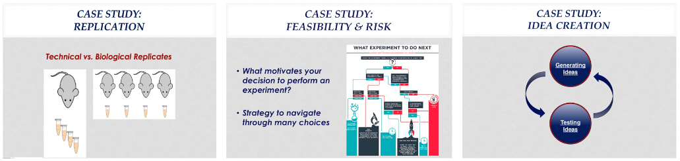
Case studies
Replication
Feasibility and risk
Idea Creation
40
Notes:
The case studies are starting points for discussion. There are no right/wrong answers.

Slide 41
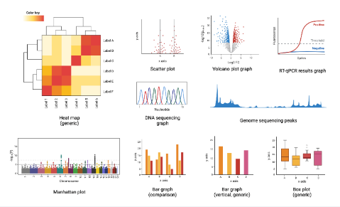
Small Groups
See Canvas or me for your small group number and location.
Groups 1-5 BRB 252
Groups 6-14 BRB Lobby
Groups 15-17 BRB Aud
Groups 18-19 BRB 253
Group 20 BRB Aud (front)
Spillover BRB Auditorium
Have fun!
41

Slide 42
42

