Slide 1
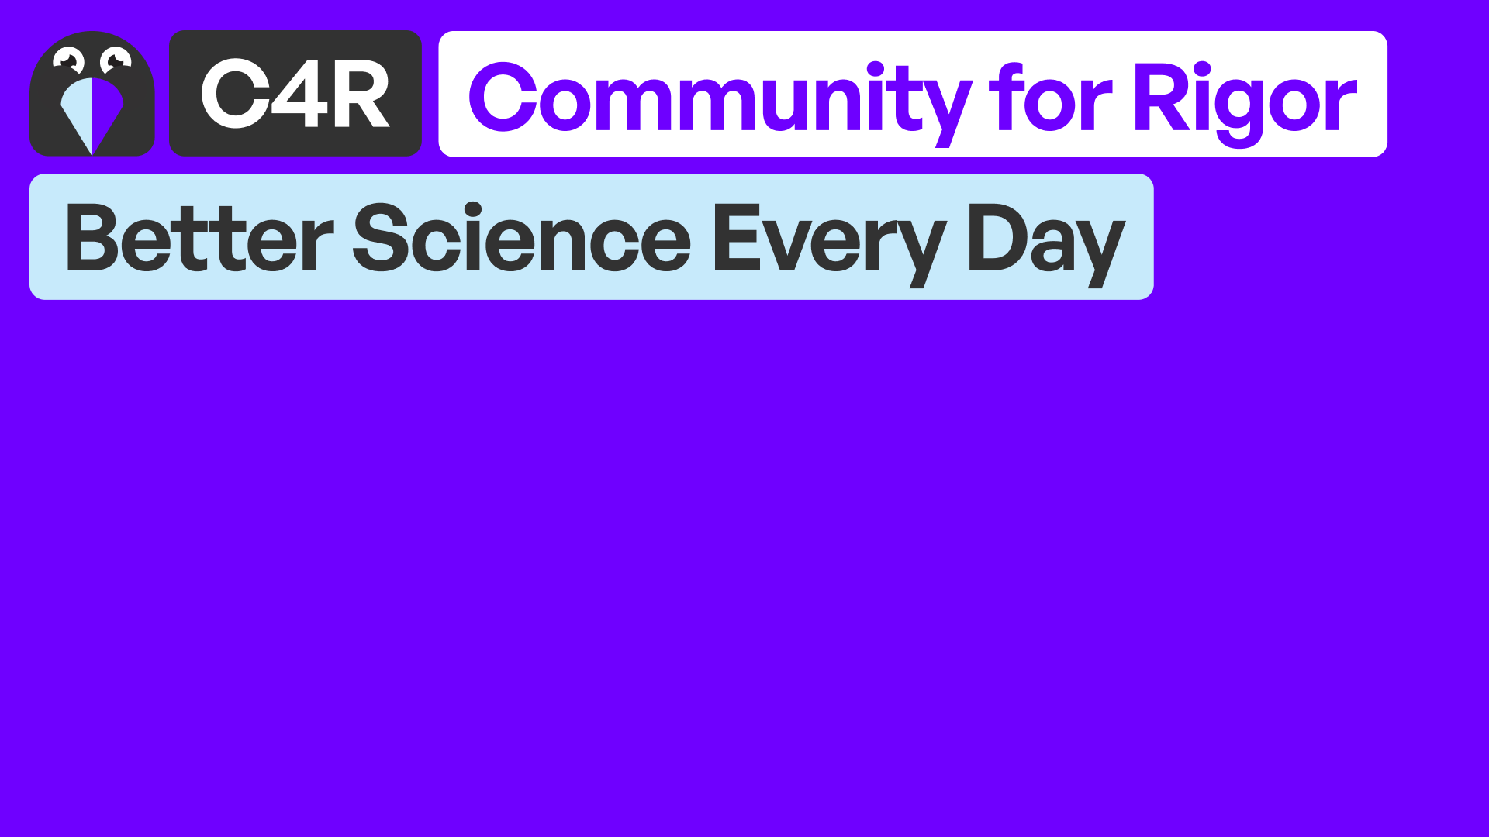
University of Pennsylvania
BGS Orientation
August 2025

Slide 2
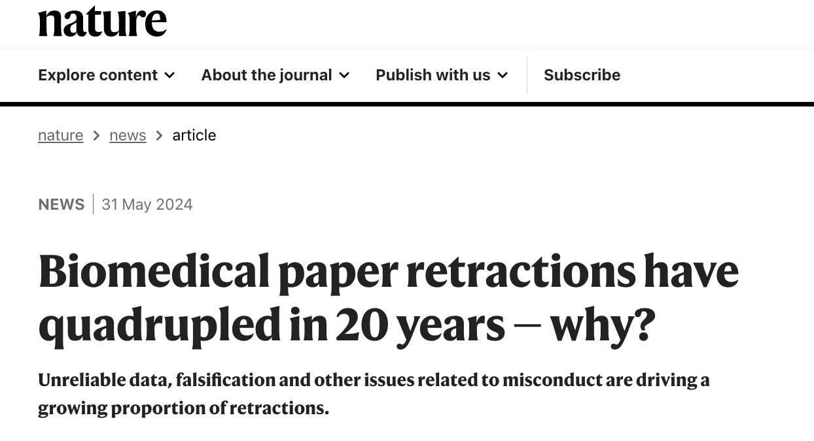


Why?
Because issues like lack of reproducibility, retractions, misconduct, and unreliable data are affecting science more than ever.

Slide 3

Who we are and what we do
New Center at Penn, funded and supported by the NIH-NINDS.
Two main components:
Online curriculum +
Global Community.

Slide 4
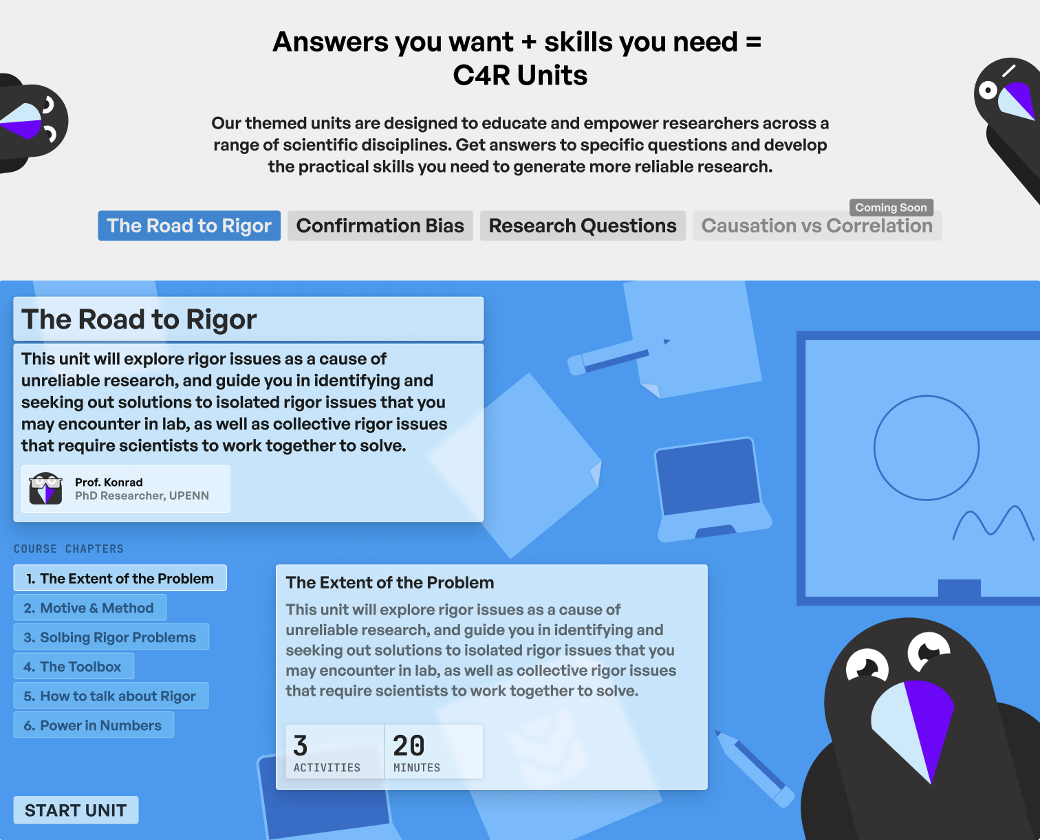
Who we are and what we do
Interactive lessons in research rigor and reproducibility
Acquire the skills everyone assumes you already have
Get the help you need to do better experimental design
Free, online, and open source

Slide 5
Rigor Topics: An Evolving Curriculum
Responsible use of Large Language Models (LLMs)
Improve your research rigor with randomization
Setting exclusion criteria in lab experiments
Causation versus correlation
How to design a good laboratory experiment: Importance of controls
Writing readable & correct scientific code
Detecting errors in your analyses
Stop fooling yourself! Diagnosing and treating confirmation bias
Formulating a valid research question
Executing structured searches of the literature
Sample Size - How much data is enough for your experiment?
Evaluate your evaluation methods! A key to meaningful inference.
Reproducible exploratory analysis: Mitigating multiplicity when mining data
Identifying rigor red flags in research reports
Effective data visualization for research communication
Transparent data sharing to advance discovery
Defining and distinguishing between hypothesis generating and hypothesis testing research
Transparency and accuracy in reporting study findings
The perils of outcome switching
Publication bias

Slide 6



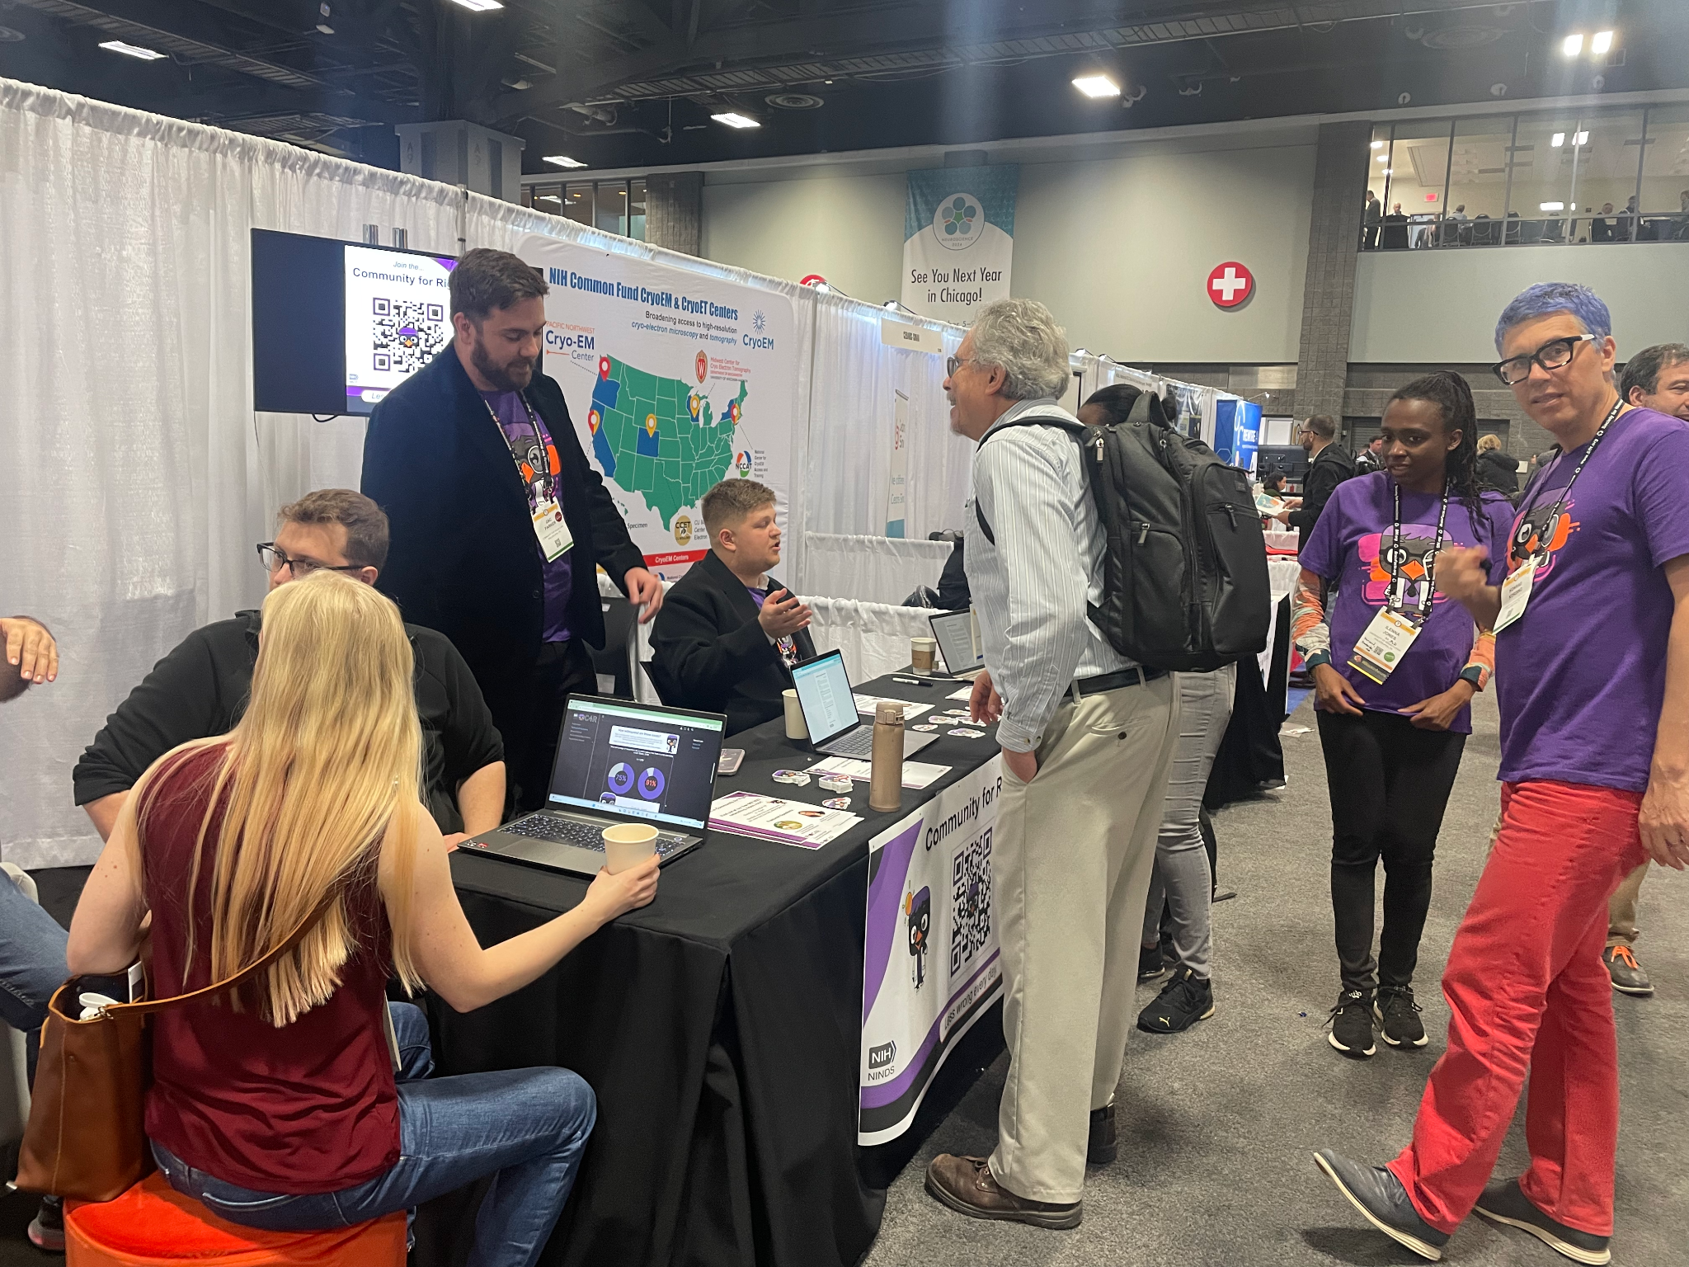
Events: Online and In-Person

Slide 7
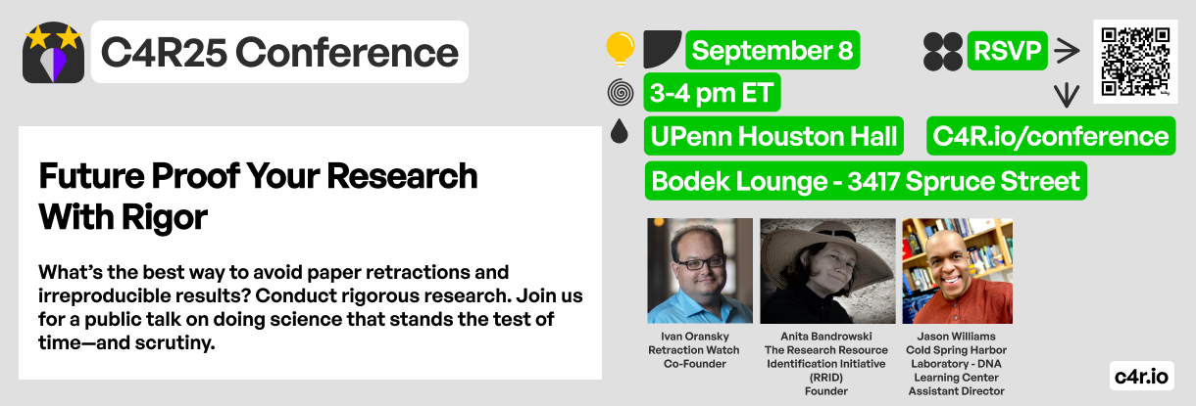
September 8-10 | Philadelphia, PA

Slide 8
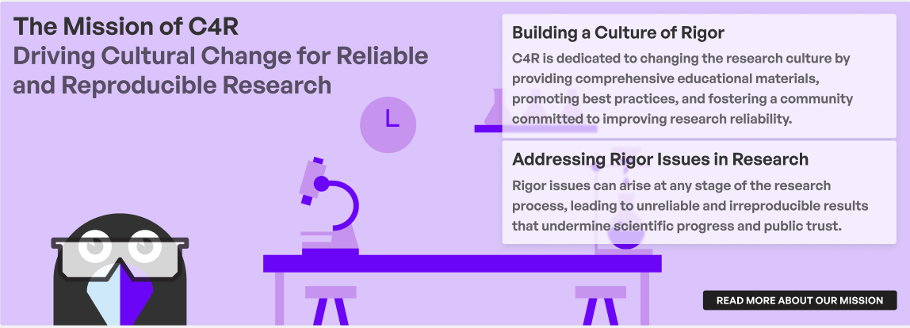
What sets C4R Apart?
What sets C4R apart?
Backed by the NIH/NINDS
Modular and adaptable
Open-source materials
Boilerplate solutions
Behavior & culture change
Global community
Fun and engaging platform

Slide 9
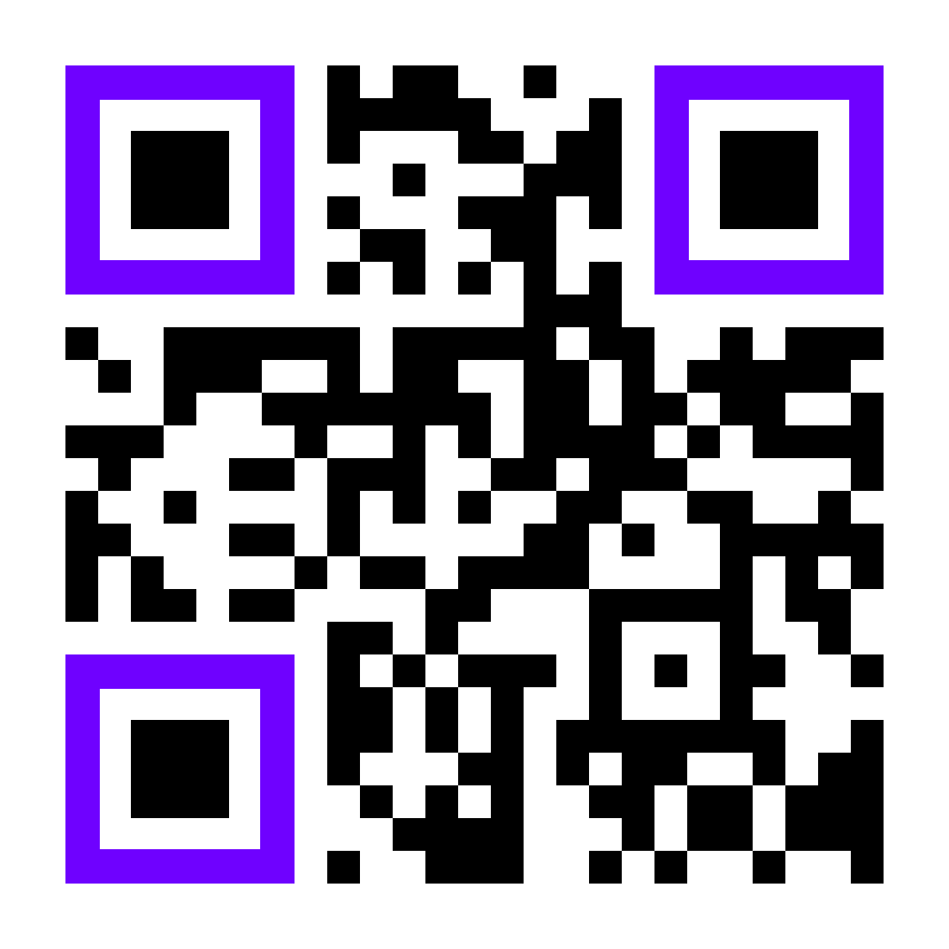
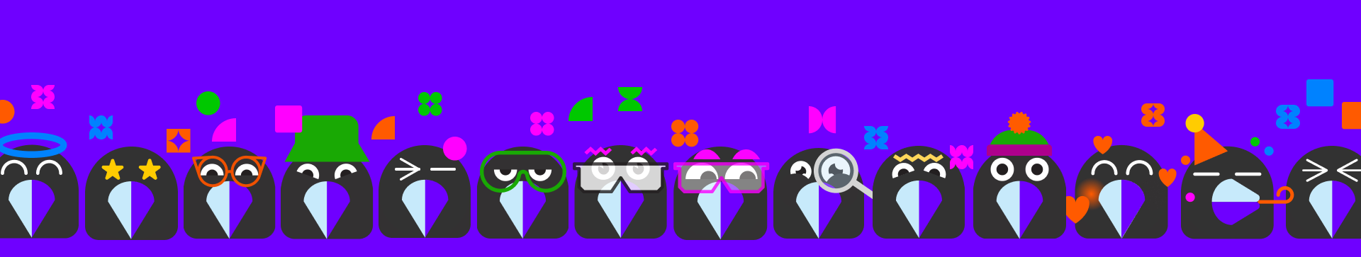
Join the Community for Rigor @
www.c4r.io

Slide 10
Thank you!
Carolina García: carogar@seas.upenn.edu Zac Parker: ztp@seas.upenn.edu

