Slide 1
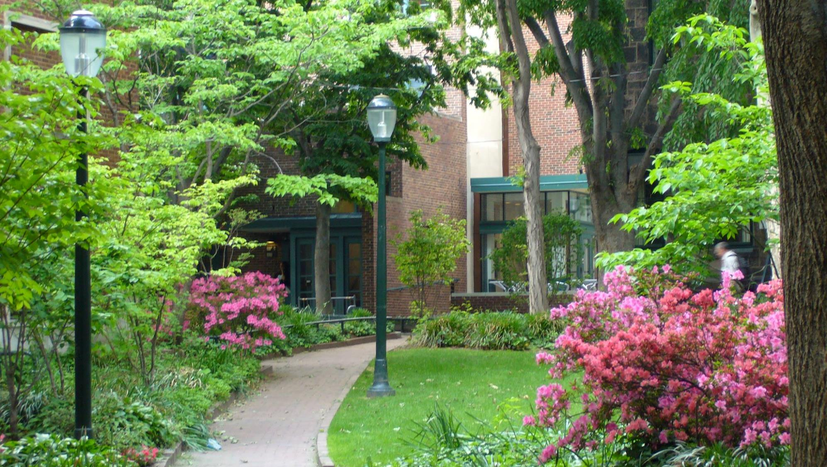
Graduate Student Center

Slide 2
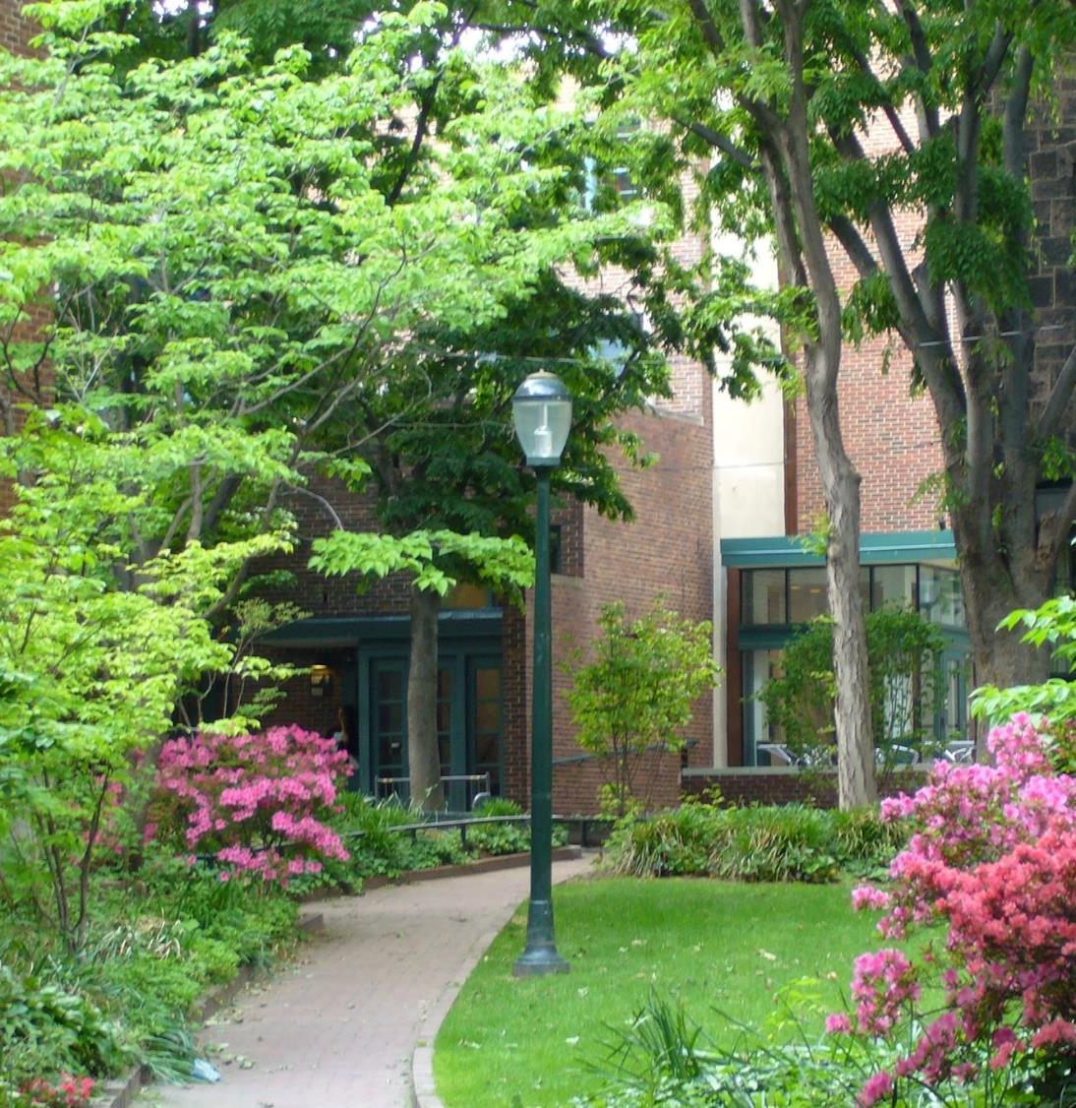

Central hub for resources, activities, support, & advocacy for all graduate and professional students
Range of social, academic, and personal enrichment programs
Individual advising & resource referrals
Space in the heart of campus for graduate students to relax and connect

Slide 3
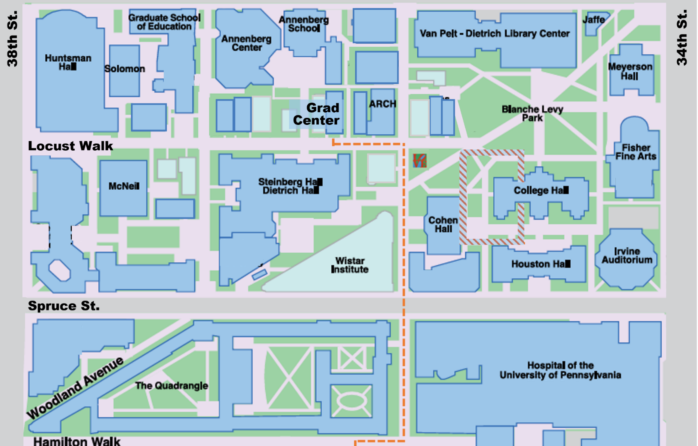
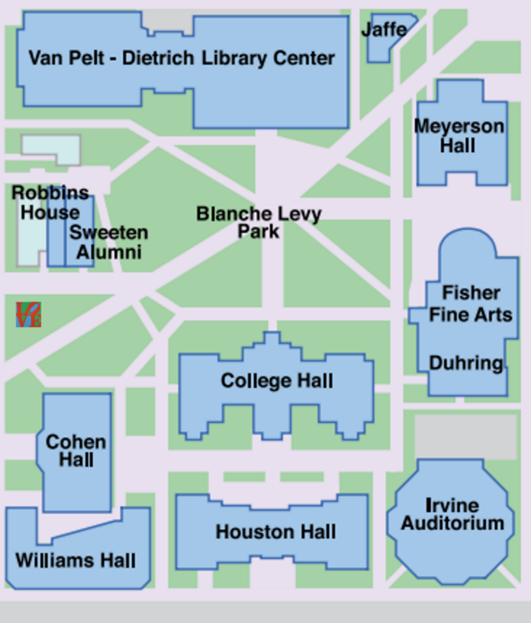

Slide 4
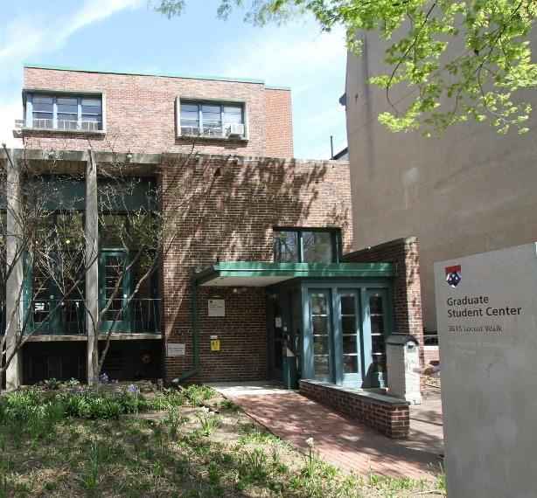
Grad Center Spaces
Outdoor terrace
Student lounge
  Free coffee & tea! BYOMug
Study & meeting rooms
Game Room
Support Services Office
Family Center (Lower Level)

Slide 5
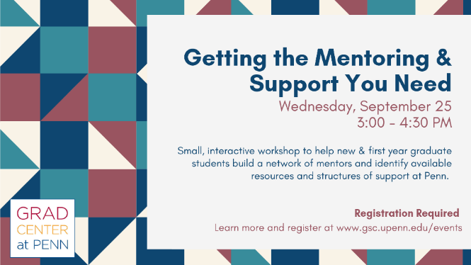
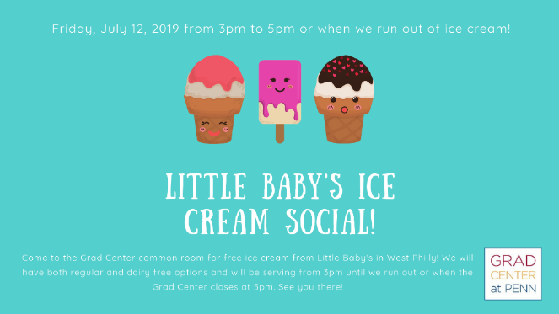
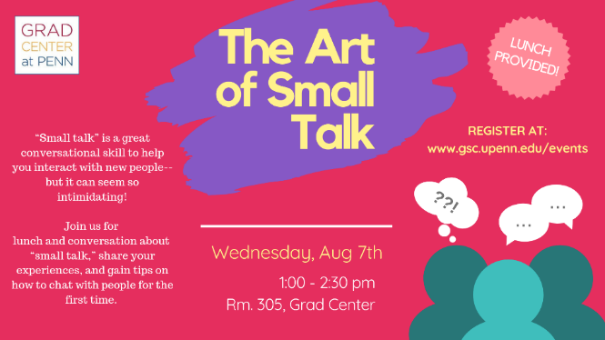


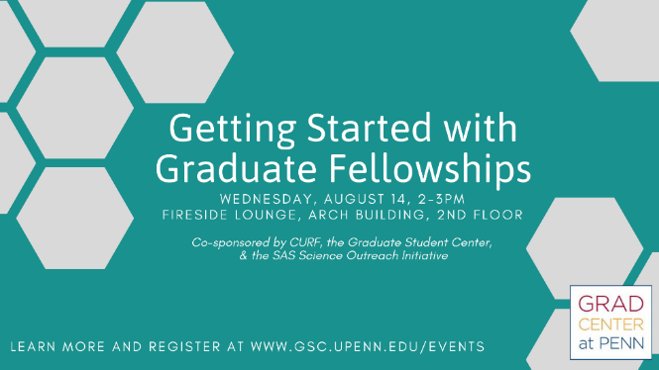
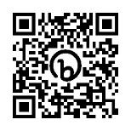
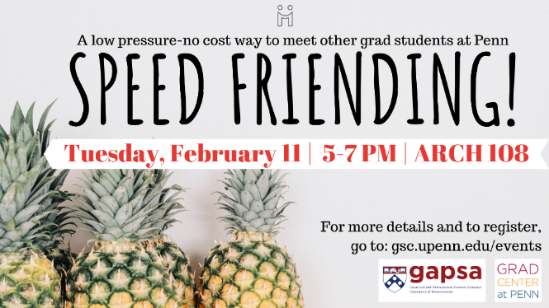
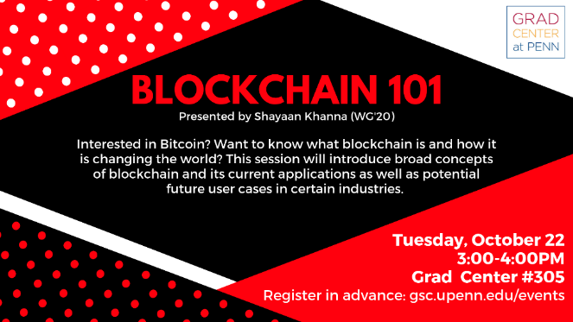
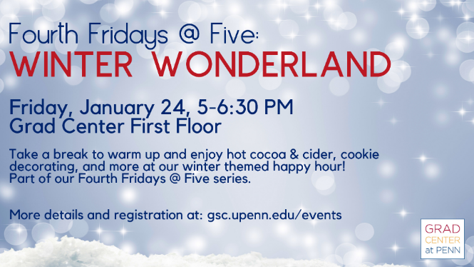
200+ programs each year

Slide 6
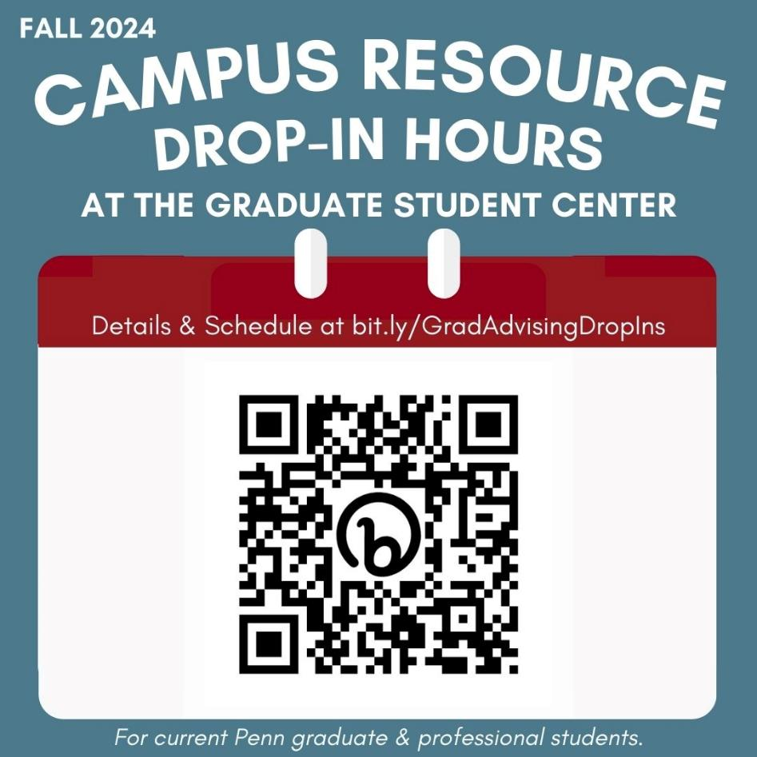
Advising & Support
Grad Center Team
  Help with navigating university resources, policies, and other aspects of the graduate experience at Penn
  Student organization advising
Campus Resource Drop-In Hours
  Fall hours include:
  Let’s Talk (Wellness)
  Financial Wellness Peer Counseling
  Weingarten Writing & Learning Consultations
  NSF GRFP Application Feedback
  & more

Slide 7
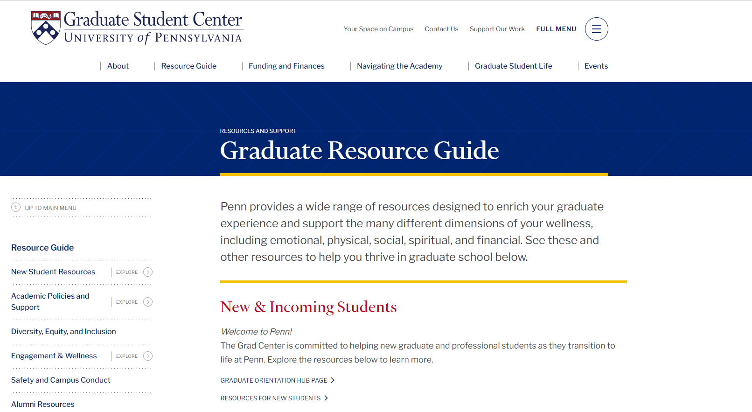
Tailored information for
New Students
International Students
Students with Children
Teaching Assistants
Research Students
. . . and more!

Slide 8
Graduate Grants Office
Coordinates with partners to administer individual graduate student grants funded through the General Fee, as well as selected need- and merit-based grants funded through the Office of the Provost.
Programs include:
www.gsc.upenn.edu/graduate-grants
Provost Sponsored Grants
  Graduate Emergency Fund
  PhD Family Grants
  PhD Individual & Dependent Health Insurance Grants
  PhD Supplemental Insurance Grants
Student Gov Supported Grants
  GAPSA Travel Grants
  GSESG Travel Grants
  Nursing DSO Travel & Research Grants
  SASGov Research Travel Grants

Slide 9
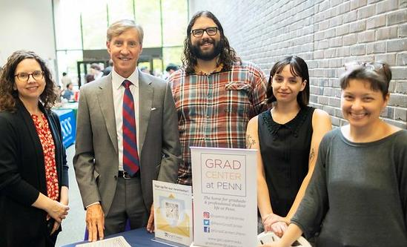
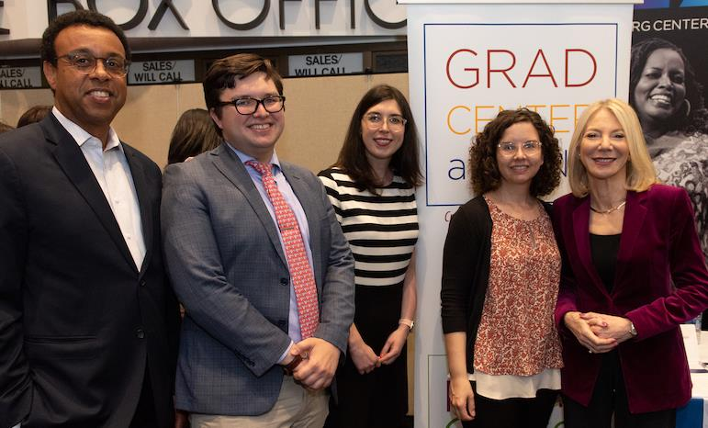
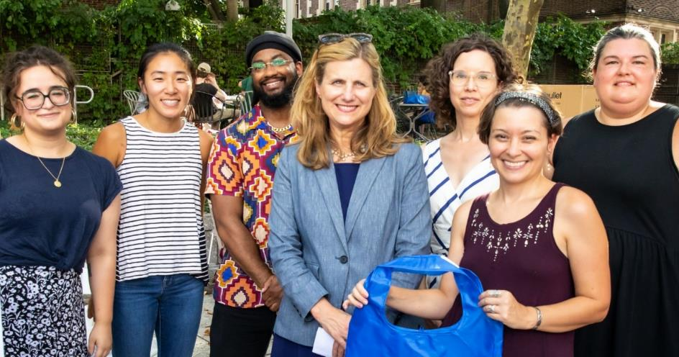
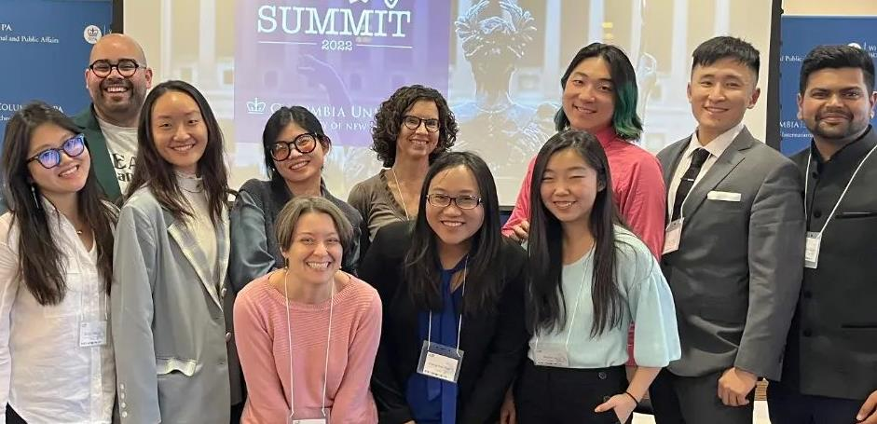

Slide 10
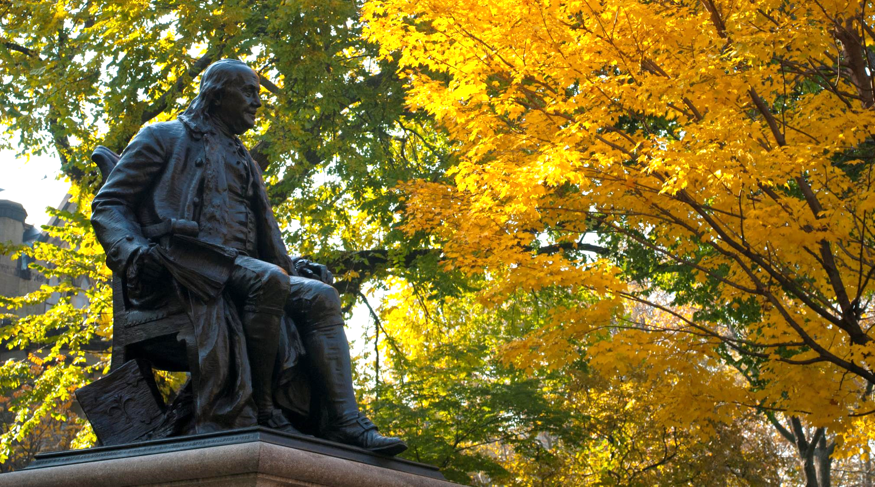


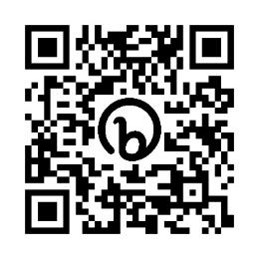
Connect with Us
www.gsc.upenn.edu
gradcenter@upenn.edu
www.gsc.upenn.edu/newsletter
upenn.gradcenter
PennGradCenter
Grad Center Events

