Slide 1
Kristy Shuda McGuire, M.S., Ph.D.
Dean of Biomedical Studies
Associate Director, Cancer Research Training and Education Coordination (CRTEC)
https://www.wistar.org

Slide 2
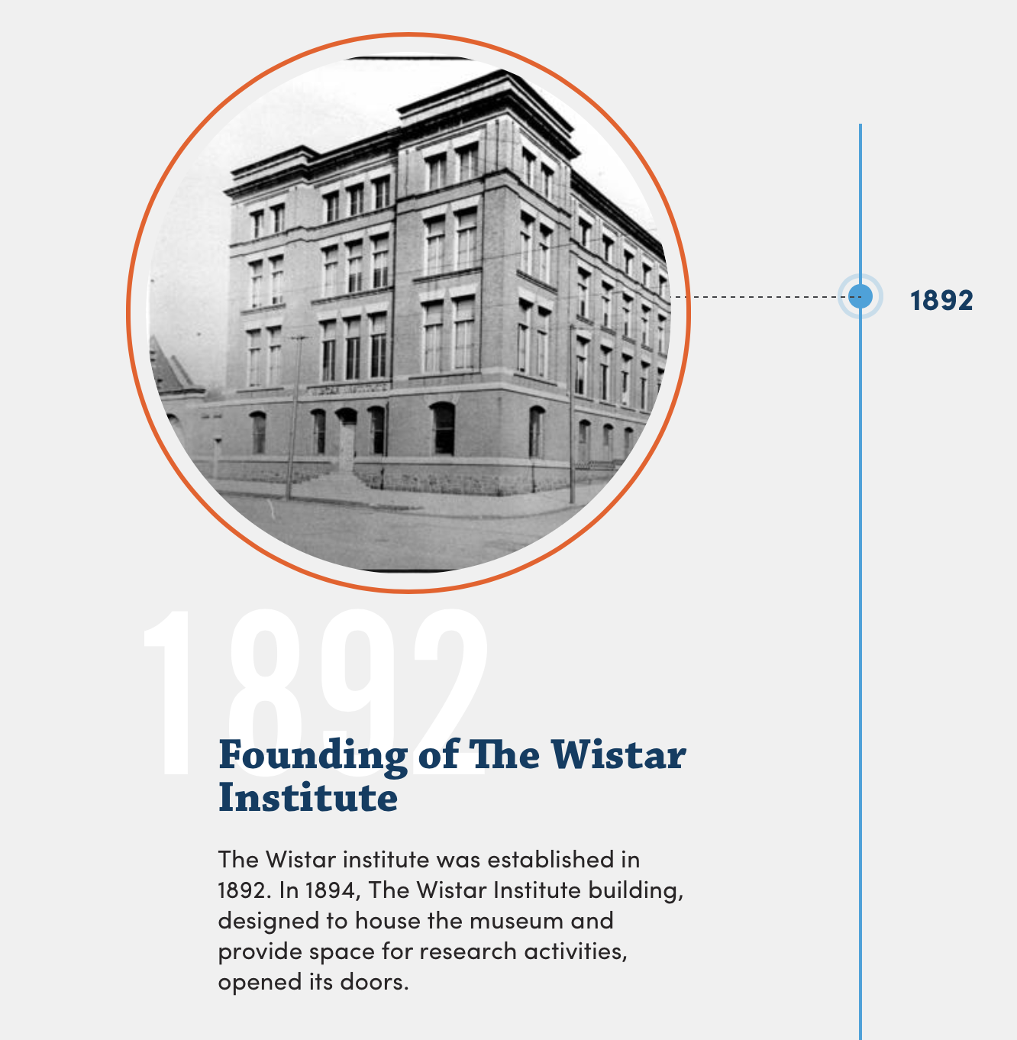
History of The Wistar Institute
The Wistar Institute is our nation’s first independent biomedical research institute.
Named for Dr. Caspar Wistar, a physician, scientist, and teacher at the University of Pennsylvania, known for his collection of anatomical models including some constructed by sculptor William Rush.
His great nephew, Isaac Jones Wistar, founded The Wistar Institute of Anatomy and Biology to house this collection and initiate “any other work for the increase of original scientific knowledge.”
Scientists at The Wistar Institute have made significant contributions to biomedical research including development of the first standardized laboratory animal model, vaccines for rubella, rabies, and rotavirus, and cancer research.
https://www.wistar.org/about-wistar/our-story/timeline/

Slide 3
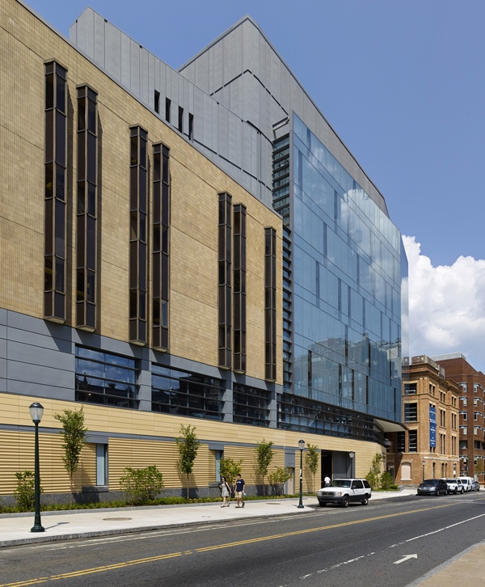
The Wistar Institute Today
World leader in biomedical research with expertise in cancer, immunology, and infectious disease
35 labs headed by Principal Investigators (PIs)
  https://www.wistar.org/articles/our-scientists/
Excellent Shared Resources
  https://www.wistar.org/resources/
Highly collaborative environment
Ellen and Ronald Caplan Cancer Center
  Molecular and Cellular Oncogenesis (MCO)
  Gene Regulation and Cell Signaling (GRCS)
Vaccine & Immunotherapy Center (VIC)
Melanoma Research Center
Center for Systems and Computational Biology
*new* HIV Cure and Viral Diseases Center
*new* Center for Advanced Therapeutics (CAT)

Slide 4

High School Students
Summer Program
Undergraduate Students
Graduate Students
Postdoctoral Fellows
Tours
Wistar Science in Schools
Research Experiences for Undergraduates (REU)
Cheyney University and Lincoln University
University of Pennsylvania
Universities of Bologna and Milan
U Sciences → SJU→ Philadelphia College of Osteopathic Medicine (PCOM)
Biomedical Technician Training (BTT) Program
Apprenticeships: Fox Biomedical Research Technician (BRT), Quality Science
Drexel University
Responsible Conduct of Research (RCR)/Rigor & Reproducibility
Training Committee
Research in Progress
Workshops and Career Panels
Wistar Trainee Association
Internships
STEM Summer Bridge
Life Science Innovation

Slide 5

kshudamcguire@wistar.org

