Slide 1

Biomedical Graduate Studies
University of Pennsylvania
Daniel Kessler, PhD, Interim Director
Notes:
More than 2700 BGS students have received their PhD in the past 34 years

Slide 2
Welcome!
40th class of BGS students
Over 3000 BGS alumni since 1985

Slide 3
BGS Graduate Groups
Biochemistry, Biophysics &
Chemical Biology (BBCB)
Cell & Molecular Biology (CAMB)
  Microbiology, Virology, Parasitology (MVP)
  Genetics & Epigenetics (G&E)
  Gene Therapy & Vaccines (GTV)
  Developmental, Stem Cell, Regenerative Biology (DSRB)
  Cell Biology, Physiology & Metabolism (CPM)
  Cancer Biology (CB)
Epidemiology/Biostatistics (GGEB)
Genomics & Computational Bio (GCB)
Immunology (IGG)
Neuroscience (NGG)
Pharmacology (PGG)
Wistar Institute
Children’s Hospital of Philadelphia
NIH Intramural Program (Immunology)
Perelman School of Medicine
Veterinary Medicine
Dental Medicine
Nursing
Arts & Sciences
Engineering & Applied Sciences
Wharton
Notes:
Explain structure of BGS and affiliated schools

Slide 4
Current BGS Community
1080 Students
  894 PhD (83%)
  160 MD-PhD (15%)
  15 VMD-PhD (1%)
  11 MS in Biostatistics (1%)
861 Faculty
  74% Perelman School of Medicine
  26% Other Schools and Institutes

Slide 5
First Year BGS Students
81 Colleges and Universities
69% Female, 31% Male
18% Under-Represented Groups
Armenia, Canada, China, Kenya, Vietnam, and the United States (including Puerto Rico)

Slide 6
BGS Team
Academic Leaders:
Dan Kessler, PhD – Interim Director & Associate Dean
Kurt Engleka, PhD – Director, Curriculum
Steve Dinardo, PhD – Director, Training Support/Career Develop
Academic Office Staff: 160 BRB II/III
Judy Jackson – Administrative Director
Kyle Brown – Registrar
Colleen Dunn – Curriculum Coordinator
Gabrielle Ostapovich – Associate Director for T32 Proposals
Catlin Herb – Admissions Coordinator
Candace Cain – Career Development Coordinator

Slide 7
Affiliated Offices
Research Trainee Affairs: JMEC, 6th floor
  Donita Brady, PhD – Assistant Dean, Research Trainee Affairs
  Edward Marshall – Director, Finance & Grants Management
  Elena Cruz – Program Coordinator
  Lautrelle Gary – Program Coordinator
Finance Office: 414-417 Anatomy-Chemistry
  Jill Baxter – Director of Financial Operations
  Carol Reich – Payroll Manager
  Sherita Blair – Student Accounts/Tuition Coordinator
  Marianne Altland – Grants and Fellowships Manager
  Jennifer Lu – Financial Coordinator
  Regina Medlock – Business Administrator

Slide 8

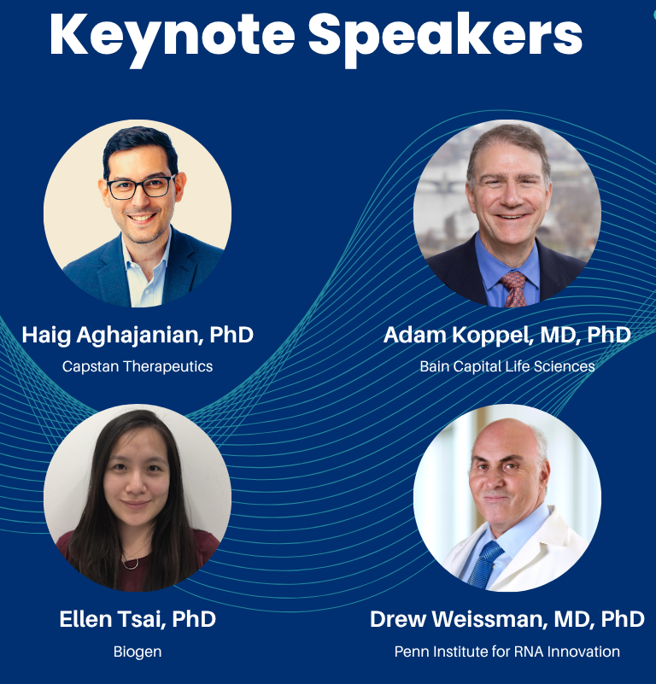

BGS 40th Anniversary
Friday, October 10 – Main event
  Keynote speakers
  Student poster session
  Career talks in 8 different fields
  Speed networking
    Workshop with Career Services
  Celebratory reception
  Register now!

Slide 9
Welcome!
We are so glad to have you join the BGS community!

