Slide 1


Slide 2




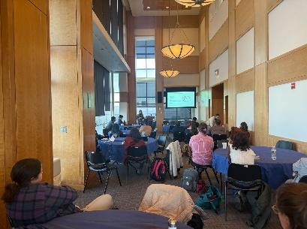


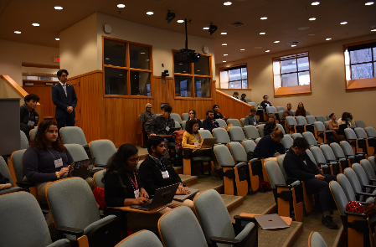
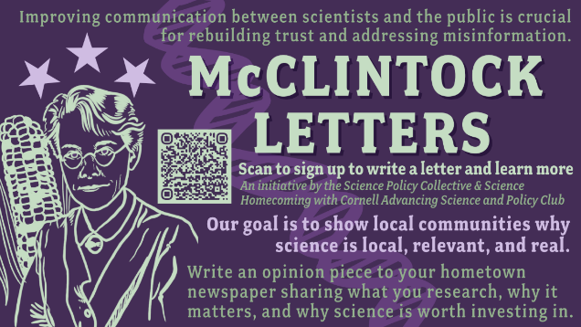
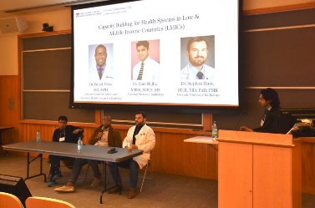

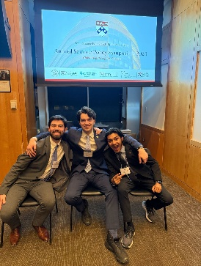
Science Policy
Training Series!
Project Teams!
Big Events!
Want to get involved? Contact Hailey Parikh (hkparikh@penncareylaw.upenn.edu)

Slide 3

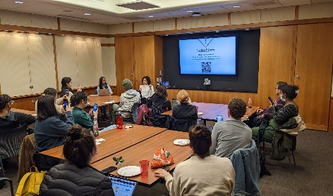
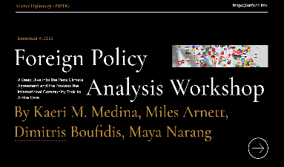
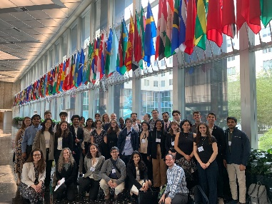

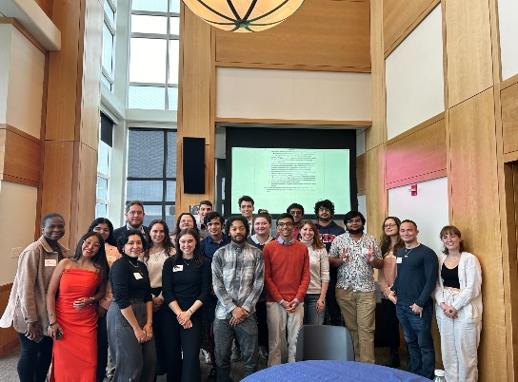
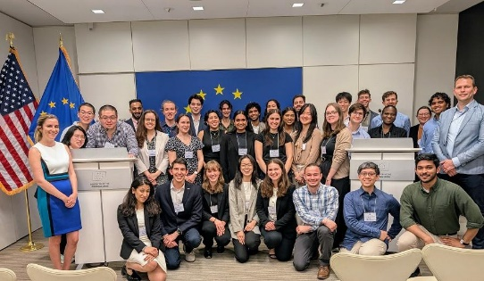







Science Diplomacy
Diplomacy for Science | Science for Diplomacy | Science in Diplomacy (Royal Society/AAAS, 2010)
2024-2025 Events
Science Diplomacy 101: Introduced attendees to Science Diplomacy, careers, and important skills
‘Core Tenets of Diplomacy’ Reading Group:
Discussed key aspect of diplomacy and international affairs to lay the groundwork for future SciDip events
‘Energy Security’ Reading Group
‘SciDip in an Era of Disruption’ Reading Group
Science Diplomacy movie night
DB presenting about Science Diplomacy at the Greek Government (Embassy of Greece in DC)
1st Annual Science Diplomacy trip to Washington DC: Swiss Embassy, EU delegation to Washington DC, State Department, networking at Penn in Washington
Want to get involved? Contact Dimitris Boufidis (boufidis@seas.upenn.edu)
Notes:
Diplomacy for science – the use of diplomatic action to facilitate international scientific collaboration, e.g. by negotiating R&D agreements and exchange programmes or enabling the establishment of international research infrastructures;
Science for diplomacy – the use of science as a soft power to advance diplomatic objectives, e.g. for building bridges between nations and creating good will on which diplomatic relations can be built;
Science in diplomacy – the direct support of diplomatic processes through science, e.g. by providing scientific advice and evidence to inform and support decision-making in foreign and security policies.

Slide 4
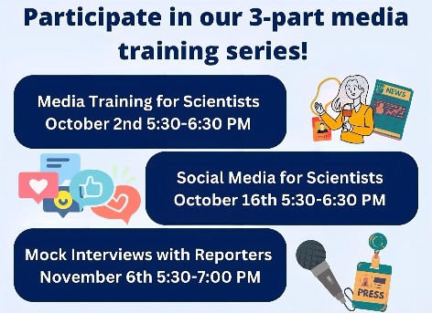

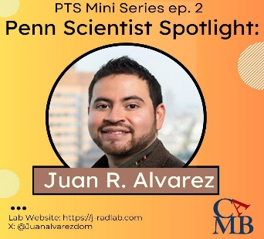

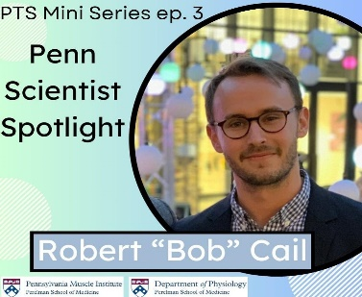
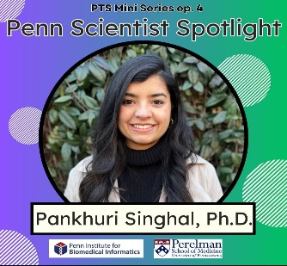
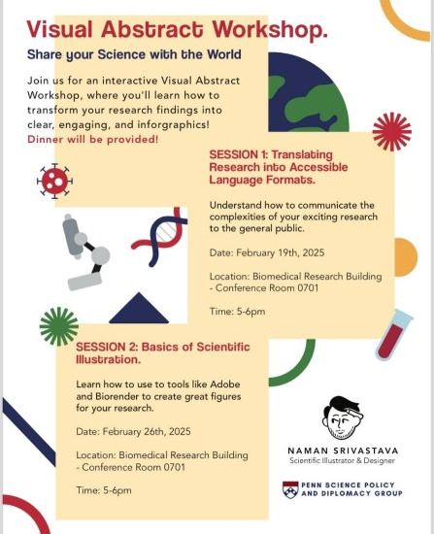




Science Communication
Programming
Products
Want to get involved? Contact Naman Srivastava (Naman.Srivastava@PennMedicine.upenn.edu)

Slide 5

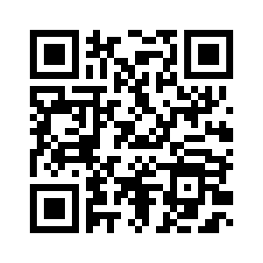



Sign up for our listserv and Slack! Comprehensive updates and opportunities
@UPennSciencePol
@penn.science.policy
@pspdg.bsky.social
Penn Science Policy and Diplomacy Group
pspdg.com/getinvolved

