Slide 1
Building effective mentor:mentee relationships
Daniel Kessler, PHD
Interim BGS director

Slide 2
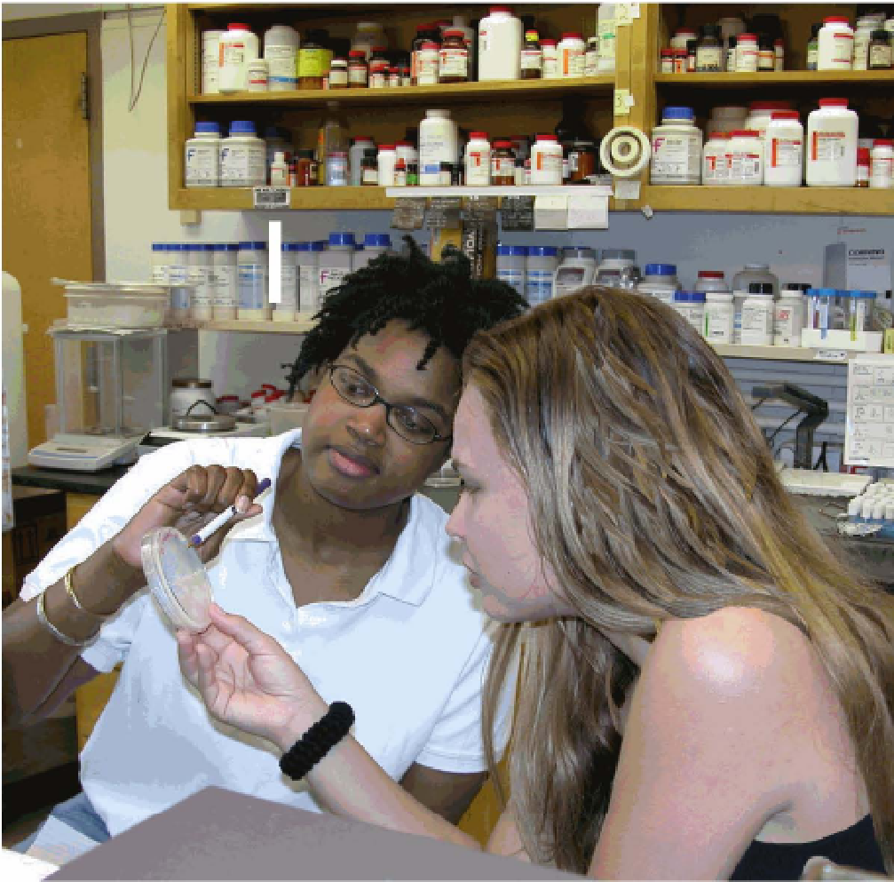
Mentoring is…
A collaborative learning relationship that proceeds through purposeful stages over time and has the primary goal of helping mentees acquire the essential competencies needed for success in their chosen career.
It includes using one’s own experience to guide another person through an experience that requires personal and intellectual growth and development.

Slide 3





Mentoring is a collaborative effort
Mentor
Mentee
Peers
Thesis committee
Research Environment/ Community
TRADITIONAL MENTORING
GROUP MENTORING
PEER MENTORING

Slide 4
Goals of Mentoring
DEFINED COLLABORATIVELY BY MENTEE & MENTOR
IN GENERAL
EVALUATE CAREER GOALS
ATTAIN NEEDED TECHNICAL AND CONCEPTUAL SKILLS
GAIN NEEDED RESEARCH EXPERIENCE
DEVELOP NEEDED PROFESSIONAL SKILLS
TOOLS
REVISIT AND REASSESS REGULARLY
MENTORSHIP COMPACT
INDIVIDUAL DEVELOPMENT PLAN

Slide 5
KEYS TO EFFeCTIVe mentorship
EFFECTIVE COMMUNICATION
ALIGNING EXPECTATIONS
BUILD RESEARCH SELF-EFFICACY
ACHIEVE INDEPENDENCE – BUILD YOUR RESEARCH IDENTITY
STRIVE FOR WORK/LIFE INTEGRATION
BUILD CULTURAL AWARENESS AND SKILLS
SEEK PROFESSIONAL DEVELOPMENT

Slide 6
Enhancing Communication
Ineffective communication is the root of many mentorship concerns
Recognize your own communication style and that of your mentor
Embrace the need for you and your mentor to adapt in developing more effective communication

Slide 7
Barriers to Effective Communication
Assumptions
Differing personalities/communication styles
Letting issues linger without discussion
Undefined expectations
Lack of cultural capital
Cultural differences in communication styles

Slide 8
EFFECTIVE COMMUNICATION
RECOGNIZE DIFFERING INDIVIDUAL STYLES
INFLUENCED BY BACKGROUND, POWER DYNAMICS, HISTORY, CULTURE, IDENTITY, ETC
ACCEPT, SEEK, AND IMPLEMENT CONSTRUCTIVE FEEDBACK
UTILIZE MUTLIPLE MODES OF COMMUNICATION
DIRECT
DISTANT
WRITTEN
VERBAL

Slide 9
Effective Communication Strategies
Identify
Identify preferred communication styles
Determine
Determine preferred communication modes
Track and share
Check in and provide feedback on what’s working and what’s not
Prepare
Prepare for each meeting
Identify goals
Communicate needs
Establish
Establish working communication approach

Slide 10
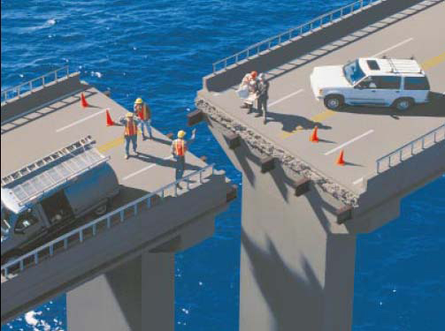
Alignment of Expectations
Key to Successful Mentoring Relationships

Slide 11
How do you know when you don’t have alignment?
Mentor is unresponsive to emails/unavailable for meetings
Mentee does not meet deadlines
Mentor does most of the talking and direction-setting
Mentee or mentor dreads mentoring meetings
Mentor or mentee avoid each other
Mismatch of mentor and mentee expectations

Slide 12
Underlying causes of misaligned expectations
Generational
Positionality
Geography
Identity
Experiences
Mindset
Power Dynamics

Slide 13
Articulating Expectations
What am I looking for from my mentor relationships?
What do I expect from my mentors and what do they expect from me?
How do my mentors know what I am expecting?
Have we explicitly discussed these issues?
If not, why?

Slide 14
How to align expectations
Establish
Establish regular meeting schedules
Set
Set your agenda for each meeting
Establish
Establish anticipated milestones and deliverables and request feedback
Leverage
Leverage the BGS Mentorship compact and IDP to establish expectations

Slide 15
Mentorship Compact: a useful tool
Description…..
      A written document used to articulate expectations between mentors and mentees
      Focused on daily/weekly expectations for the working relationship
      Review together at the beginning and periodically throughout
      Differs from the Individual Development Plan (IDP) which focuses on short and long-term career plans
      The value…..
      Documentation of expectations which can be revisited and revised
      A shared reference point for regular progress reviews
      Makes invisible expectations, visible
      Levels the playing field among mentees

Slide 16
BGS Mentorship CompaCT
Purpose: to facilitate discussion, align expectations and clarify responsibilities for both mentor and mentee
Define a core set of responsibilities for the mentor and mentee
Individualize for the specific mentoring relationship
Review and signed at the beginning of the mentor:mentee relationship
Revisit as needed to ensure continued alignment of expectations

Slide 17
BGS Mentorship Compact
Mentee
Mentor
Establish Expectations.
Take ownership of my thesis project.
Take ownership of my professional development.
Communicate with my mentor(s) about my research progress, access to resources and milestone achievements.
Arrange regular meetings with my mentor(s).
Arrange meetings with my thesis committee.
Stay abreast of the latest developments in my field.
Build a professional network.
Respect all ethical and institutional standards.
Maintain a relationship with my mentor(s) that is based on trust and respect.
Maintain a safe, respectful, inclusive, and secure working environment.
Comply with all institutional policies.
Ensure my mentee's thesis project is feasible.
Establish expectations and goals with mentee on research project.
Know requirements of graduate program.
Ensure mentee meets with their thesis committee.
Support my mentee’s professional skills development.
Strive for open and effective communication.
Provide guidance through scientific challenges.
Work collaboratively with co-mentors and thesis. committee members to further benefit mentee.
Establish and maintain a safe, respectful, inclusive, and secure working environment.
Submit student’s thesis project for publication.
Promote all ethical and institutional standards.
Maintain a relationship with my mentee that is based on trust, mutual respect and aligned expectations.
Support my mentee and facilitate their transition to the next stages of their career.

Slide 18

ALIGN EXPECTATIONS –Individualized Development Plan
UP FRONT ASSESSMENT:
  WHAT IS NEEDED TO ACHIEVE YOUR GOAL?
  WHAT ARE YOUR SPECIFIC NEEDS AS A MENTEE?
    SCIENTIFIC SKILLS
    PROFESSIONAL SKILLS
    CAREER SKILLS
    OTHER SUPPORT
ESTABLISH MUTUATL AND BENEFICIAL EXPECTATIONS
COMMUNICATE THE EXPECTATIONS
ALIGN EXPECTATIONS BETWEEN MENTOR AND MENTEE
REVISIT EXPECTATIONS AND ADJUST WITH MENTEE GROWTH

Slide 19
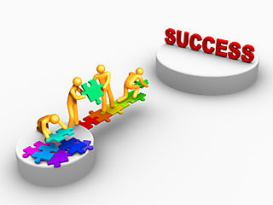
What Expectations?
  Professional networking
  Work/life integration
  Developing a career development plan
  Additional education/training needed
Topics to discuss:
  Short and long-term goals
  Areas of interest
  Communications styles
  Meeting schedules
  Timeline and milestones
  Identifying others involved

Slide 20
BUILD SELF-EFFICACY
SELF-PERCEIVED CONFIDENCE THAT A GOAL IS ACHIEVABLE
SOURCES OF SELF-EFFICACY
MASTERY – BY EXPERIENCE – “I’VE DONE THIS BEFORE”
SOCIAL – BY SUPPORT –” YOU CAN DO THIS”
VICARIOUS – BY EXAMPLE – “I’VE SEEN THIS DONE BEFORE”
EMOTIONAL/PHYSIOLOGICAL – BY EXCITEMENT – “DISCOVERY MAKES ME HAPPY
MENTORS SHOULD USE ALL OF THESE MODES TO INSTILL SELF-EFFICACY
BUILD YOUR OWN SELF-EFFICACY
BUILD THE SELF-EFFICACY OF THOSE AROUND YOU

Slide 21
ACHIEVE INDEPENDENCE—Research Identity
MENTOR THESIS COMMITTEE PROGRAM
ELEMENTS OF INDEPENDENCE
ADVANCED KNOWLEDGE OF DISCIPLINE
CRITICAL EVALUATION OF LITERATURE
USE LITERATURE TO IDENTIFY KNOWLEDGE GAPS
DESIGN AND EXECUTE EXPERIMENTAL PLAN
PREPARE PROPOSAL FOR EXPERIMENTAL PLAN
COMMUNICATE FINDINGS IN WRITTEN AND ORAL FORMATS
EACH MENTEE IS ON A DYNAMIC CONTINUUM THROUGHOUT THEIR TRAINING

Slide 22

Academic Growth
Growth mindset
Explore
Learning from mistakes
Pace will vary
May be uncomfortable
Mentor:mentee relationship needs to evolve to accommodate growth

Slide 23
ACHIEVE WORK/LIFE INTEGRATION
METHOD:
  BE REAL
  BE WHOLE
  BE INNOVATIVE
WORK
FAMILY
SELF
COMMUNITY
Notes:
Be Real: act with authenticity by clarifying what’s important
Often, we feel stressed at work because we find ourselves involved in many activities that we would rather not be doing, and not involved in the things that we find more important or interesting. This often results from our failing to define what is most important to us and the specific goals we have for ourselves in the four domains of our lives. Through a series of reflective exercises, participants will help articulate a personal vision statement for themselves, as well as clarify the specific goals they have for the four domains of their lives, their current success in achieving these goals, and opportunities for improvement.
Be Whole: act with integrity by respecting all your people
While we will not focus specifically on this aspect of the Total Leadership program during the mentor training, this part of the program enables you to clarify who the various people are that impact the work (e.g., department head, mentees, colleagues), family (e.g., spouse, children, parents) and community (highly variable and defined differently by each individual, e.g., friends, school community, sports leagues) domains of your lives, and to assess the expectations these people have for you. This is an important step in clarifying the goals you have in each domain and what it might take to achieve these goals to the satisfaction of those impacted by your actions. While we will not specifically cover this part of the program, you are encouraged to read chapters four and five in the book and conduct stakeholder interviews as described.
Be innovative: act with creativity by experimenting
Once you have clarified what is important to you, the goals you have in each domain of your life, and the opportunities you have identified for improving integration of these goals across domains, you will design an “experiment”- a small-scale change in your behavior that is designed to bring better alignment of the goals you have in all four domains. You will be divided into groups of 3 and work together to design your individual experiment and then over time, serve as a coach to one another providing feedback, advice and guidance on the progress of each other’s experiments.

Slide 24
Core VALUES for Mentees
Know yourself – reflect and identify needs
Act with Intention
Communicate Effectively
Clarify Expectations
Enhance your Self Efficacy

Slide 25
Mentorship Workshop led by BGSA
Thanks to BGSA
  Thomas Zhang, President BGSA
Workshop Leaders
Adam Kramer
Alaina Wojciechowski
Anastasia Lucas
Anna Kasper
Erin DeNardo
Fernanda Holloman
Francine Baker
Hannah Gura
Jason Lin
Jill Henrich
Julia Ferrante
Junyoung Shin
Kassidy Kantwell
Katie Premo
Kerry Nix
Krista Budinich
Lauren Cominsky
Lexi Li
Liran Mao
Maya English
Molly Nelson
Nick Marotta
Reid Banciella
Riannon McKracken

Slide 26
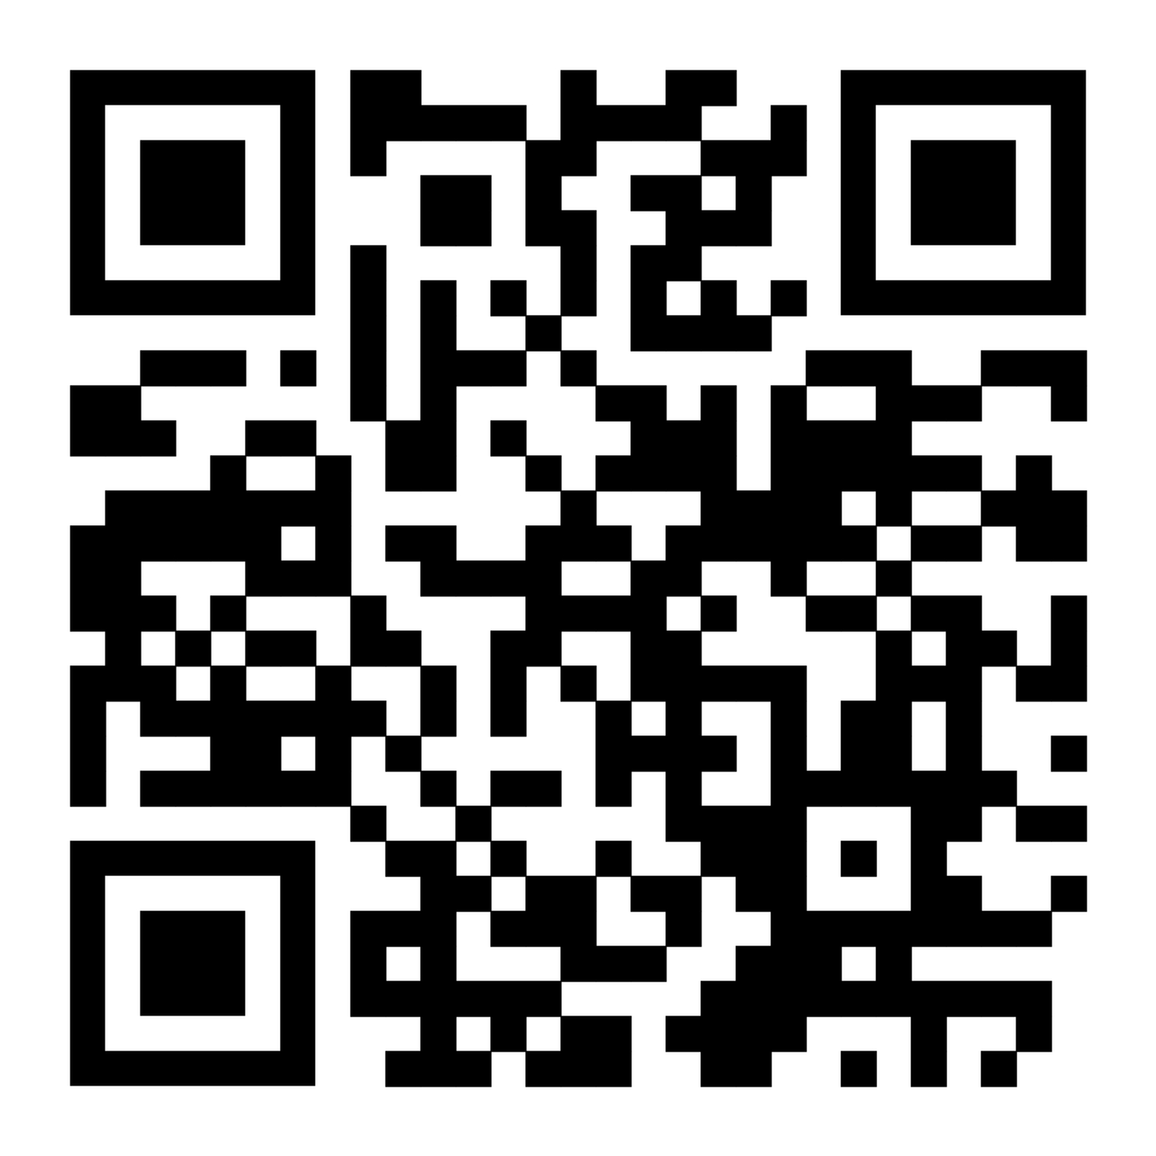
BGS Orientation Mentoring Session Case Studies
August 12, 2025: 10am-11am

Slide 27
RESOURCES
BGS
  https://www.med.upenn.edu/bgs/documents/Responsibilitiesofthesismentorsthesisstudentsandthesisadvisorycommitteemembers_7-20-16_000.pdf
PENN VICE PROVOST FOR EDUCATION – ADVISING AND MENTORING PHD STUDENTS
  https://catalog.upenn.edu/graduate/academic-resources/advising-mentoring/
EVIDENCE BASED MENTORING
  https://www.nigms.nih.gov/training/strategicplanimplementationblueprint/pages/EvidenceBasedMentoring.aspx
CENTER FOR THE IMPROVEMENT OF MENTORED EXPERIENCES IN RESARCH (CIMER)
  https://cimerproject.org/#/
NATIONAL RESEARCH MENTORING NETWORK
  https://nrmnet.net/#undergradPopup
ENTERING MENTORING
  https://www.hhmi.org/sites/default/files/Educational%20Materials/Lab%20Management/entering_mentoring.pdf
AAMC APPROPRIATE TREATMENT OF RESEARCH TRAINNEES
  https://www.aamc.org/media/56841/download

Slide 28

Wishing you a journey full of Learning, Exploration, fulfillment, Discovery and Science
Notes:
Wishing you a journey full of Learning, Exploration, and Discovery.

