Slide 1
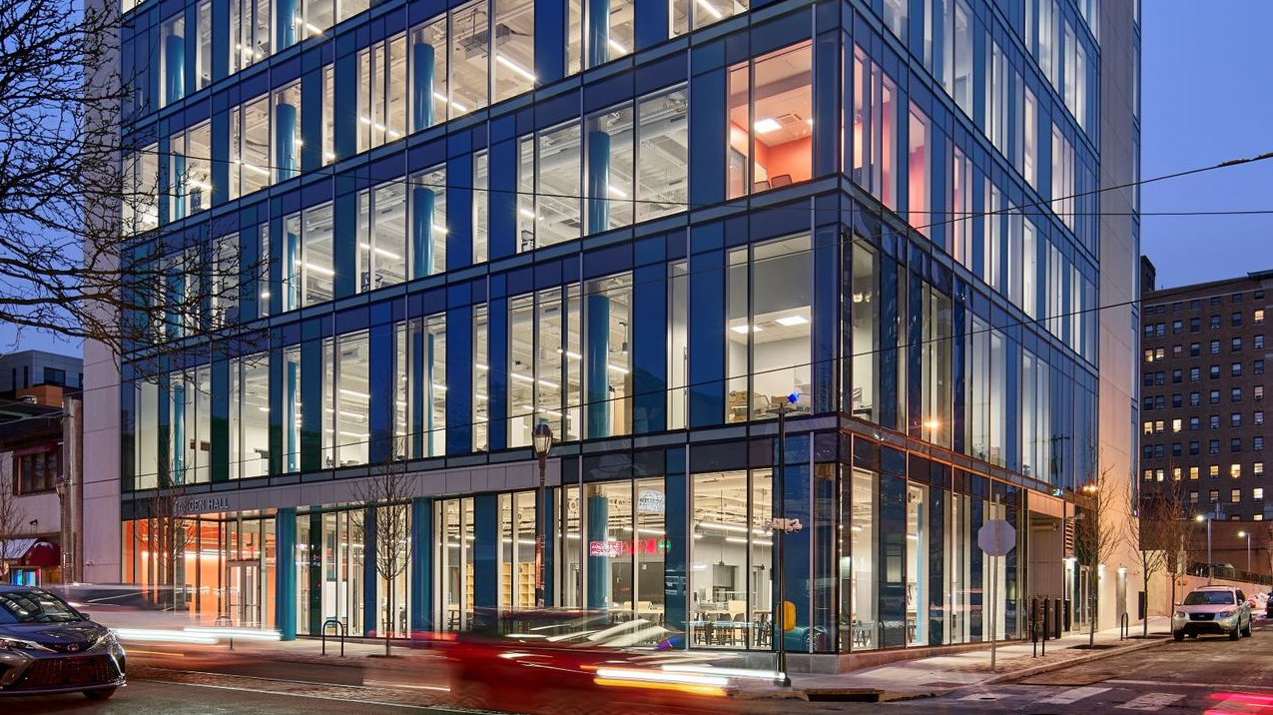
VENTURE LAB
Graduate Student NSO
August 2025

Slide 2
Our Mission
Venture Lab empowers Penn students to innovate, build, scale, and invest in enduring businesses and solutions to the world’s problems.

Slide 3

Entrepreneurial Pathways
Founder
Investor
Want to build from idea to operating venture
Need to develop skills, test concepts, and connect with future collaborators
Raise and commit capital to help start or scale ventures
Explorer
Joiner
Searching for what they want to do and/or where they might best fit in professionally
Love entrepreneurial environments and prefer to contribute to an existing venture

Slide 4
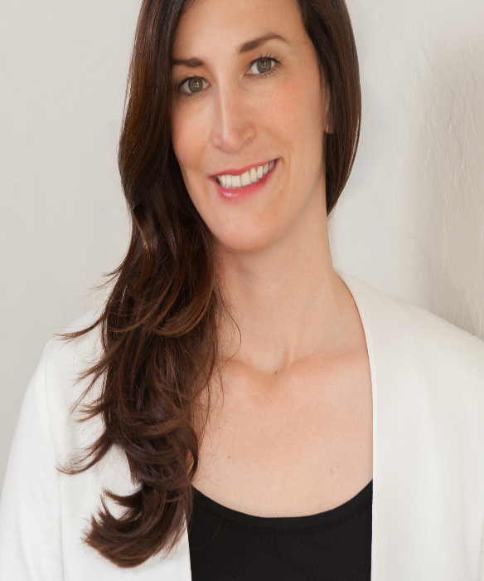
Alumni Profile
Christine Moseley WG'11
Full Harvest is a B2B produce marketplace that connects farmers with produce buyers with expertise in reducing on-farm food loss while improving profitability.
Full Harvest has saved over 4 B gallons of water and 20 million kilograms of carbon dioxide equivalent, or CO2e, emissions and has sold 125 M lbs of food
Funding: Over $30M to-date

Slide 5

Founders
Getting Started Resources
Community Events
Venture Development 'Course'
  Become a Venture Lab member to gain access
Monthly Founder Coaching Sessions
  Become a Venture Lab member to gain access
Joiners Fair TBD
Visiting Experts

Slide 6
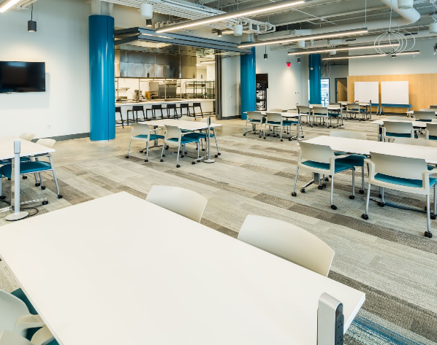
All Students
Venture Lab Membership
Open to currently enrolled Penn students in a degree seeking program with a valid PennKey.
  Tangen Hall access 7 days/week, 7 AM-2 AM ET
  Venture Lab Slack workspace
  Venture Lab Weekly Newsletter
  Room reservations
  Studios @ Venture Lab
    Safety Training
    3D Printer Training
    Laser Cutter Training
All students have access M-F 7AM-9PM ET with Penn Card

Slide 7
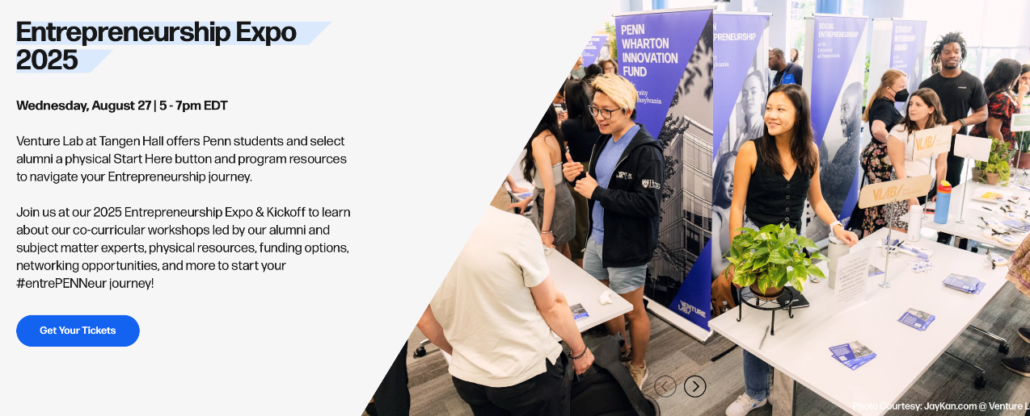

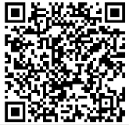

Slide 8

Get Started!
Sign up for VL membership & newsletter
Attend the Entrepreneurship Expo
Schedule a Start Here Mondays office hours appointment - starting September

Slide 9
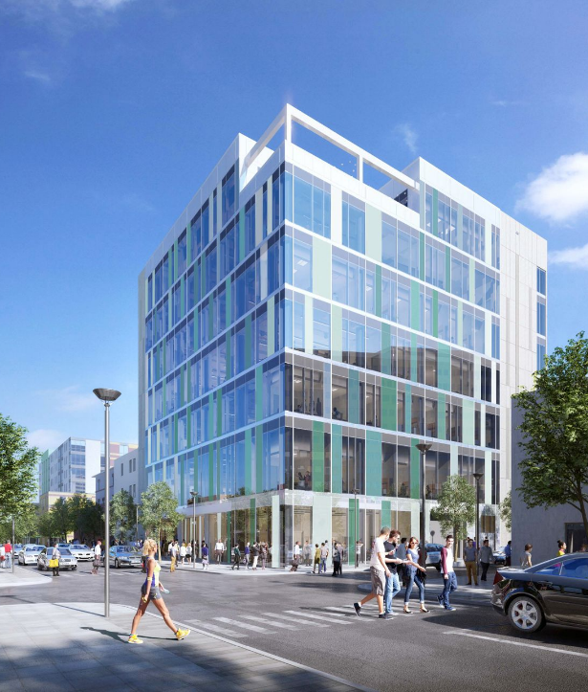
Tangen Hall
8 labs and studio spaces
2,700 sq ft colloquium with 200+ seats
Founders' suites with 16 team rooms and pods
2 structured active learning rooms
1 rooftop terrace

Slide 10

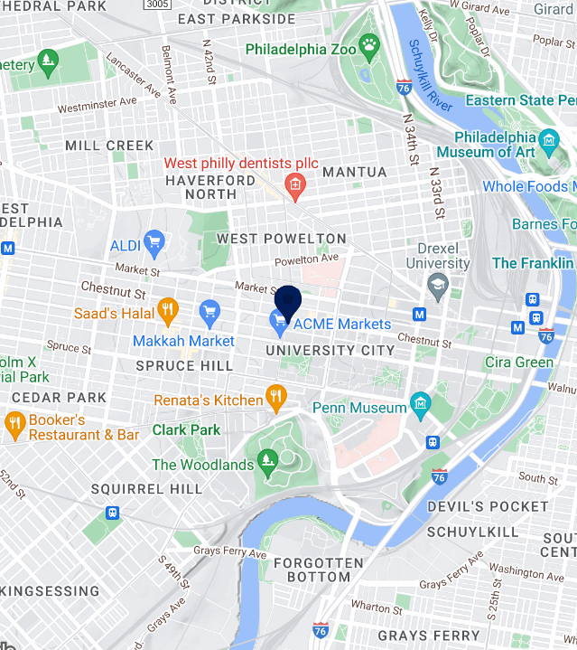
Venture Lab
The Wharton School at the University of Pennsylvania
115 S 40TH ST, PHILADELPHIA, PA 19104
venturelab.upenn.edu
facebook.com/WeAreVentureLab
linkedin.com/company/vntrlab
@vntrlab
@WeAreVentureLab

Slide 11

Q&A

Slide 12


