Slide 1
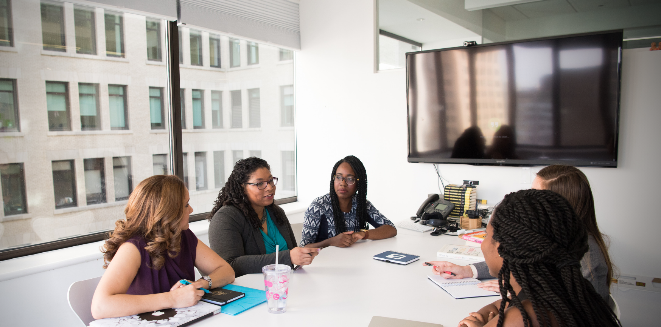

Weingarten Center
Penn’s Home for Academic Support & Disability Services
Notes:
New background needed

Slide 2

A Holistic Approach to Supporting Students
We assess students’ needs, make appropriate referrals, and help students navigate campus resources.
We offer expertise in developing effective study skills and strategies as students pursue their academic goals and rise to their own potential.
We help students develop effective communication, problem-solving, and self-advocacy skills.
We encourage students to prioritize their mental health and well-being and make time for self-care.
We strive to destigmatize disability, normalize asking for help, and support accommodations that remove barriers and level the playing field.
Weingarten Center services are available to all Penn students.

Slide 3
Weingarten Center
Academic Support
Disability Services

Slide 4



Learning Specialists
Meet with students
1-on-1 in 50-min learning consultations
Facilitate group workshops related to academic preparation and engagement
Collaborate with campus partners to offer additional group programming
Notes:
Learning specialists work with students in a few different ways:
- Individual and confidential appointments
- Group workshops about topics like time management and study strategies (we'll show more on the next slide)
- Special programs developed through collaborations with different campus partners (College Houses, Schools, Cultural Centers, etc)
And perhaps, the greatest thing is that all of these services are free to you!

Slide 5







Learning Specialists help students with
Study Strategies
Time Management
Exam Prep/Taking
Academic Reading and Writing
Productivity
Communication
and Engagement
Transition/Integration
Notes:
Julianne – Emphasize that we often talk with students time management and productivity. We separate them there and will explain later on.

Slide 6
When should you see a learning specialist?
Whenever you'd like to adjust your habits and systems
Meet with us in the first weeks of the semester to get organized
Check-in regularly, especially after you receive graded feedback
Reconnect with us around as you prepare for final projects and exams
Notes:
You can meet with us at any point in the semester, but here are a few times that usually make a lot of sense for students:
- Early after attending each of your classes at least once or before exams and papers
- Throughout the semester, especially after you receive some graded feedback
- Around finals season to evaluate the semester
- Whenever you'd like to adjust your habits and systems for sustained academic wellness
Mention that students can see us even on a weekly basis (some students come in for one-time sessions; others visit on a more consistent basis)
Emphasize the importance of seeing us sooner rather than later

Slide 7



Disability Services
Reviews documentation and determines reasonable accommodations
Works collaboratively with students through the accommodations request process
Coordinates implementation of student accommodations
Advocates for students with disabilities
Notes:
Julianne – Emphasize that we often talk with students time management and productivity. We separate them there and will explain later on.

Slide 8
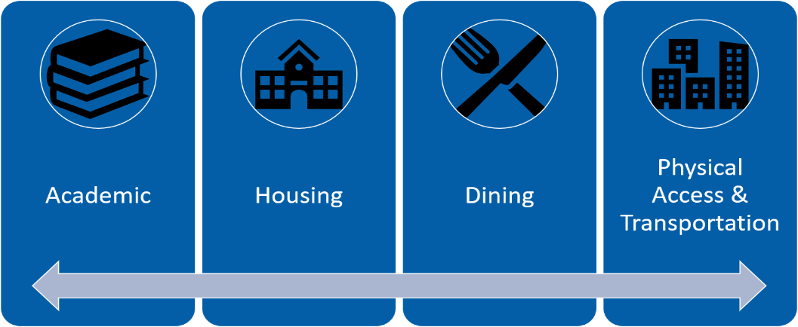
Accommodation Types

Slide 9
Disability Services Registration Process
Accessibility
Request
Initial Appointment
Renew Approved Accommodations
Documentation of Disability
Accommodation Approval

Slide 10
To Make an Appointment
Visit Our Website
Click MyWeingartenCenter

